Slide 1
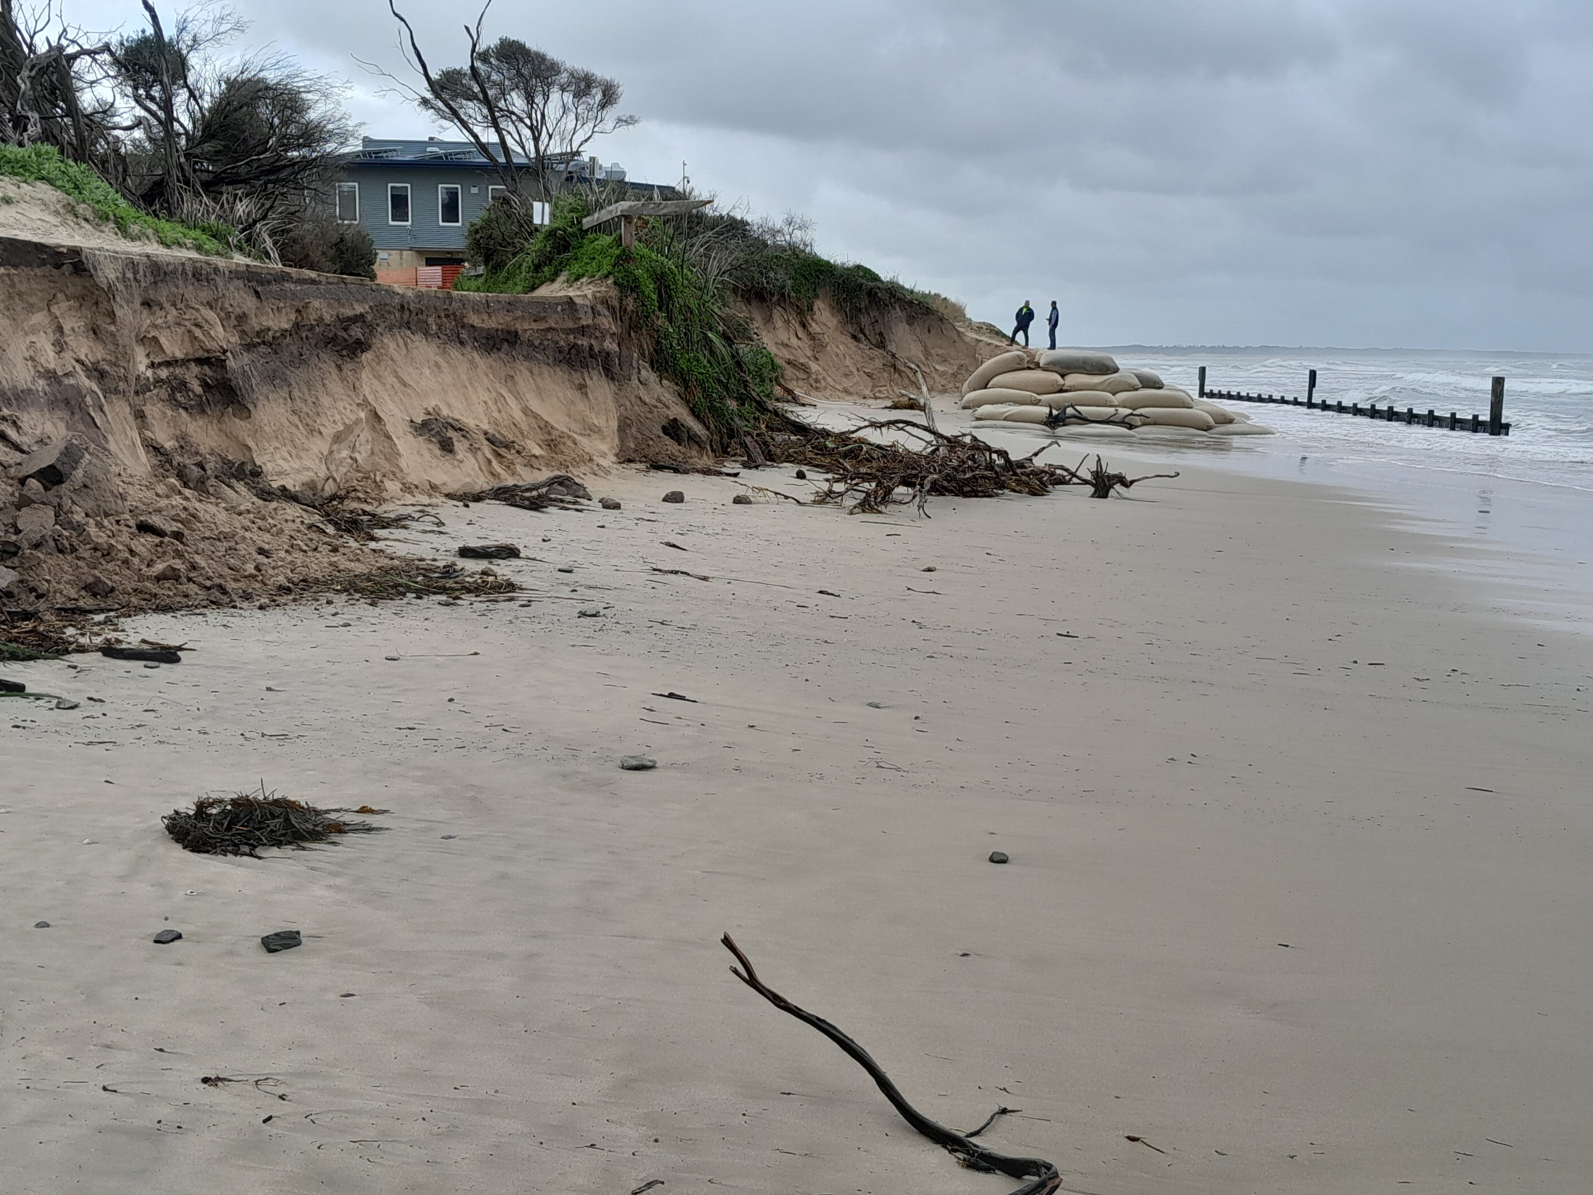
HOW CLIMATE CHANGE
IS DRIVING COASTAL
EROSION
INVERLOCH CASE STUDY

Slide 2
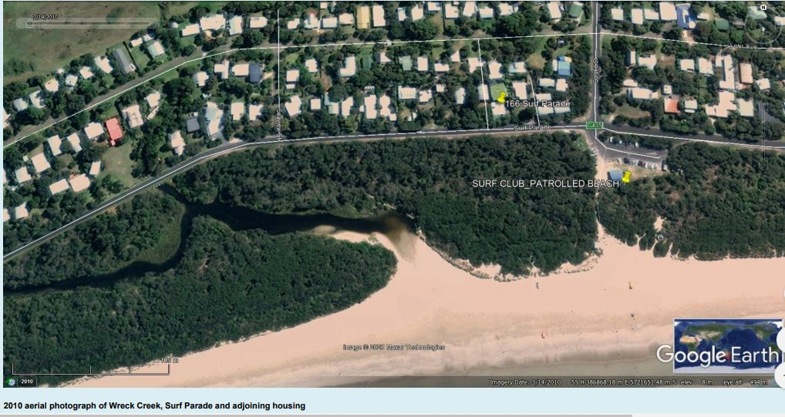

Slide 3
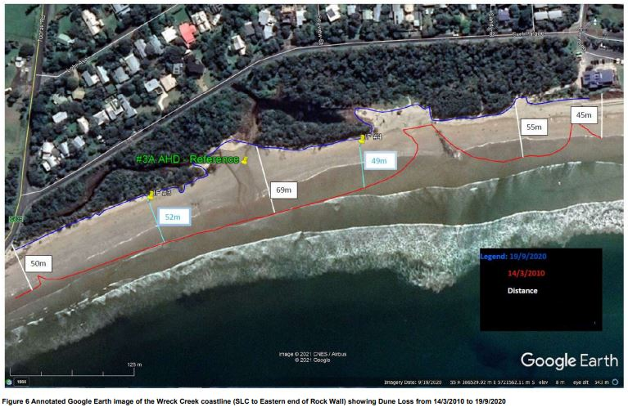
Coastal Resilience Project
Notes:
- Between August 2018 & January 2020 over 100,000 m³ of sediment was lost from the surf beach.
- The vegetated dunes behind the beach receded 9 - 20 metres between the Surf Life Saving Club and the Ozone Street access track. The level of the beach dropped by up to 1 metre.
- These changes are in addition to the average 40 metres of coastline recession that occurred between 2013 and 2018.
At the Wreck Creek end another 8 metres of beach was since February 2020, including 4 metres since June 2020.
CAPE TO CAPE importing around 100,000 m3 of sand to Flat Rocks and another 100,000 to 200,000m3 to the main Surf Beach. These volumes have been determined to achieve protection of the remaining dunes through to 2040,

Slide 4
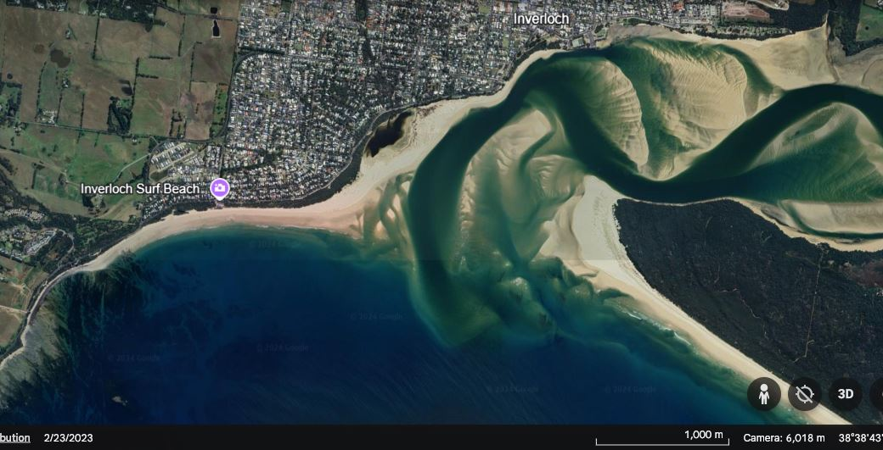
Notes:
Orientation – identify Inverloch, Point Smythe, Anderson Inlet, Tarwin River, the Inverloch Surf Beach & the start of the Bunurong coastline & coastal reserve.

Slide 5
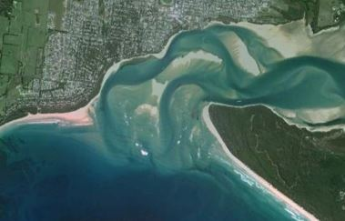
2014 google
Notes:
Apologies that this is an unclear image – but it is useful to swap between this & the most recent image to identify changes – two channels here, one at Point Norman + volume of sand + changes to Point Smythe

Slide 6
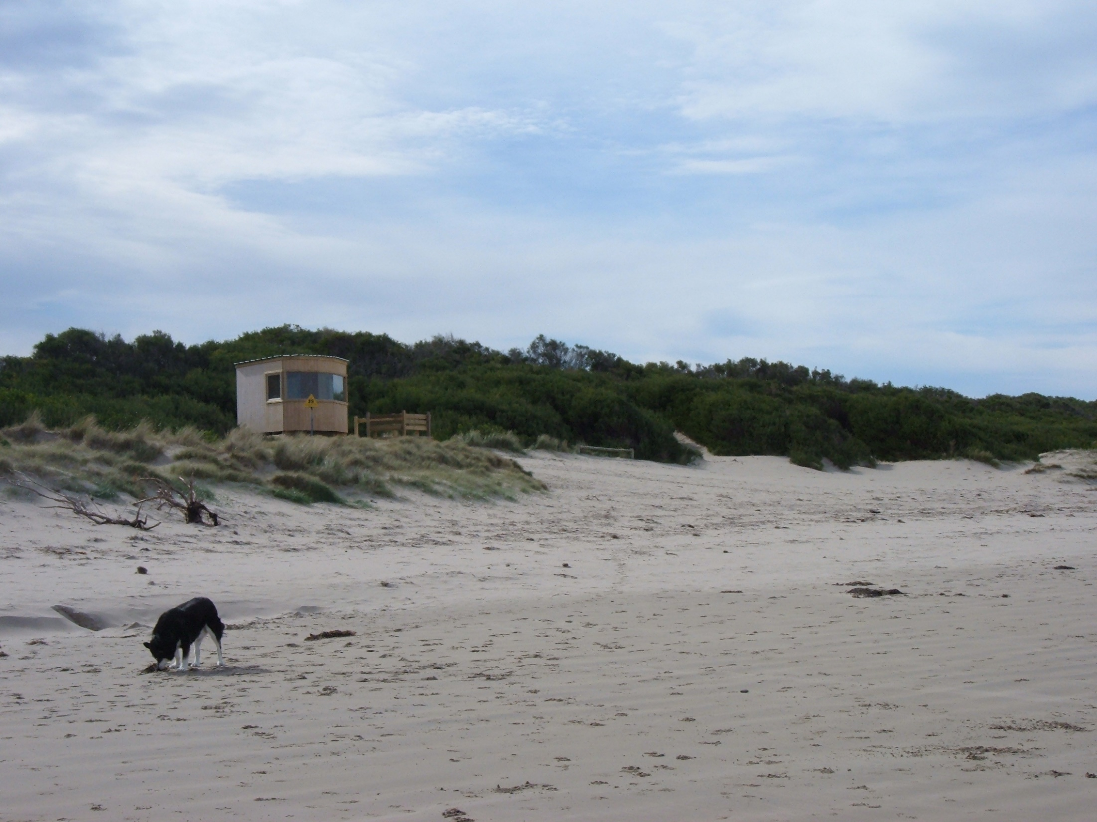
Inverloch Surf Beach Lifesaving Tower
2004 (?) – photo Steve Dunn
Notes:
First lifesaving tower & ‘normal’ dune & vegetation profile

Slide 7
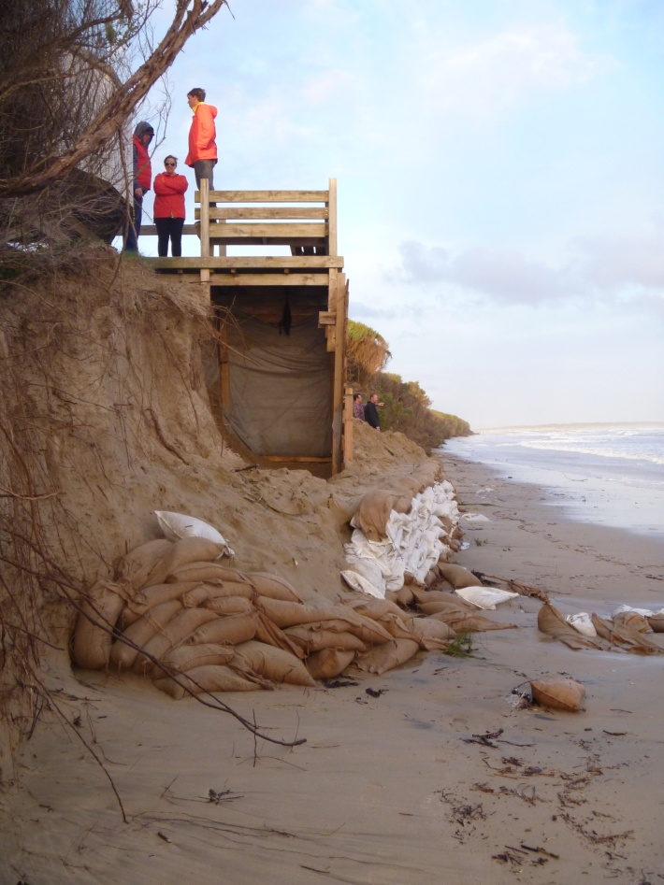
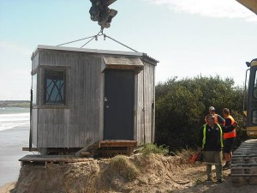
28 Oct 2013
Photo: The Star
12 October 2013
Notes:
The same tower was taken away October 2013

Slide 8
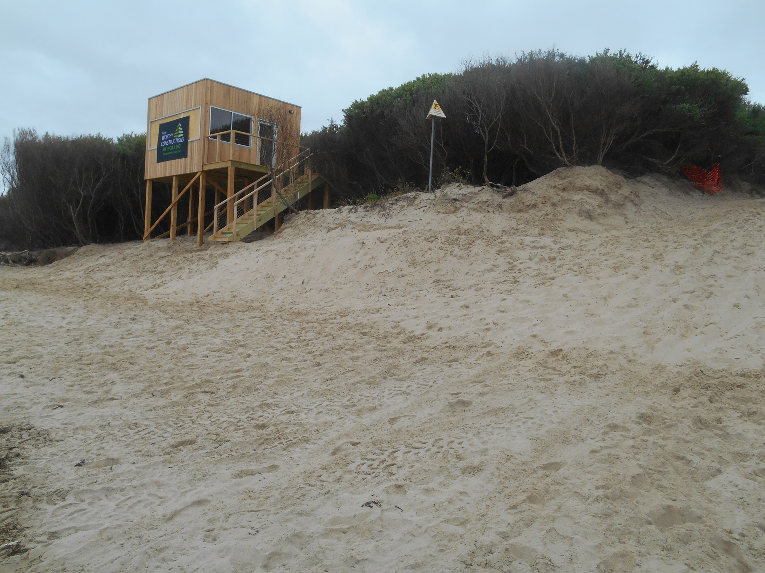
5 December 2014
Notes:
And replaced with this $120,000 tower tucked up into the tea tree. Note the high tide line. The lifesaving club house is over the dune to the right

Slide 9
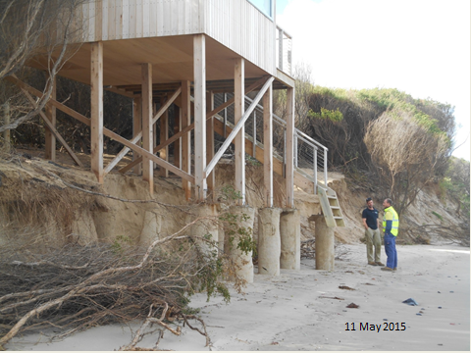
Notes:
6 months later, tower & pathway unusable

Slide 10
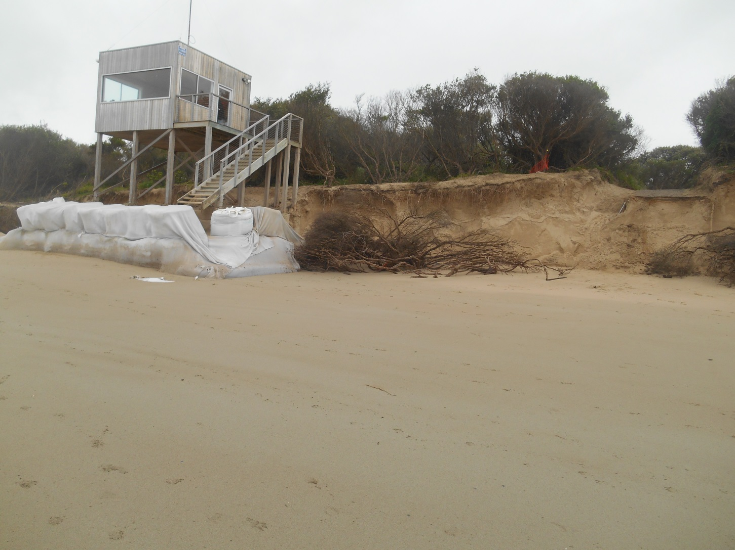
22 oct
October 2016
Notes:
Sandbagging secured the tower for 18 months but they began to fail, waves were washing in behind the bags. Tower and pathway again unusable

Slide 11
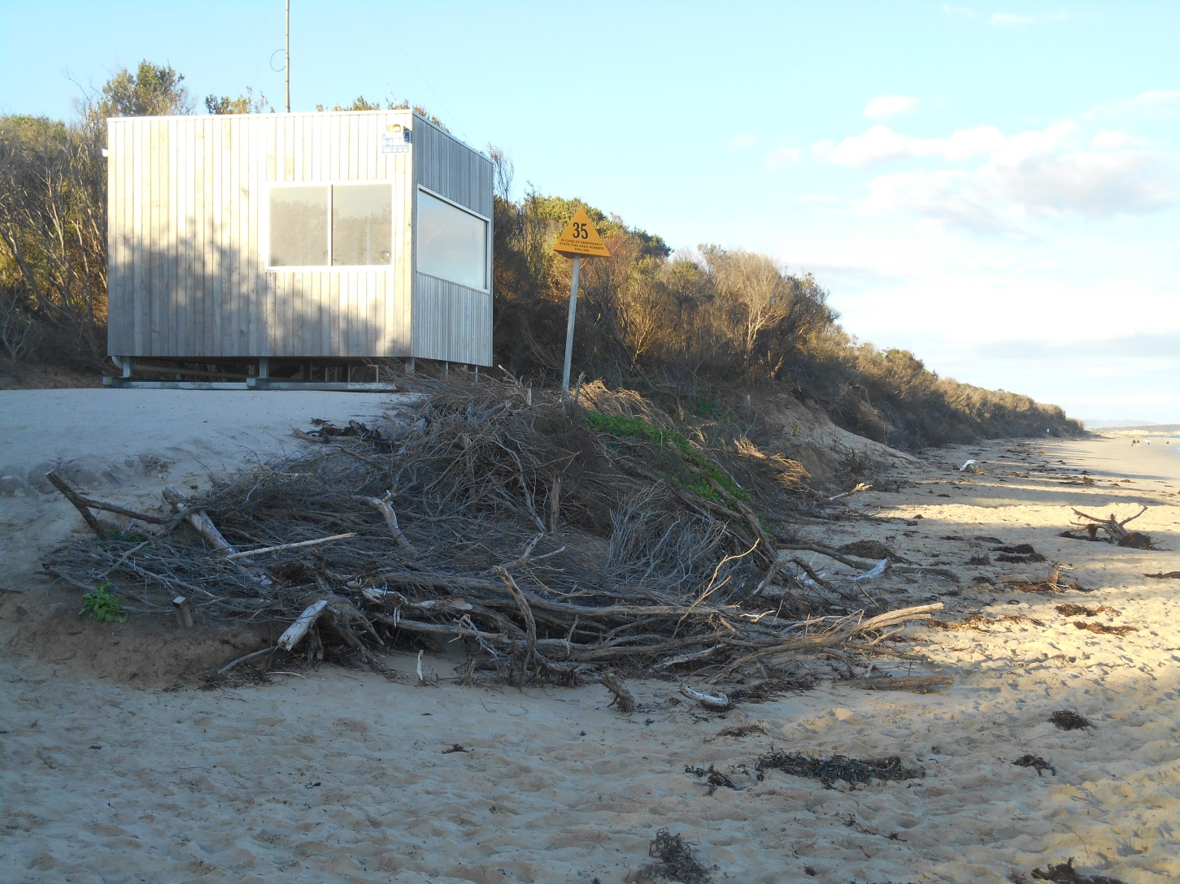
April 17
2017
Notes:
A new pedestrian path was cut through the tea tree to the west of the SLSC. The tower was taken from its pylons, put on ‘skis’ and moved to this new location.

Slide 12
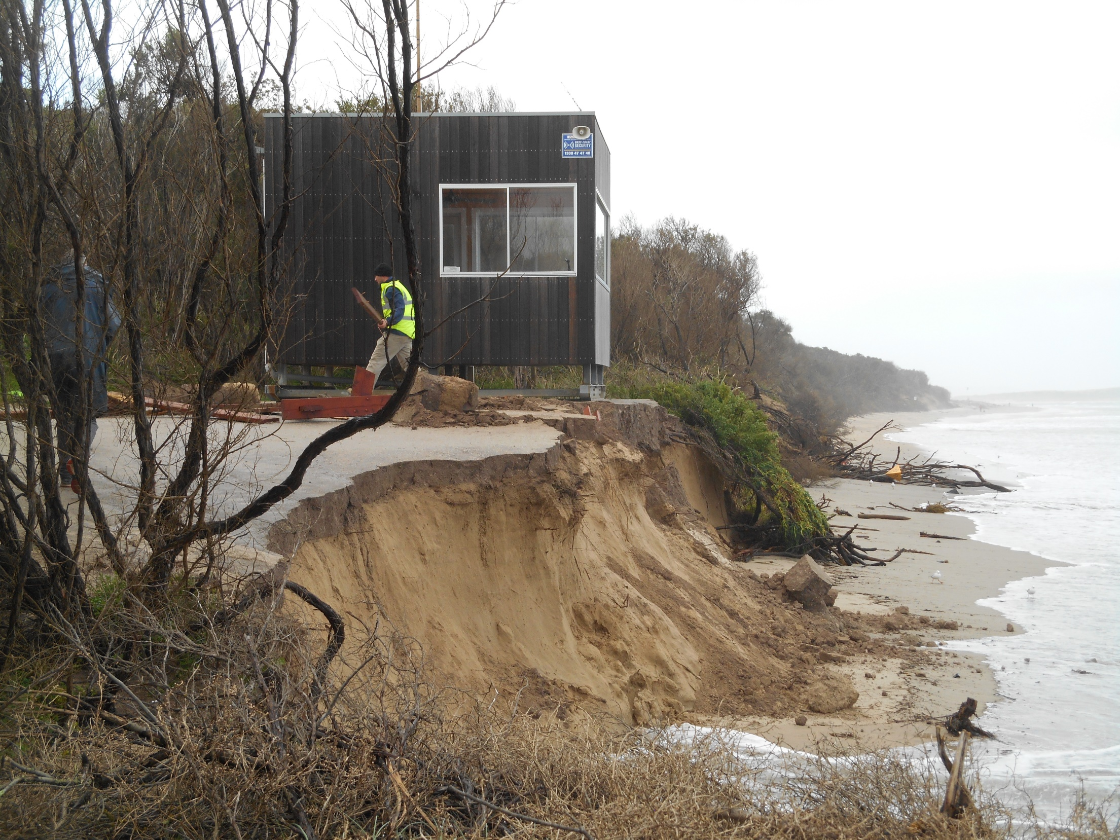
8 July 2018
Notes:
On this day a tractor was brought in to drag the tower back from the edge. Note how easily erosion will occur on the face of these dunes during a storm/high tide

Slide 13
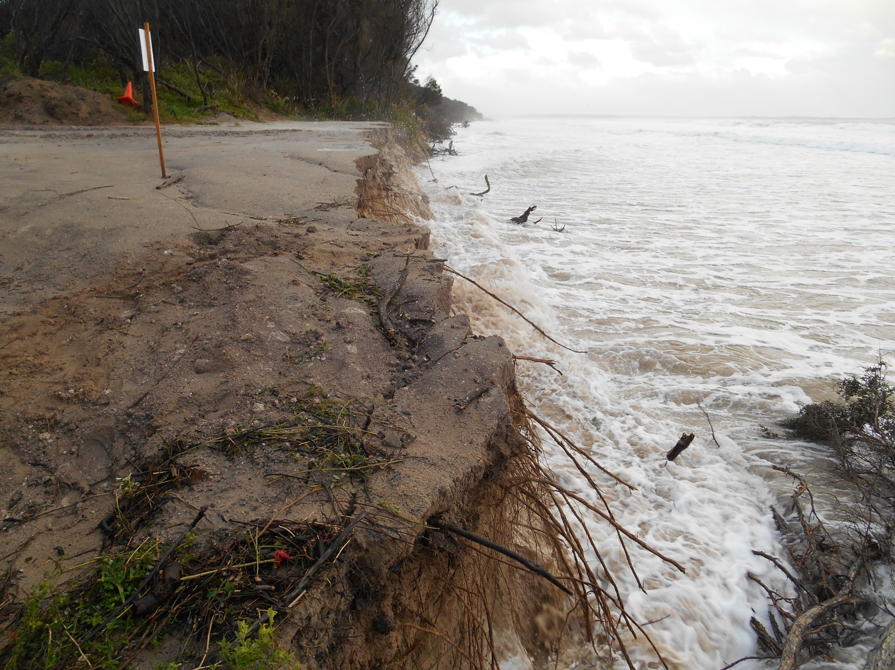
20 July 2018

Slide 14
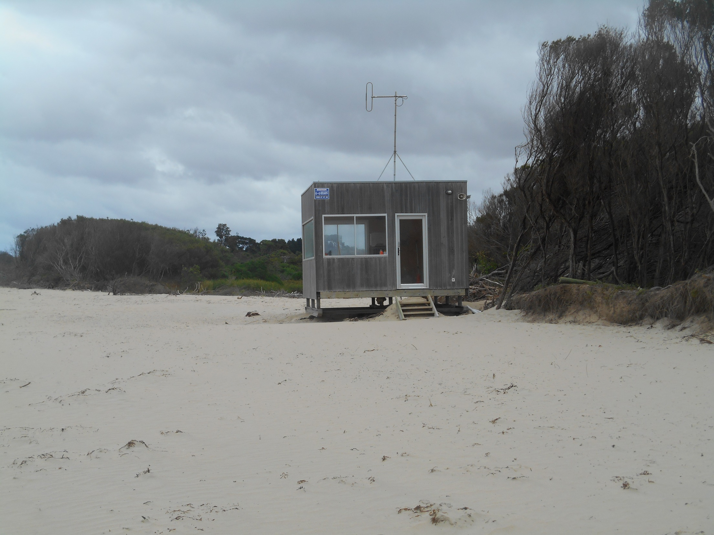
December 2018
Notes:
The tower was moved further west where it spent the summer of 2018

Slide 15
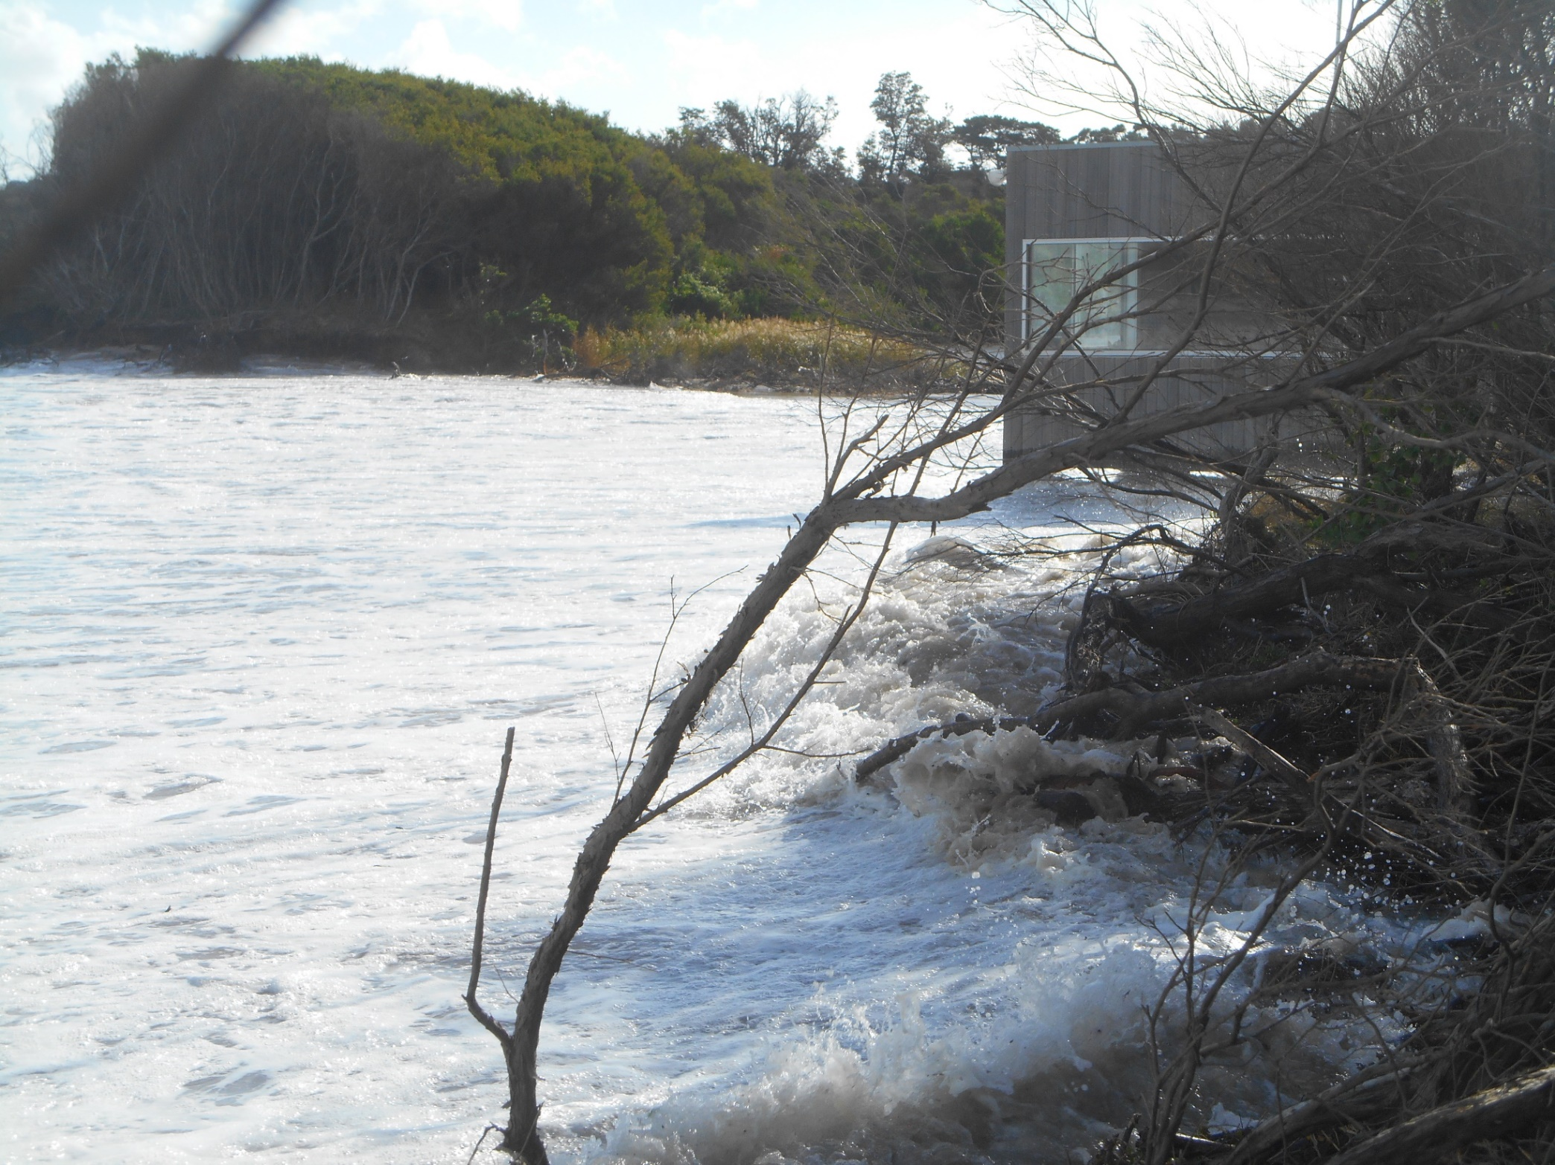
25 March 2019
Notes:
The tower was dismantled shortly after this

Slide 16
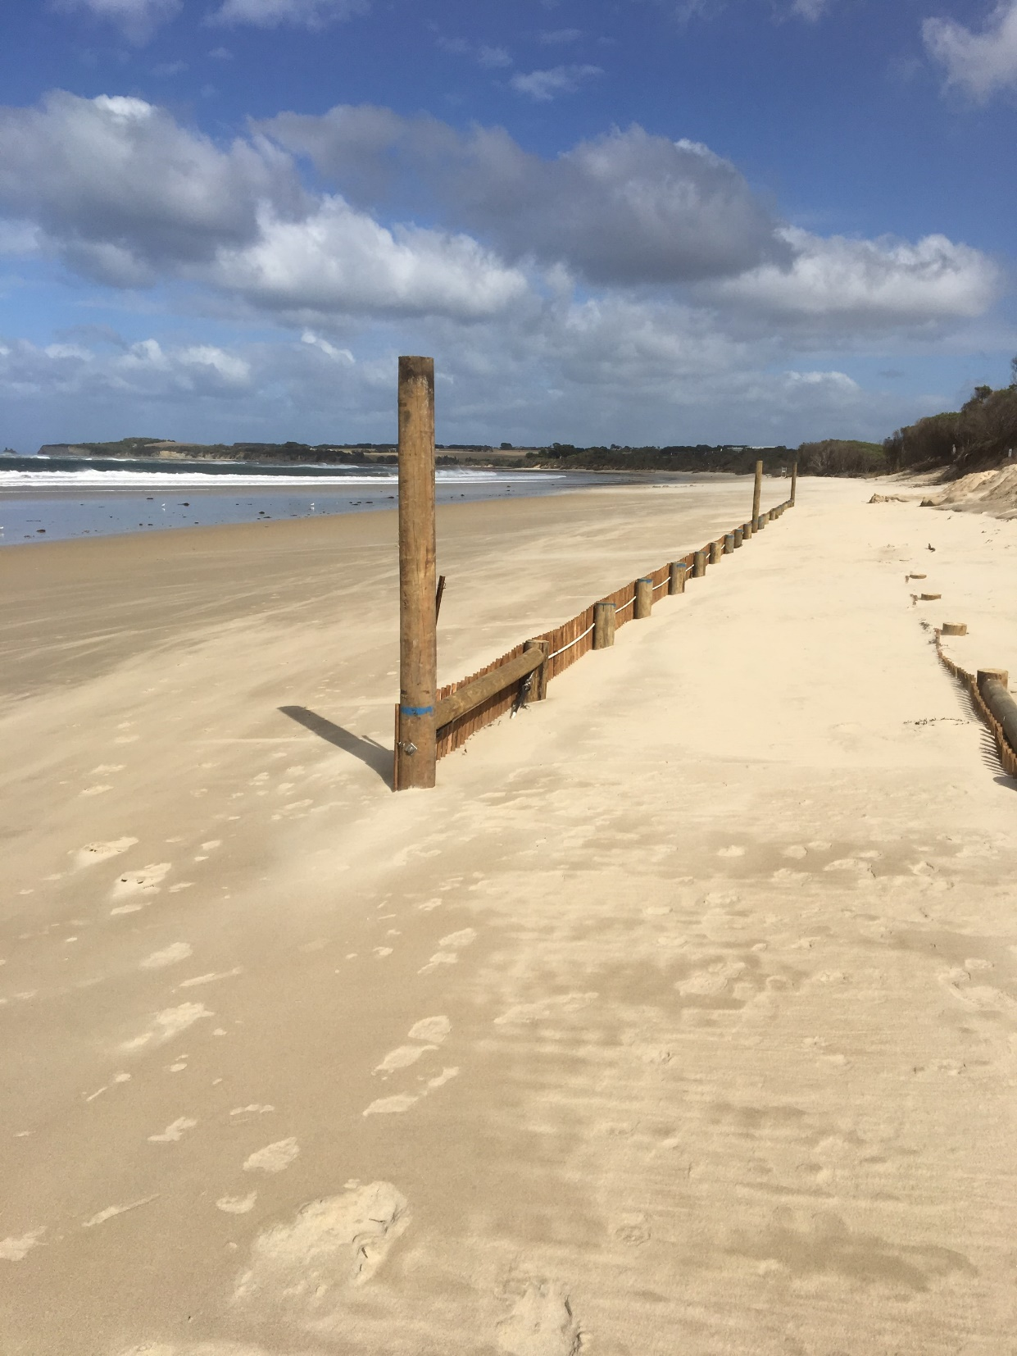
WET SAND
FENCING
25 March 2019
Notes:
Two lots of wet sand fences were constructed – one set adjacent to the SLSC and the second at the Bunurong Road corner. The idea was modelled on fencing at Port Fairy. The fences are like picket fences, pickets joined with wire. Waves would was through the fencing and would be slowed down, sand would be trapped on the landward side and build up the adjacent sand dunes.

Slide 17
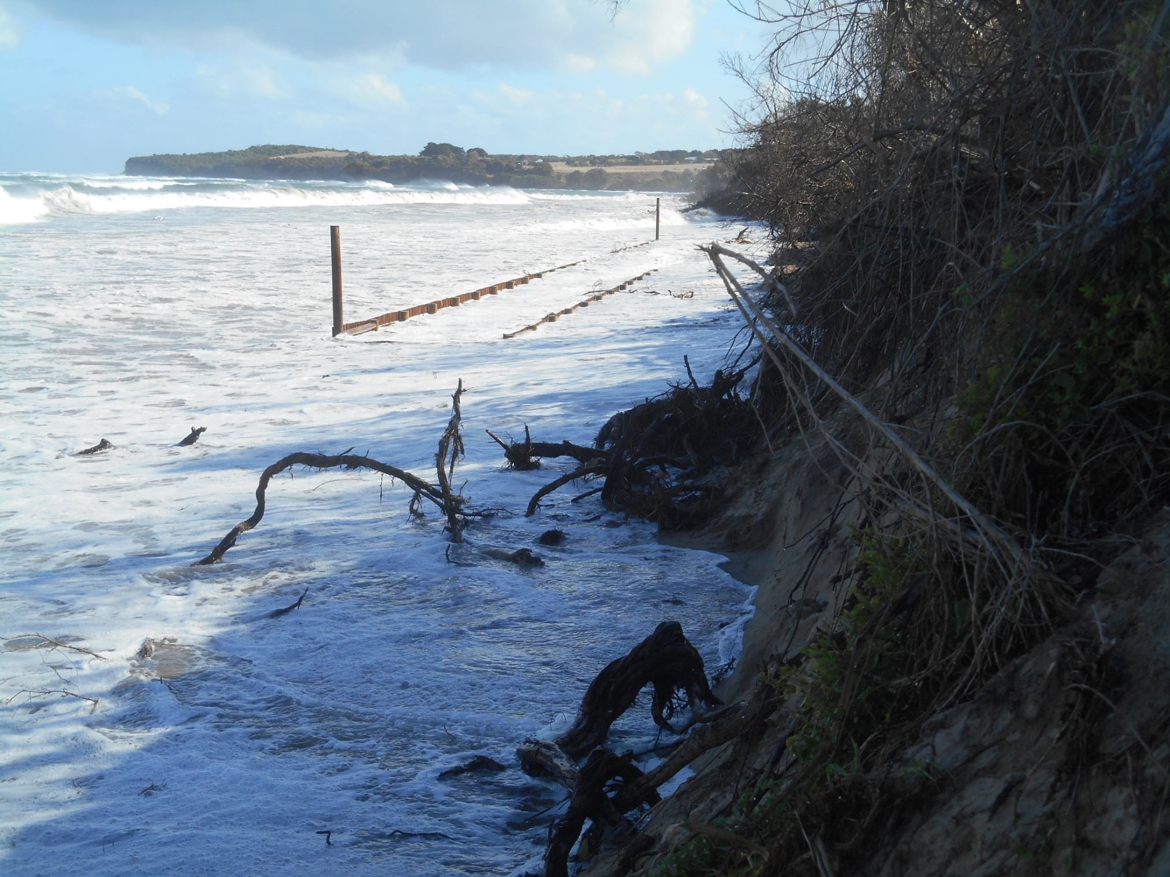
25 March 2019

Slide 18
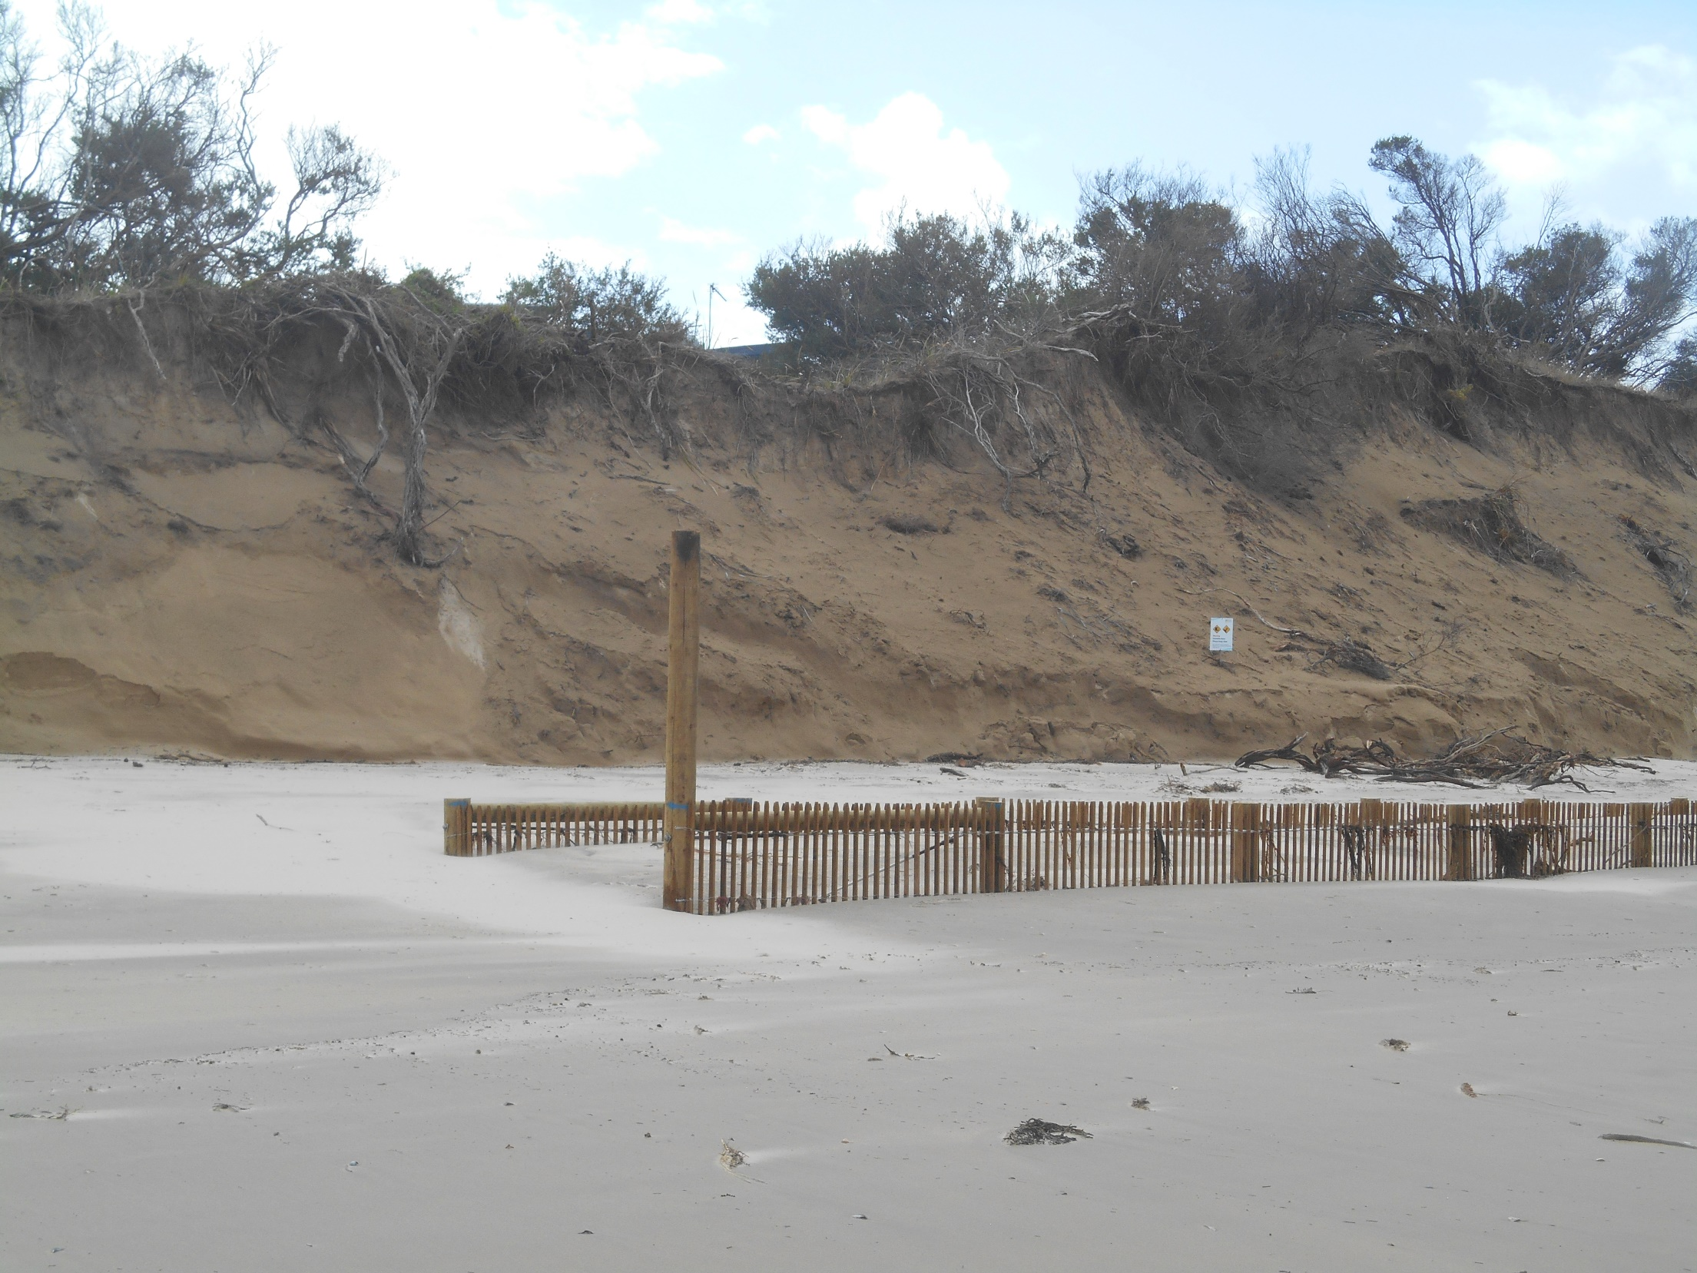
Notes:
There were two problems – longshore drift meant that waves were washing along the beach from west to east, in behind the fences, scouring out sand from the dunes. Secondly they were not strong enough & began to fail at the Bunurong Road corner within a month of construction.

Slide 19
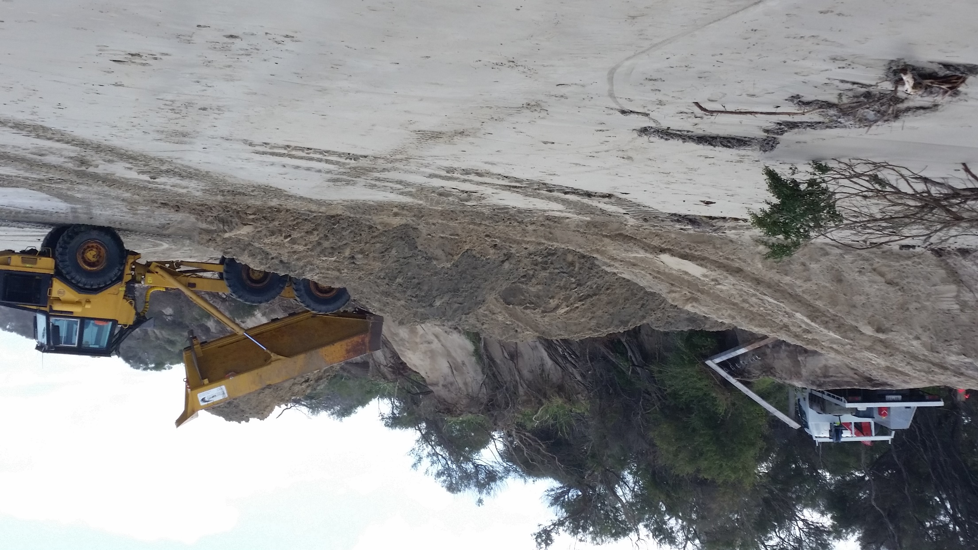
10 Sept 2019
Notes:
Tonnes of sand was transported from Point Norman back along the surf beach and placed adjacent to the SLSC and Bunurong Road

Slide 20
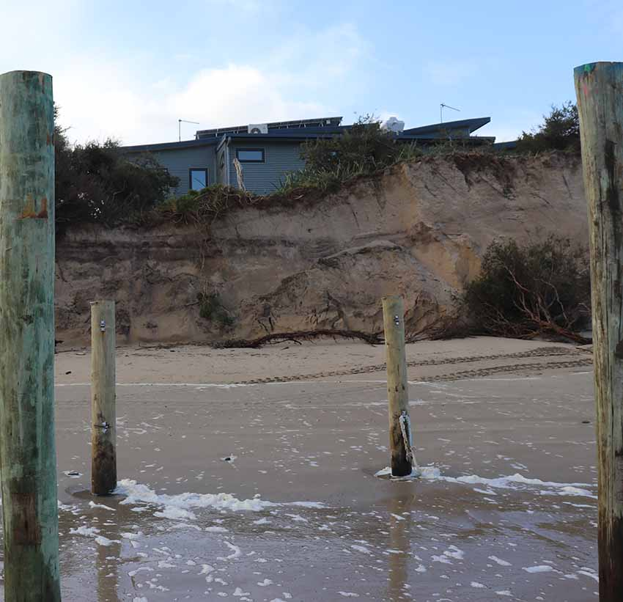
Sept 13
Photo Geoff Ellis

Slide 21
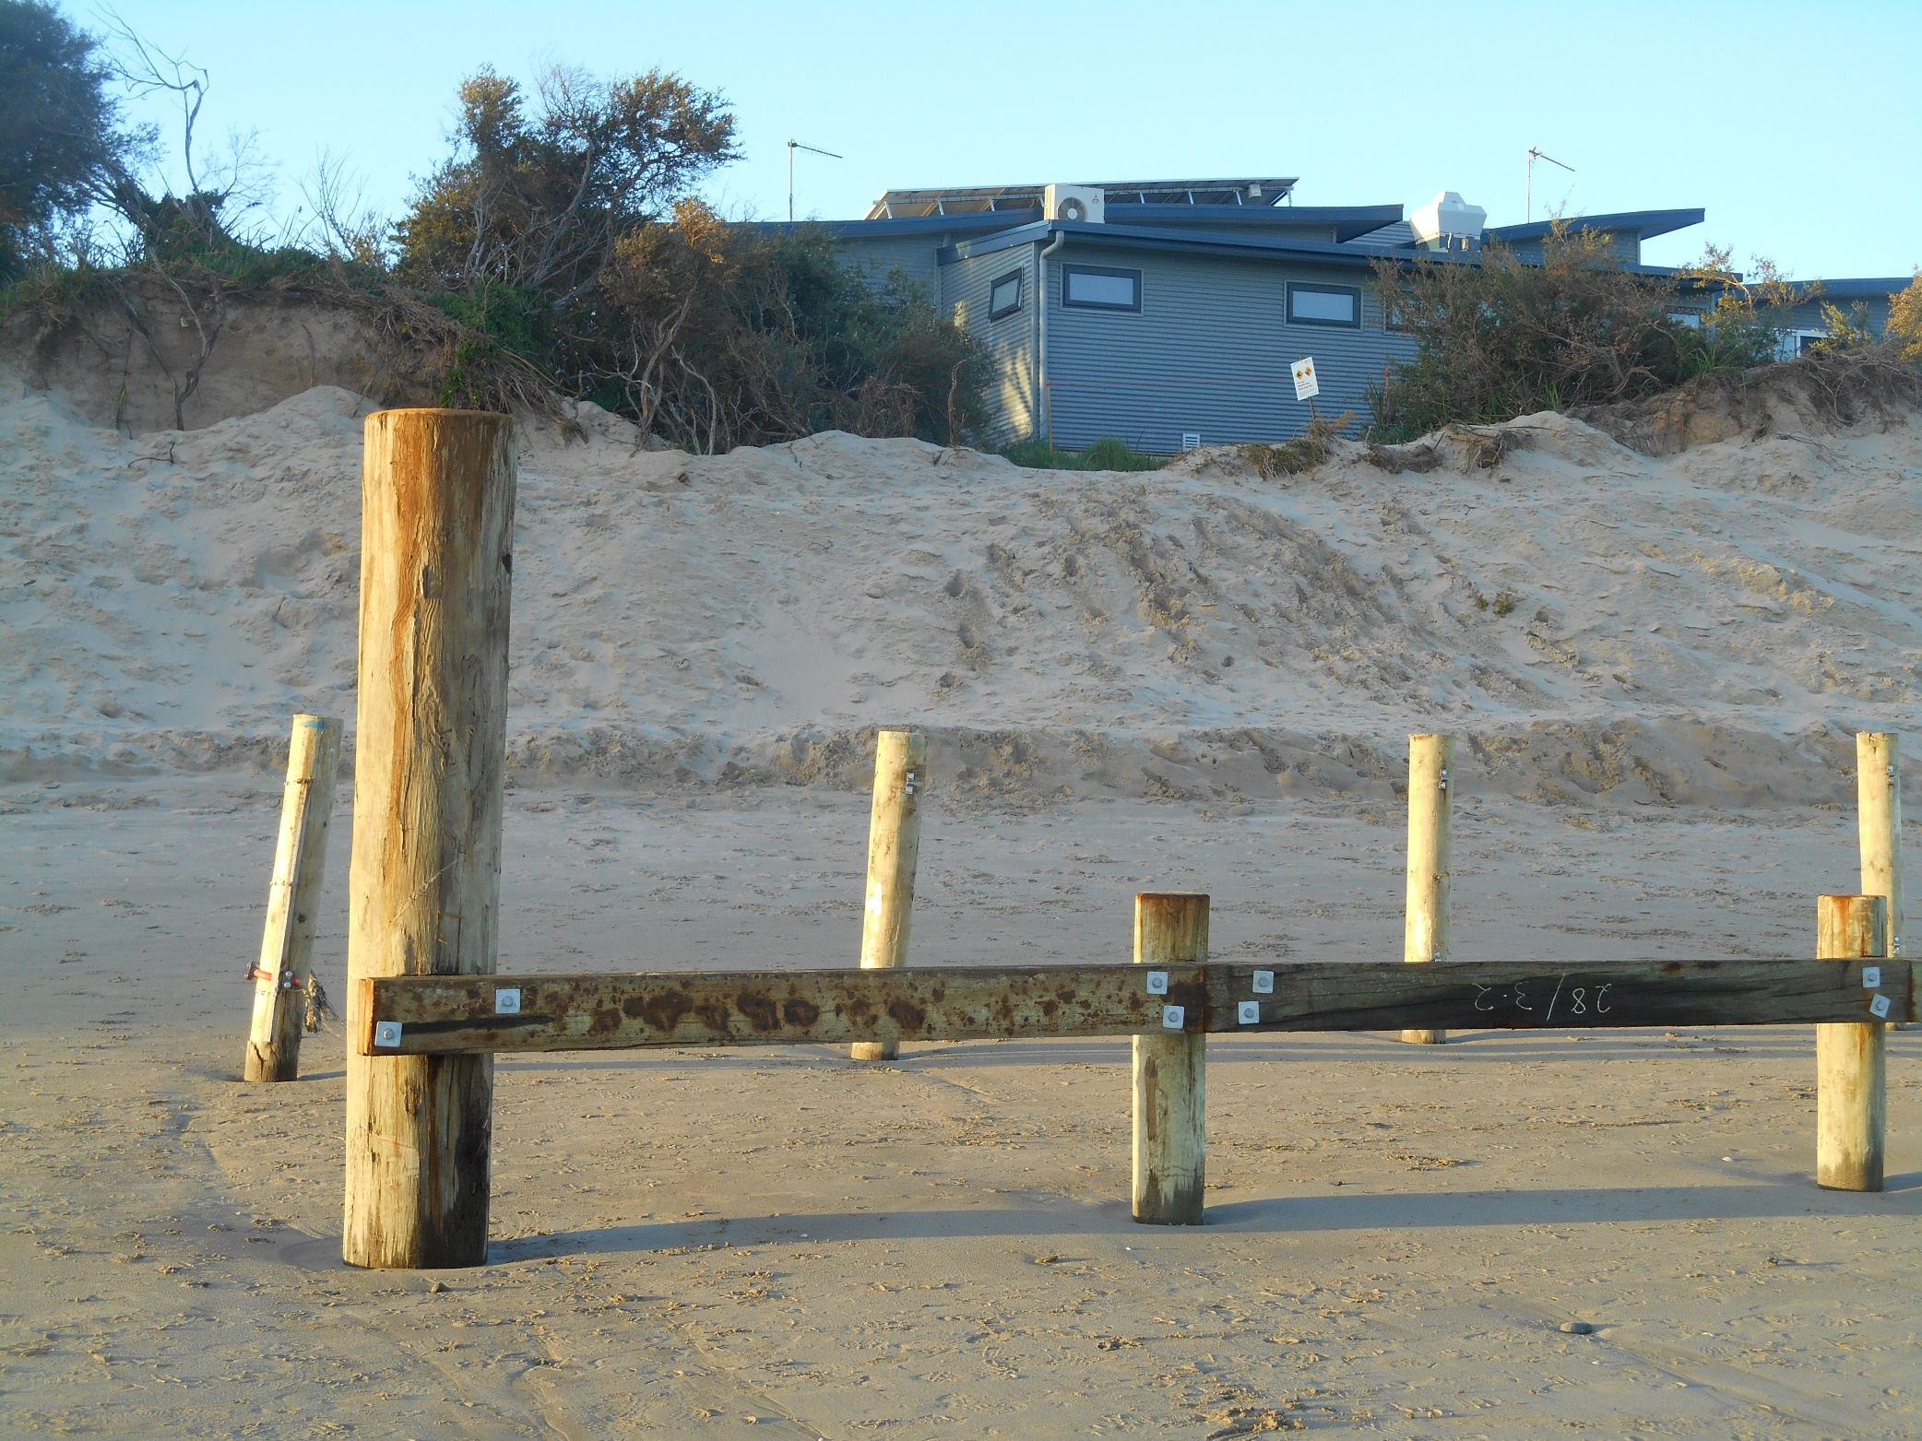
28 September 2019

Slide 22
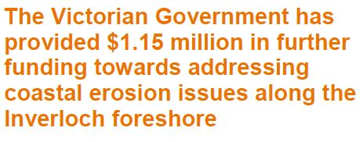
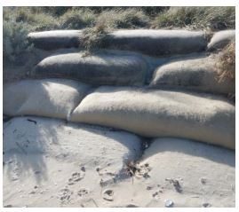
+
$700,000 has been provided to form a pilot
Regional and Strategic Partnership (RaSP)
under the new Marine and Coast Act 2018,
over the wider Inverloch marine and coastal
area.
$450,000 to install a 70-metre
sand-filled geotextile container wall at
the lifesaving clubhouse

Slide 23
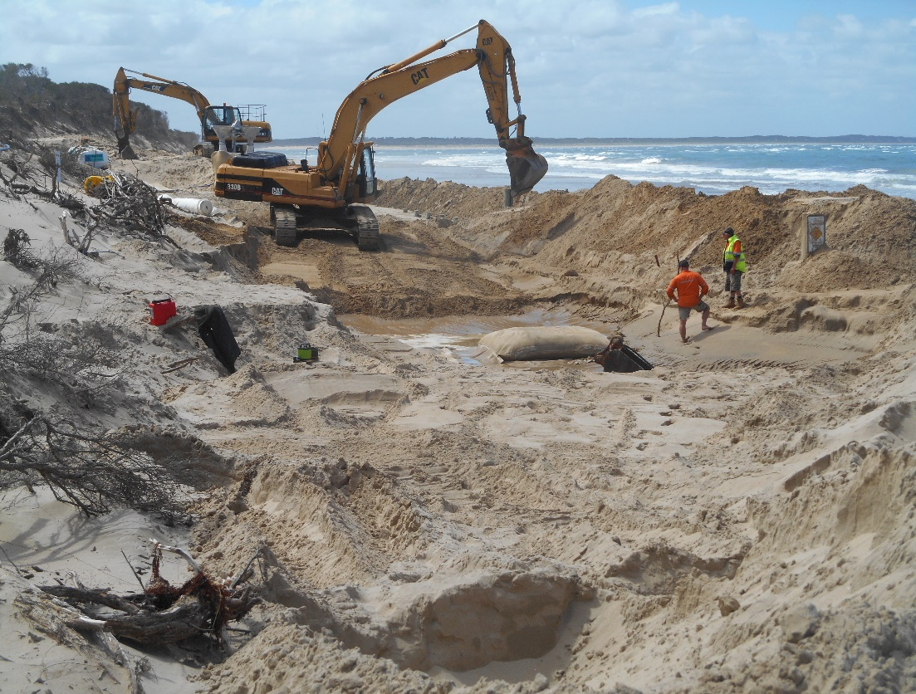
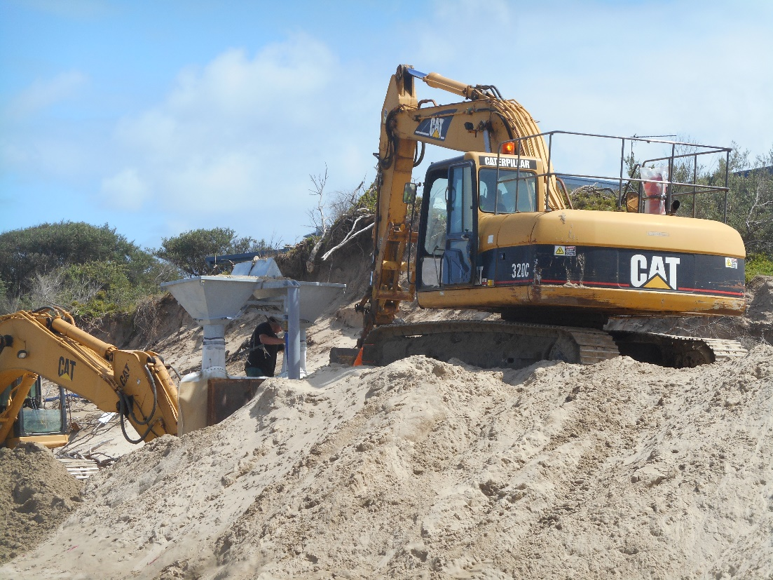
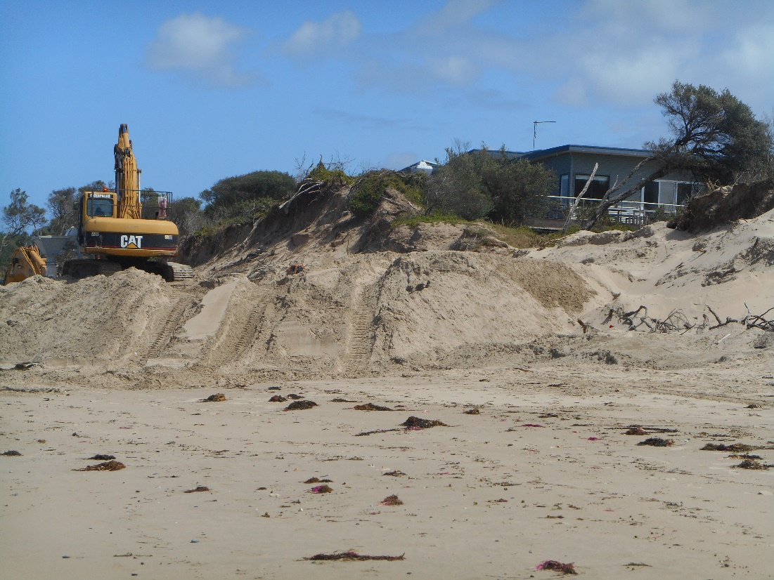
Excavating to
install sand bags
Filling sand bags
21 February 2020

Slide 24
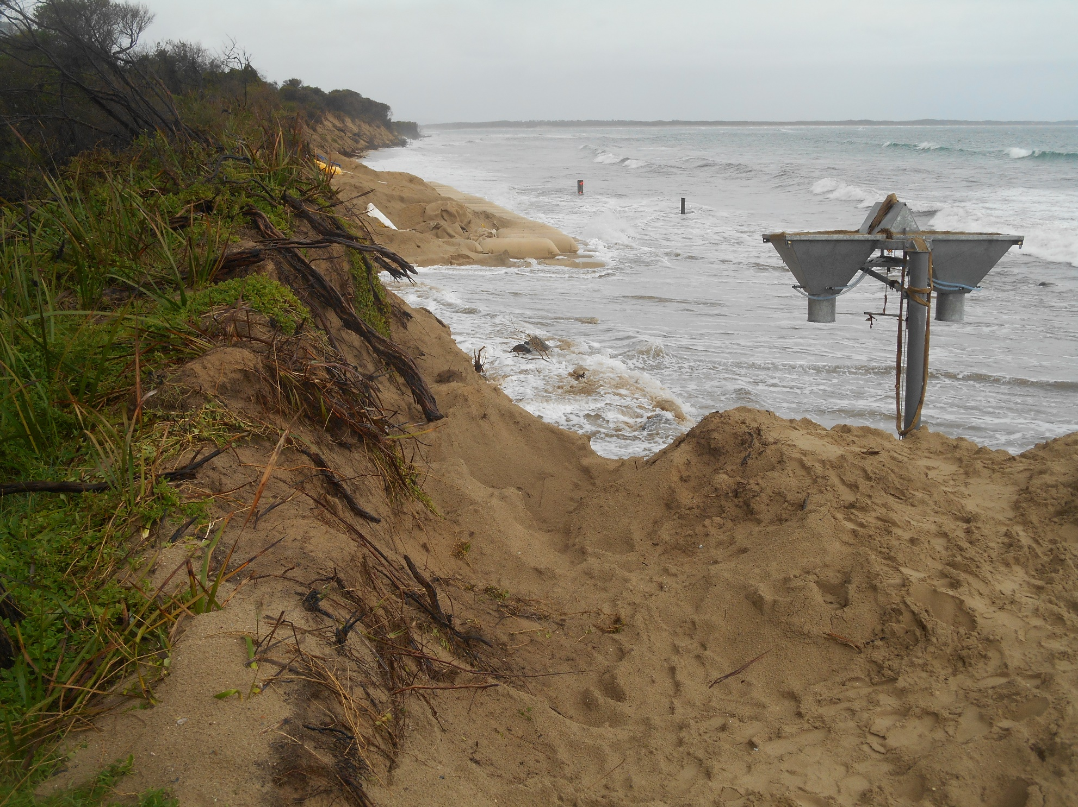
5 May 2020

Slide 25
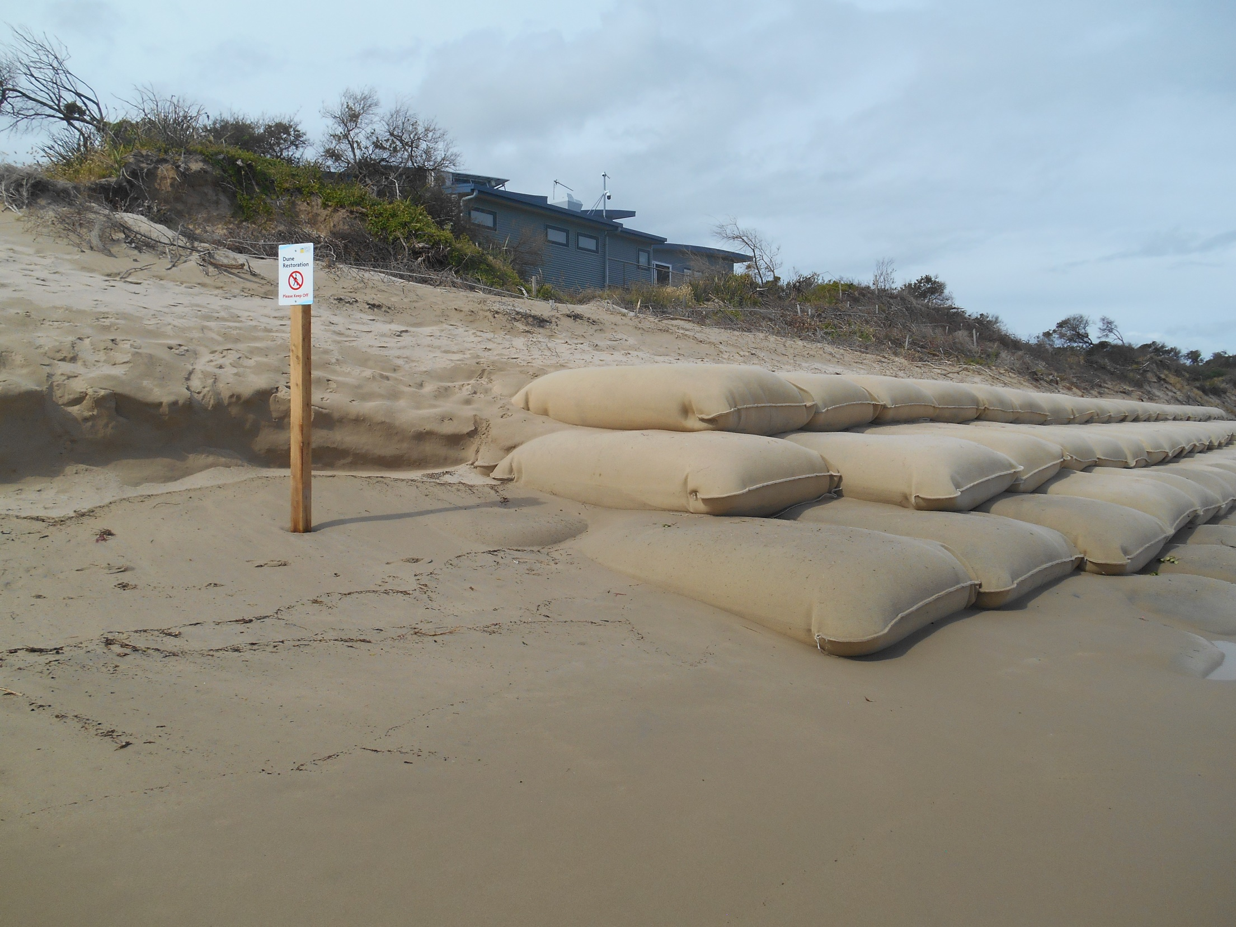
December 2020

Slide 26
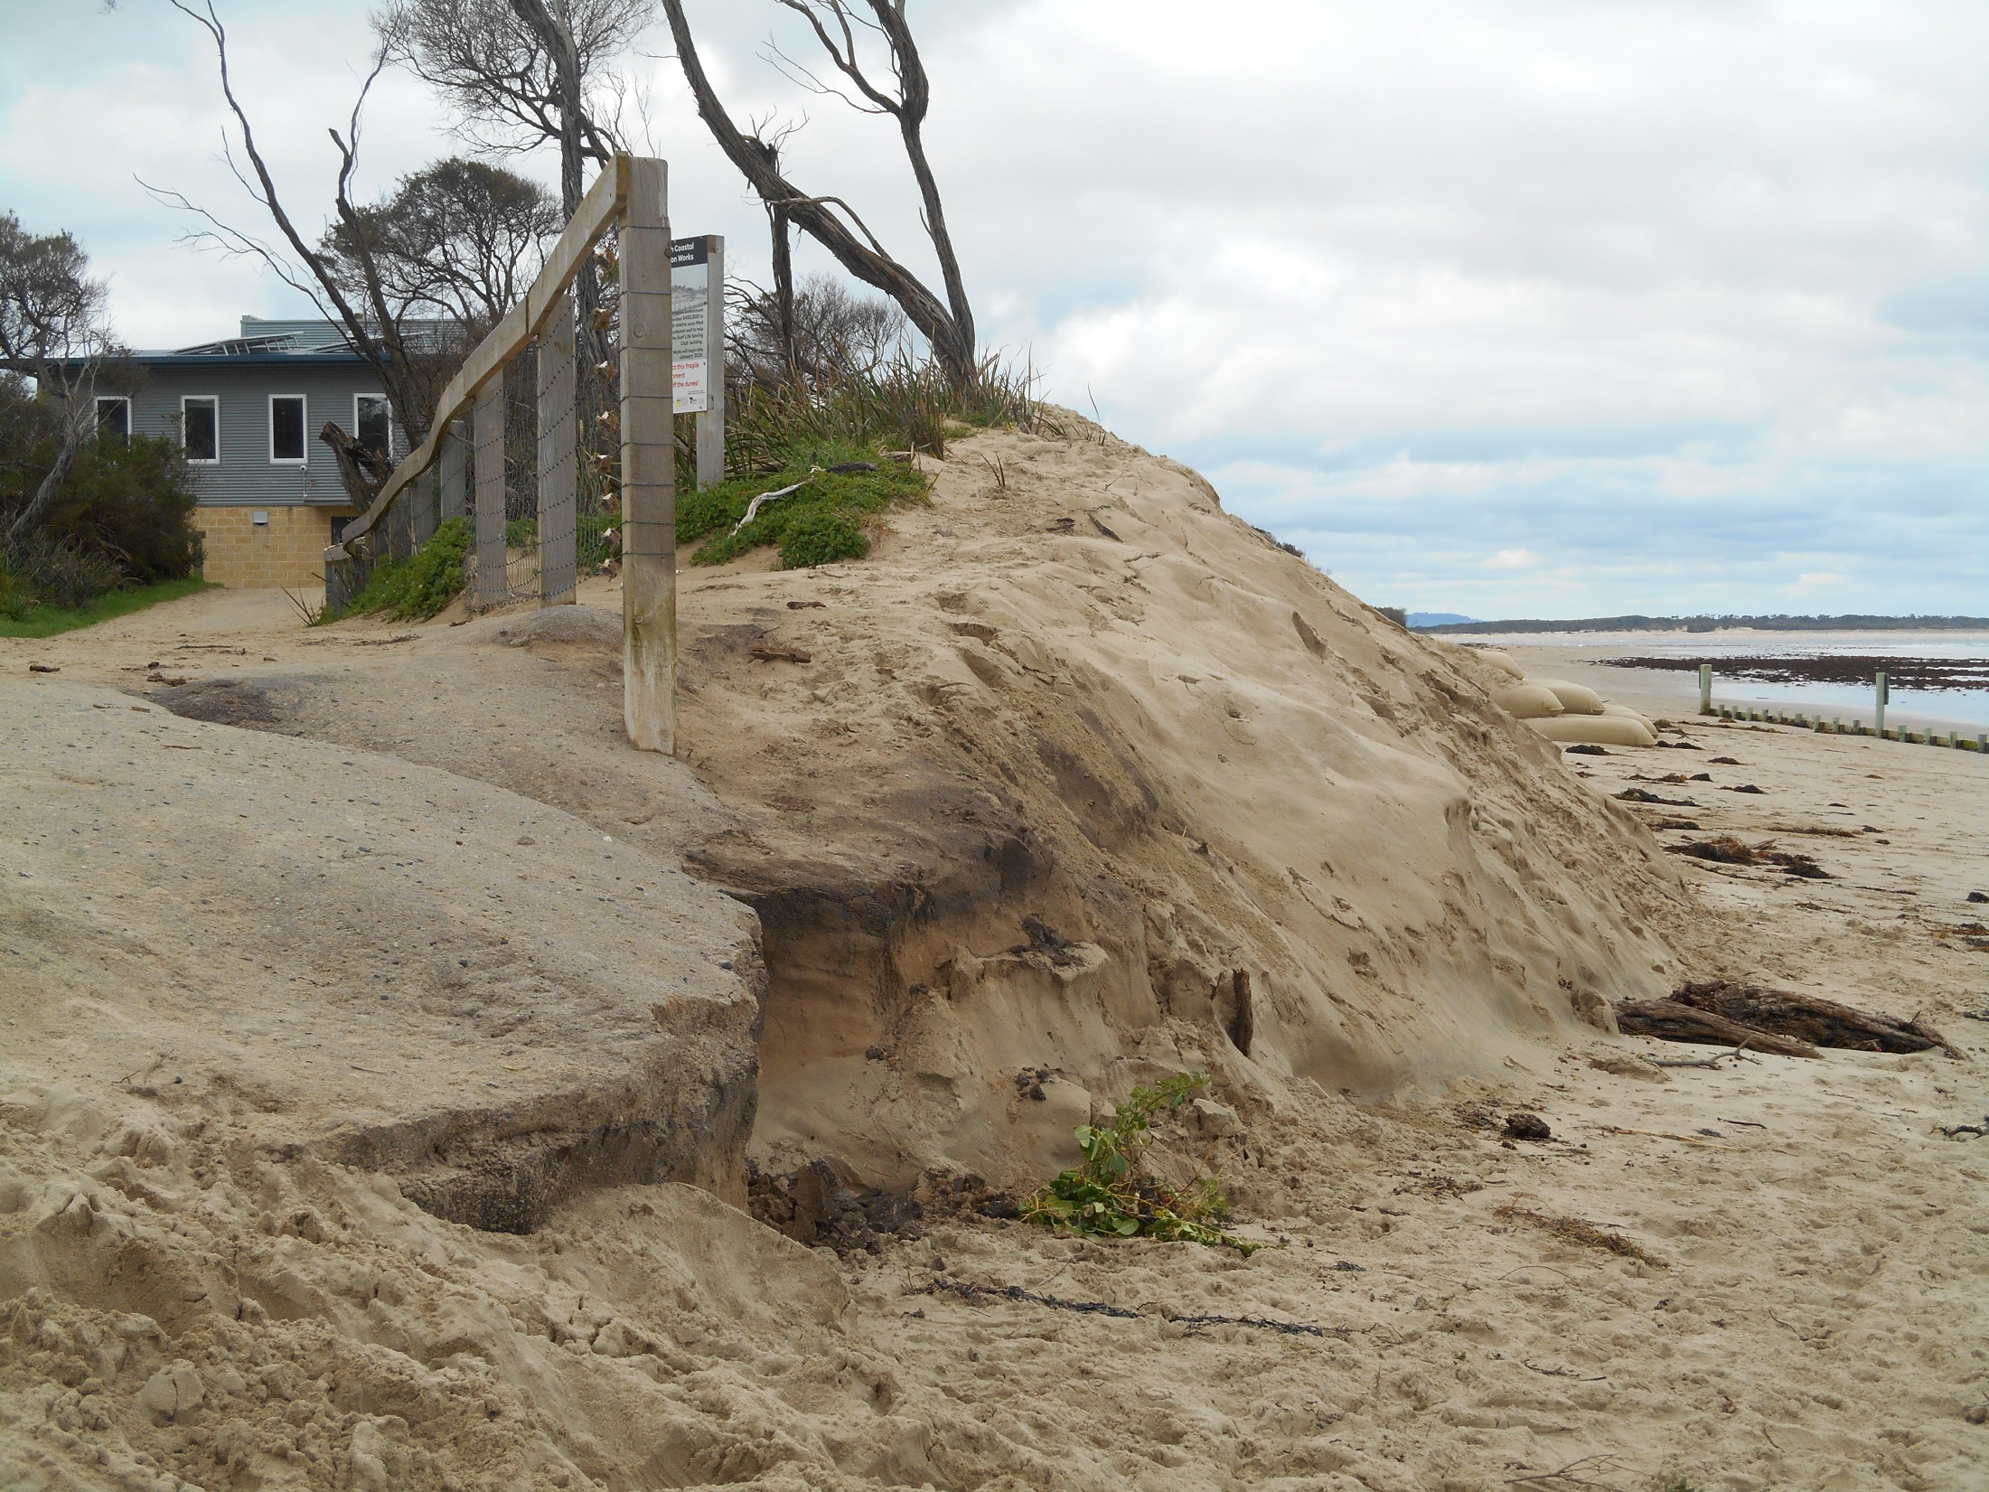
18 August 2021

Slide 27
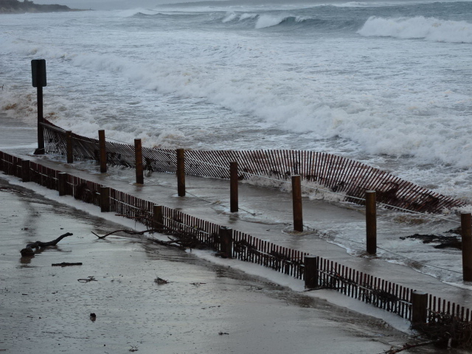
Bunurong Road Corner
26 April 2019
Bunurong Rd/Surf Pde
wet sand fence
Notes:
Bunurong Road corner wet sand fence began to fail one month after installation

Slide 28
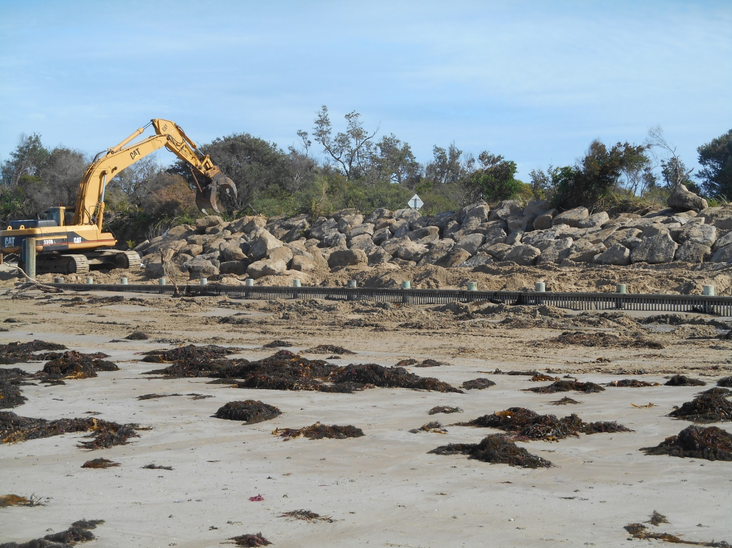
14 April 2020
Notes:
7,000 tonnes of rock now in place. Rocks and sand bags both installed on an angle sloping away from the beach, so that waves will run up rather than crashing into them & dragging sand away. This is a key problem of rock walls. Waves crash into the hard surface & drag sand away. So the road/ buildings are protected but the beach is lost. A second significant problem is at the ends of each of these structures. You will see accelerated erosion at the ends. What to do about this…. The most active erosion during 2021 has been along Wreck Creek next to the rock wall at the Bunurong Road corner, and at the Rotary Park near the boat ramp – next to a rock wall.

Slide 29
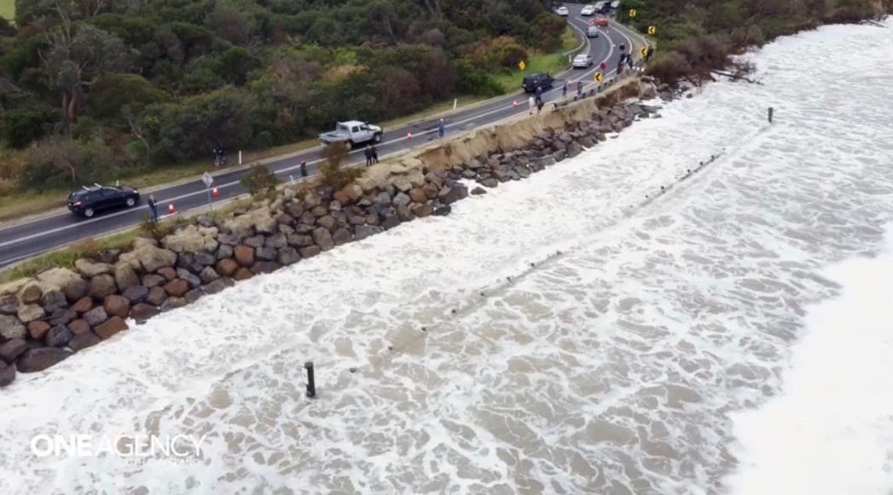

Slide 30
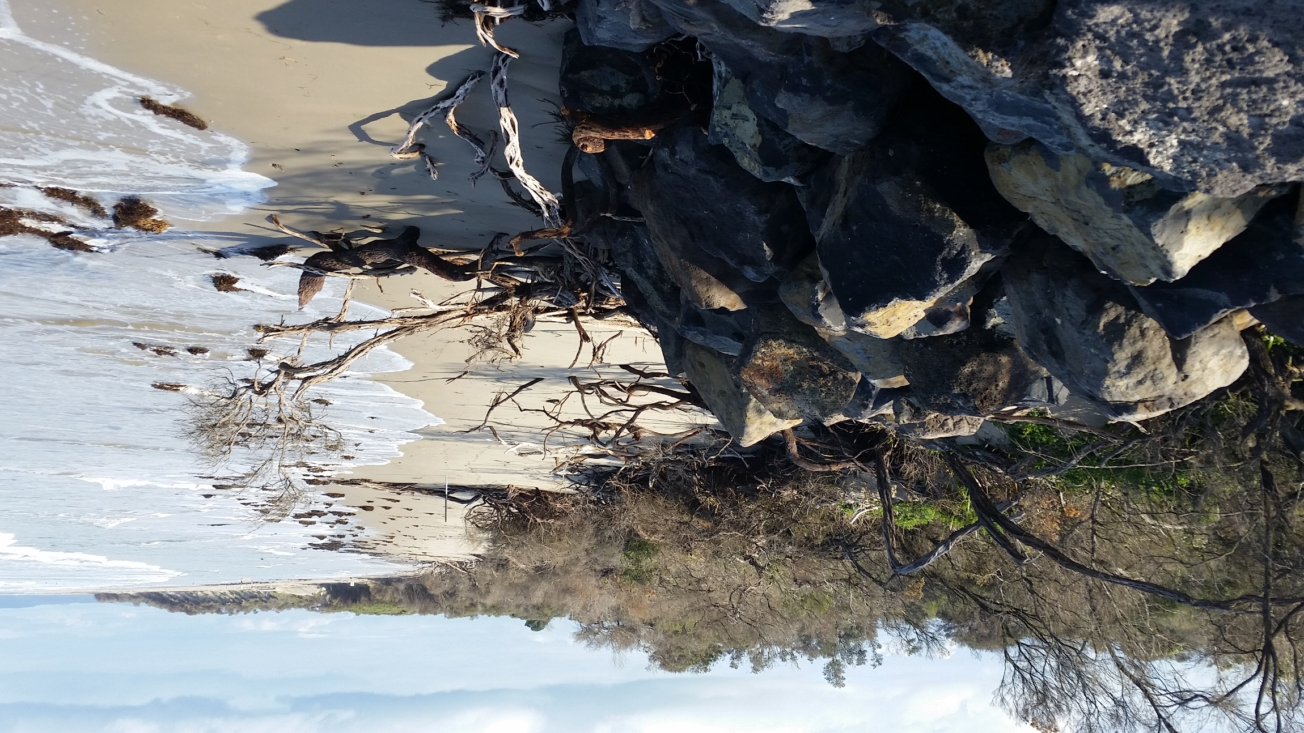
October 2021 looking east towards SLSC from
Bunurong Rd corner. The next 5 photos taken
from here
Notes:
Eastern end of surf beach rock wall. One branch of Wreck Creek runs parallel to shoreline flowing east and is now just a few metres from being inundated by waves.

Slide 31
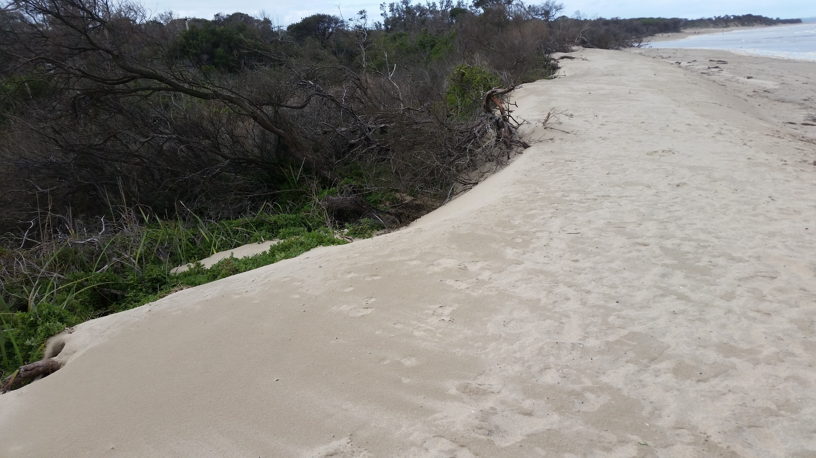
September 2022

Slide 32
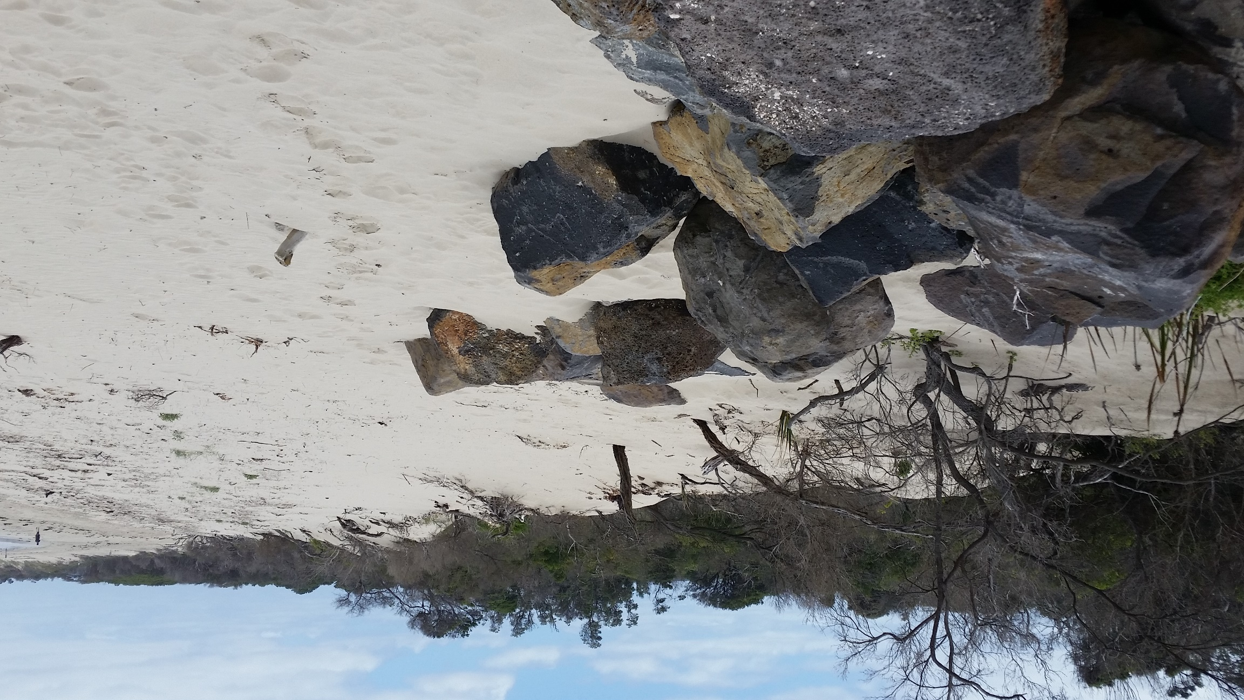
February 2023

Slide 33
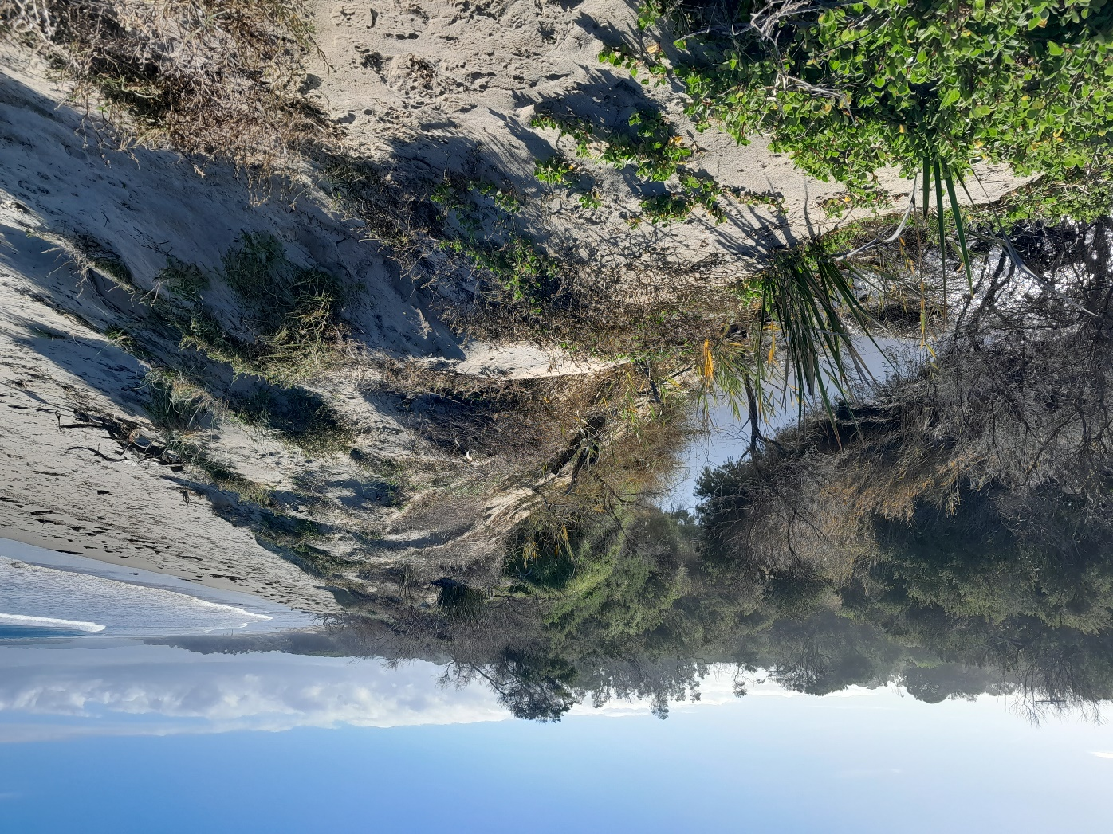
June 2024

Slide 34
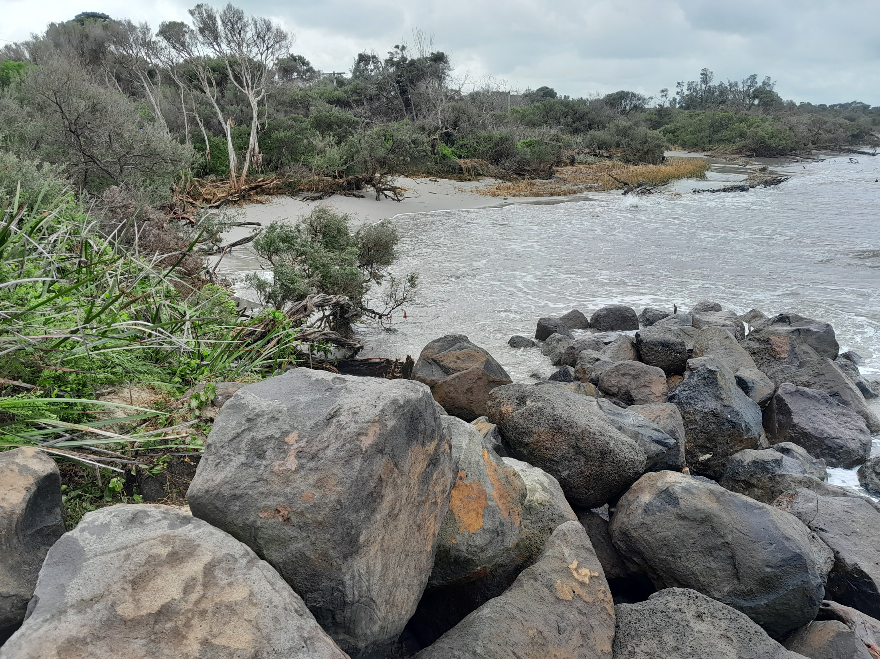
3 September 2024

Slide 35
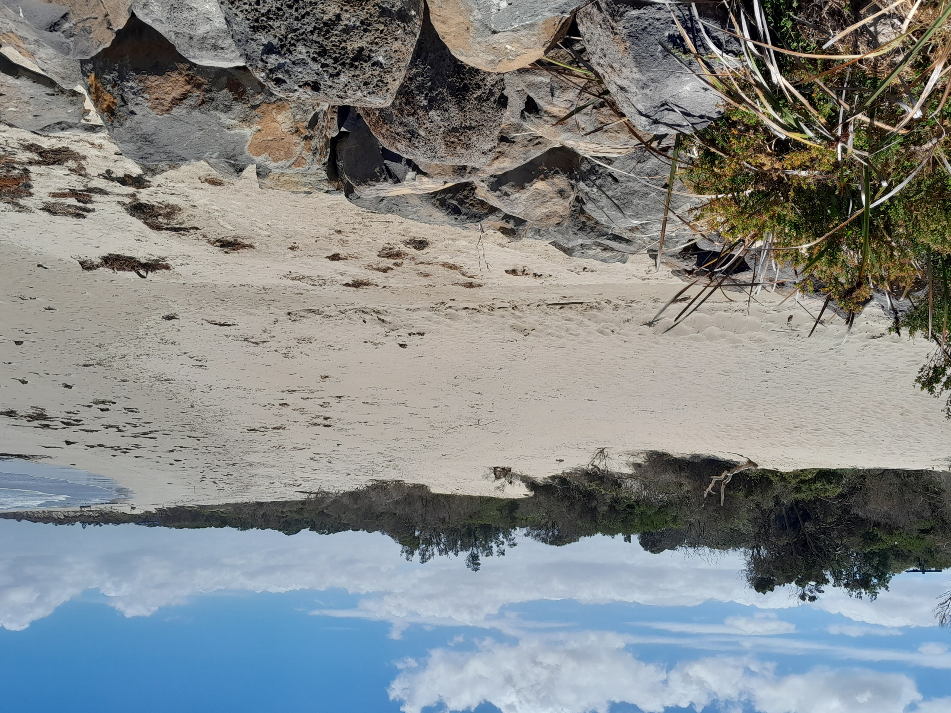
Where’s the creek?
January 28 2025

Slide 36
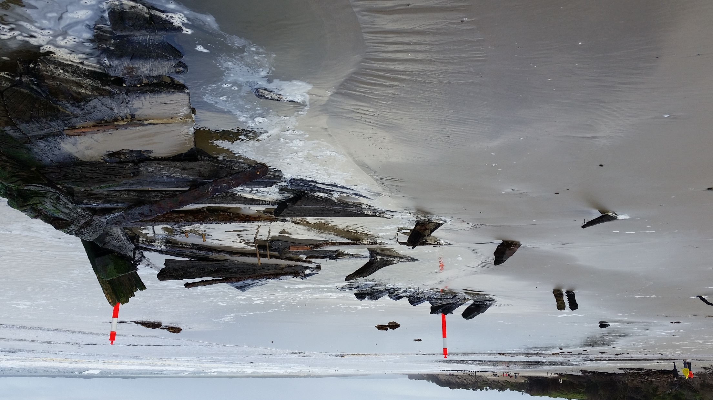
Amazon shipwreck July 2020
Notes:
Between Wreck Creek & the Bunurong Road corner can be seen at low tide sometimes

Slide 37
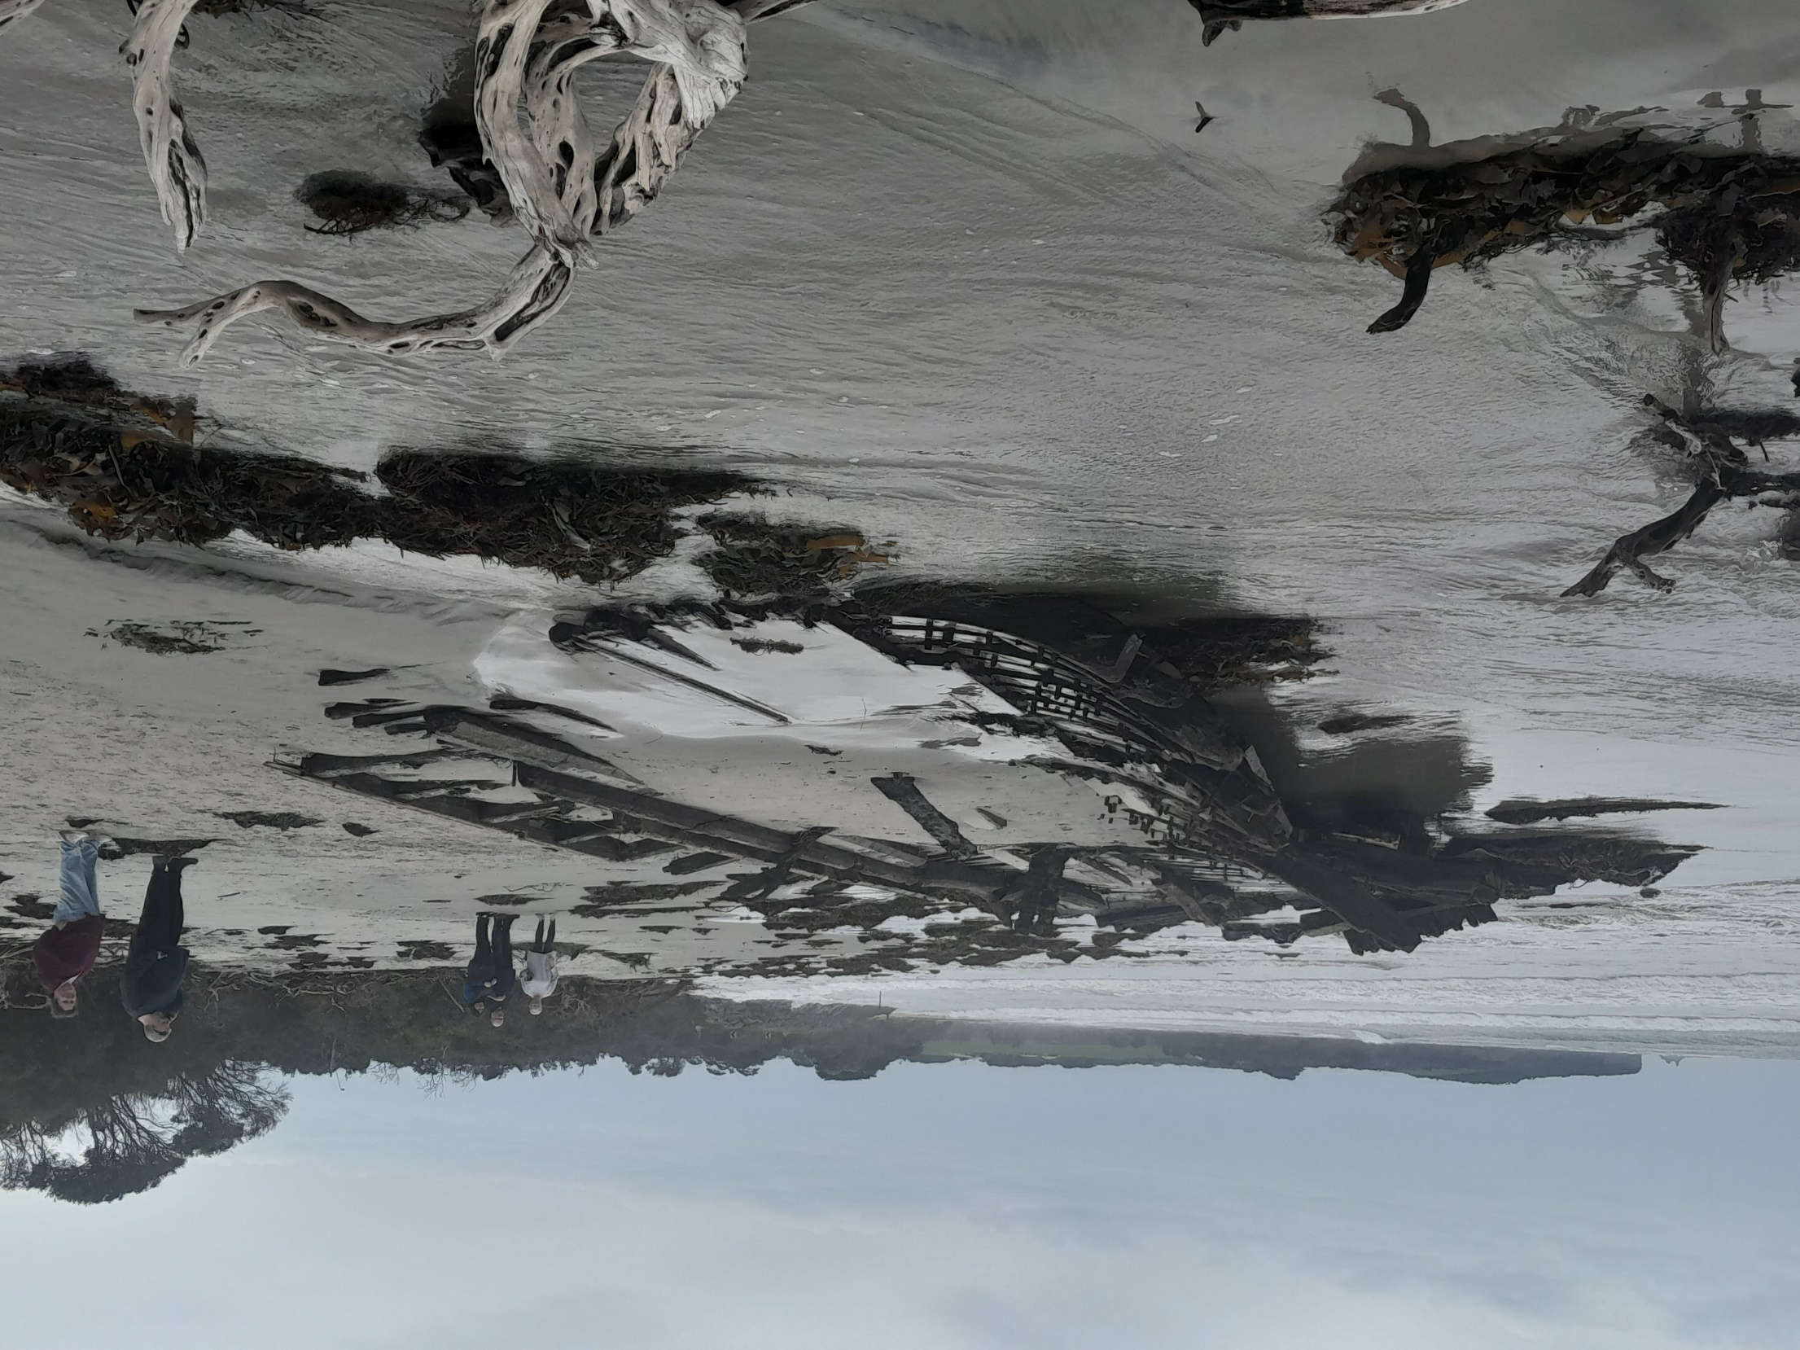
Amazon floated to
a new site
September 2024

Slide 39

Inverloch beach erosion worsens after 'huge' storms and high tides
William Howard ABC Gippsland 4 September 2024
3 September 2024

Slide 40
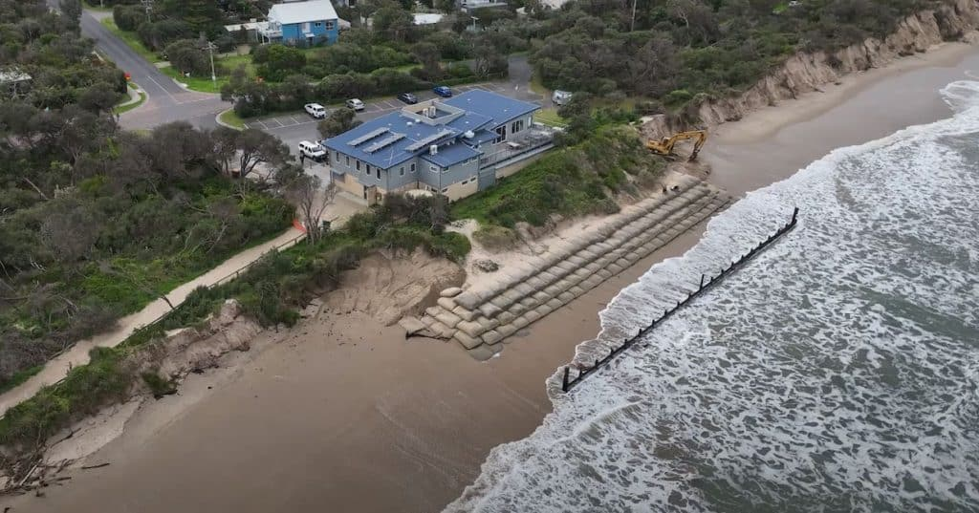
Note: excavator at work.
Image supplied ISLSC
The state government is planning to use a dredge & pump
150,000cum sand back to the surf beach later 2025. (soft
engineering)

Slide 41
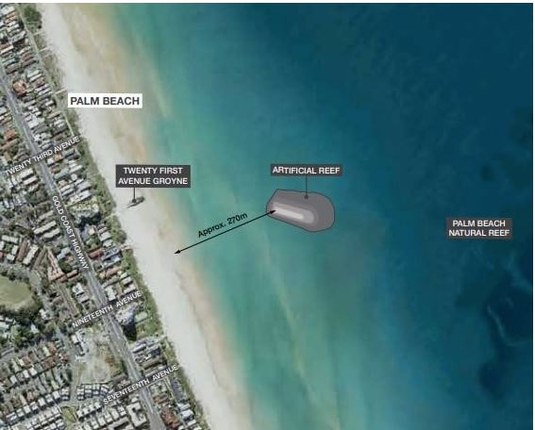
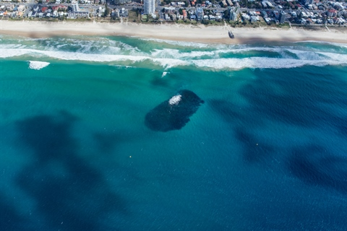
One solution to erosion at Inverloch – an offshore artificial reef to break up wave energy
PALM BEACH, GOLD COAST artificial reef
COST: $18.2 million
270 metres offshore,160 metres long and 80 metres wide. Constructed using 60,000 tonnes of boulders

Slide 42
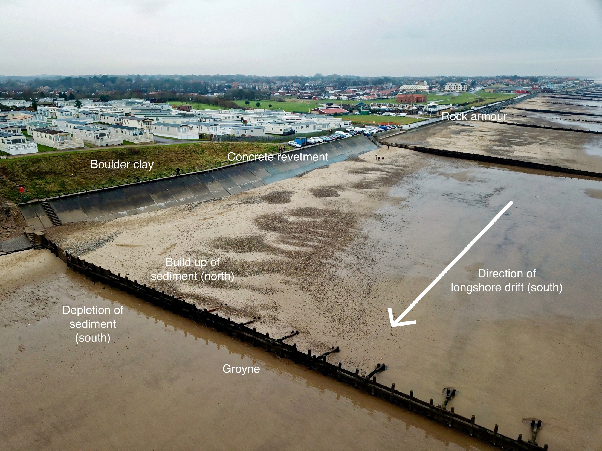
GROYNES? Would disrupt eastward movement of sand
at Inverloch

Slide 43
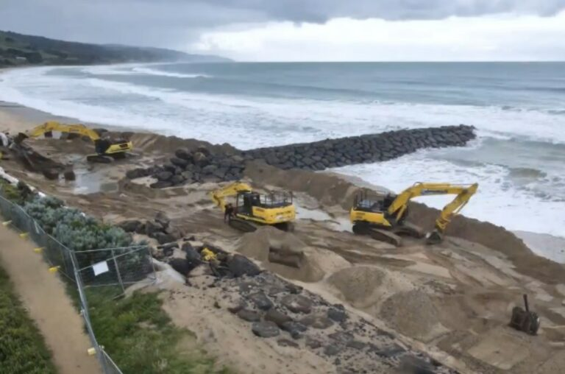
This Apollo Bay restoration suggested as a solution
at Inverloch. See details next slide

Slide 44
Successful foreshore protection at Apollo Bay April 26, 2022
The Victorian Department of Environment, Land, Water and Planning (DELWP) recently announced the successful completion of the $7.4 million Apollo Bay Foreshore Protection project.
Works included:
three groynes comprising around 63,833 tonnes of rock;
675 metres of rock seawall;
two heavy vehicle access ramps;
one light vehicle access ramp;
four wooden beach access stairs;
475 metres of reinstated foreshore path.
The construction of new groynes was followed by sand renourishment to fill the space next to the structures and prevent scouring of the beach to the north, and revegetation works will also take place.

Slide 46
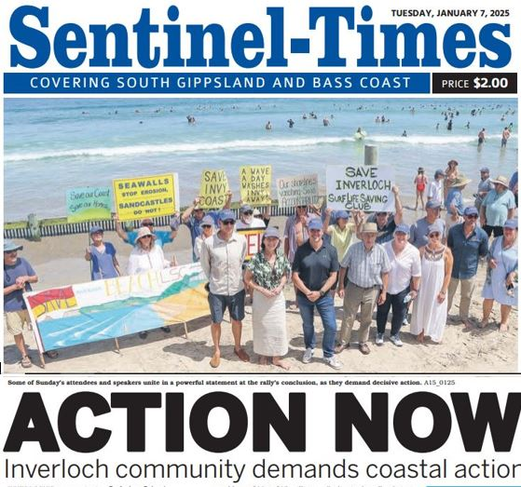

Slide 47
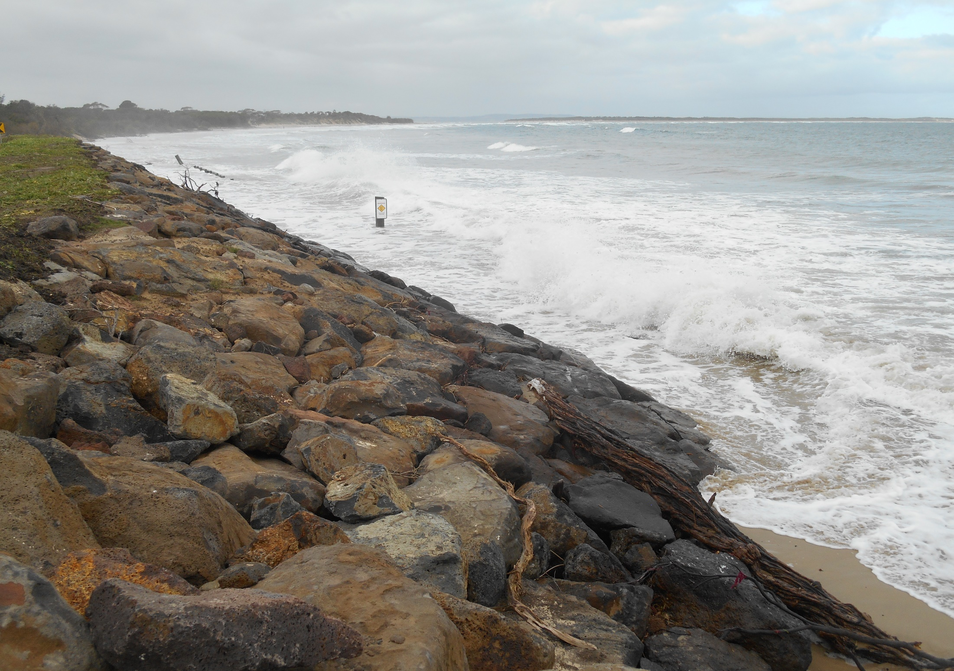
Rock walls are ‘hard engineering’. At Inverloch if they can be afforded they can
save the SLSC but beach will be lost. Waves crash against rocks & drag sand away.
"We will lose the beach because sand in front of rock walls always, everywhere around the world, there are examples of it having disappeared.“ Byron Bay
Residents’ Group

Slide 48
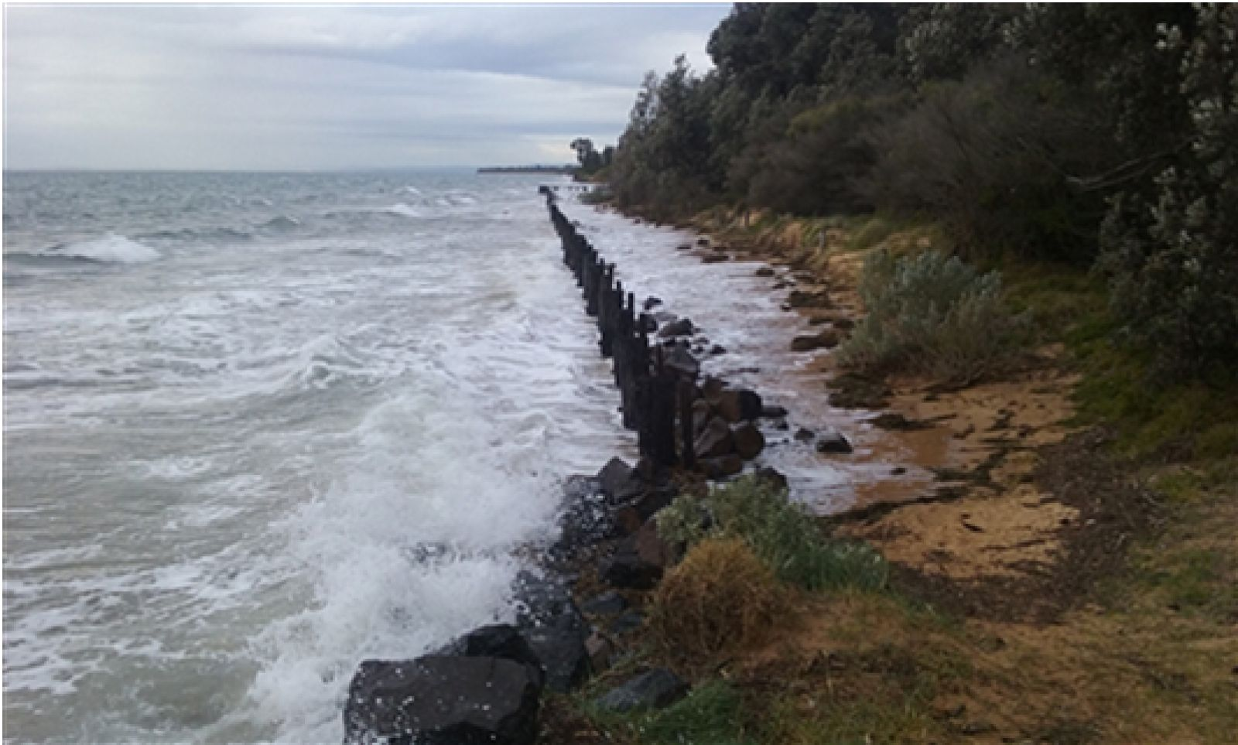
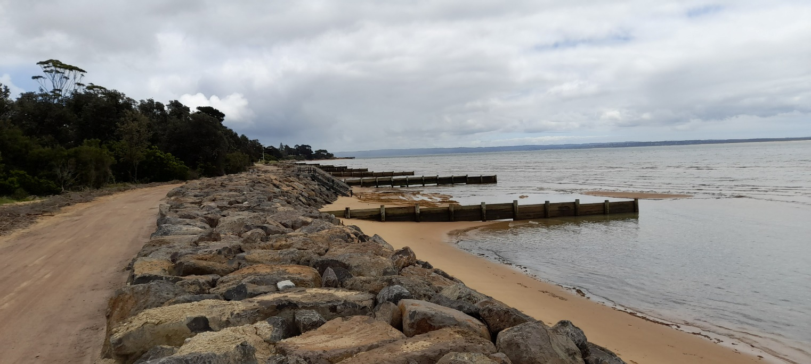
BEFORE
Cowes East beach restoration
AFTER

Slide 49

Surf beach sand transported east to Anderson Inlet
New lagoon at Ayr Creek
Photo: Alison & Leo Brewster Jan 2016
Notes:
There has been an enormous amount of sand transported east into Anderson Inlet from the surf beach. The Tarwin River flows out here. Channels regularly change their position. The lagoon in the foreground is at the mouth of Ayr Creek. It opens to the sea from time to time, but can become stagnant & unfit for swimming when it doesn’t rain for a while.

Slide 50


Wreck Creek catchment with
.8 metre sea level rise by 2100
Surf Lifesaving
Club
Wreck Creek
Notes:
This imaging from the Bass Coast Shire Council of what a .8 metre sea level rise would look like in the area behind the Inverloch SLSC & upstream along Wreck Creek. The following slide shows this same location. How should sea level rise & inundation caused by flooding up Wreck Creek be managed? Who should pay? How much?

Slide 51

Mid 2020

Slide 52

Notes:
Prevailing wind and wave direction, coastline orientation, long distance & local waves, tides. King Island. Amount of water coming down Tarwin River. What’s happening at Point Smythe

Slide 53


Slide 54


Slide 55


Slide 56


Slide 57


Slide 58


Slide 59


