Slide 1

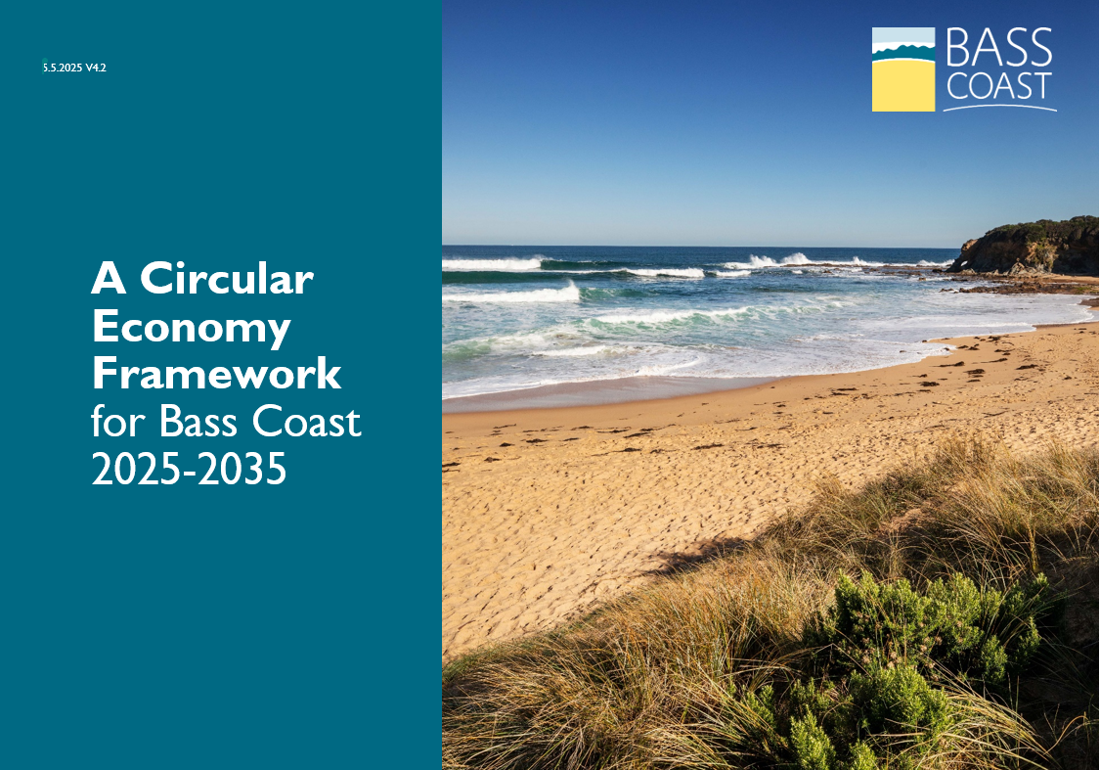


Acting on Climate in Bass Coast:
Our Journey and Mid-Term Review
Bass Coast Shire Council Climate Change Action Plan 2020 -2030
Notes:
Welcome and thank you for joining.
I’d like to acknowledge we are meeting on the lands of Bunurong who are the Traditional Owners and Custodians of the lands and waters, and pay respect to their Elders past and present for they hold the memories, the traditions, the culture, and Lore.
I’d like to extend that acknowledgement to any Aboriginal and Torres Strait Islander people that are here today.
Today we’ll look at how Bass Coast is tackling climate change.
We'll share where we’ve come from, where we are now, and what’s next.

Slide 2
Why we acted
Climate Emergency Declared
In August 2019, Bass Coast Shire Council declared a Climate Emergency
Recognised the urgent need for action to reduce emissions and prepare for climate impacts
Bass Coast was one of the first regional councils in Victoria to do this
The community played a big role in calling for strong action

Slide 3
Climate Change Action Plan
Climate Change Action Plan 2020 - 2030
Created with help from the community, experts and Council staff
Sets a path to net zero emissions for council and community emissions by 2030
Supports the community to reduce emissions and adapt
Focuses on energy, transport, waste, nature and more
For more information on the plan see our Taking Action Webpage and the Community Action Portal

Slide 4
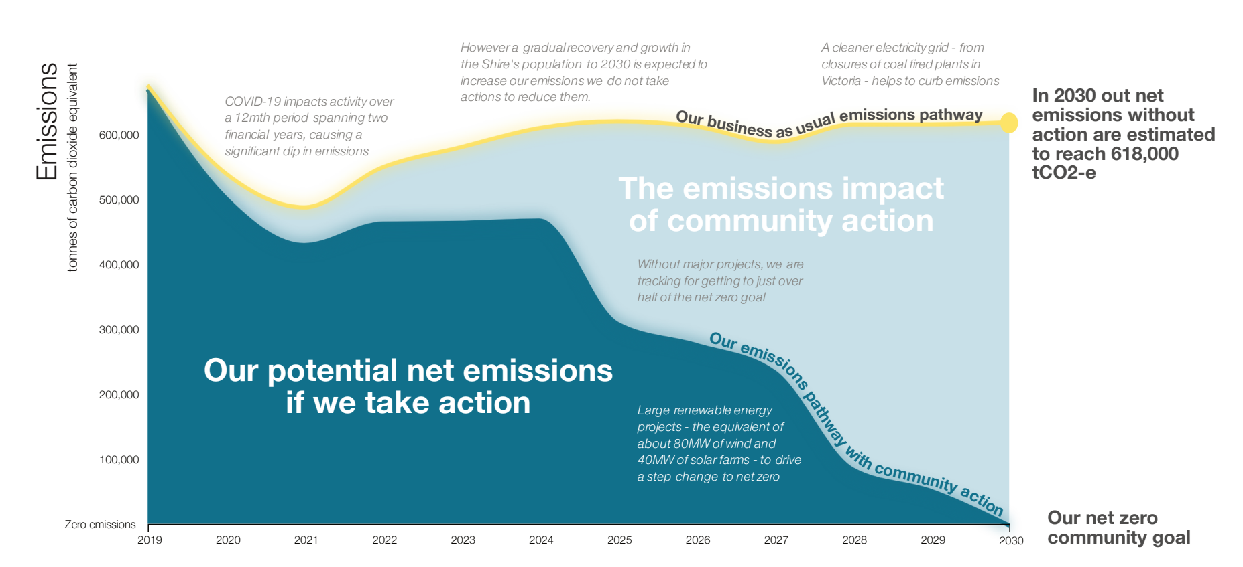
Net zero pathway
Notes:
Community emissions profile from Climate Change Action Plan

Slide 5
What we have achieved so far
Progress since 2020
Switched to 100% renewable energy for Council operations
Supported community action through funding grants and workshops
Installed solar panels on community buildings and supported establishment of resilience hubs with batteries
Transition Council fleet to EV
Developed the Urban Forest Strategy and implemented the Biodiversity Biolinks Plan
Aligned Council policy and strategies with the climate emergency
Notes:
Some Impact Areas
Powering Council operations with 100% renewable energy has reduced Council emissions by almost 2,000 tonnes CO2-e
Living Lightly workshops, available through the Climate Action Portal – link to the calander and encourage participation if you haven’t come across these aleardy
Biolinks has seen over 315,000 plants go in the ground 2021-22 estimated to store 58,000 tonnes CO2-e over 25 years
Council fleet transition – electric and hybrid vehicles comprise approximately 31% of Bass Coast Shire Council’s light vehicle fleet . This falls short of the Council's 2024/25 target of 50%, due to the limited availability of electric vehicles with necessary towing and off-road capabilities for certain operational roles. To support this transition, the Council has also invested in EV charging infrastructure, in process of installing four 22 kW chargers across two sites in Wonthaggi, part funded through a $150,000 state government grant.
Urban Forest Strategy aims to achieve 40% canopy coverage across townships by 2040 – committed to planting 1,500 trees annually (an increase in 1,200 from previous programs), in 2024 this was exceeded at 1,531 trees planted
Biolinks Plan – focuses on creating wildlife corridors to connect remnant vegetation, aiming to revegetate around 200 Ha per year…
Council policy and strategy changes - Divestment from fossil fuels in investment policy, climate considered in Health Plan, climate risk embedded across asset management plans, etc.

Slide 6
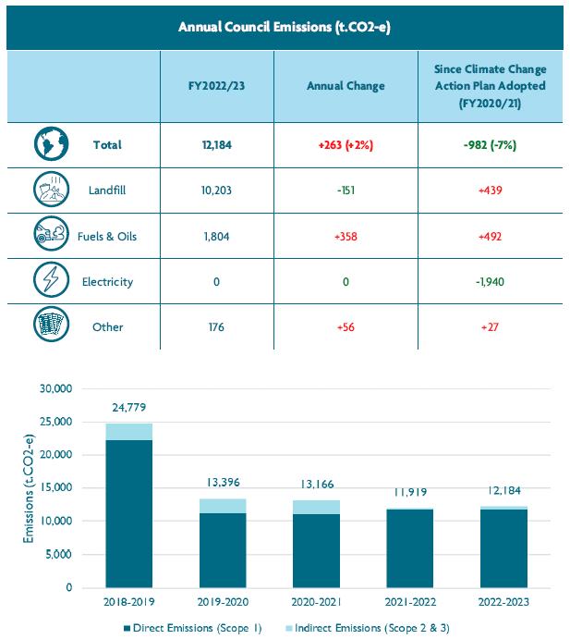
Net zero pathway – Council emissions
Council emissions
FY 2022/23
For more information see Community Action Portal
Notes:
Emissions Source breakdown:
Landfill direct scope 1 emissions methane – some 83.7%
Fuels and oils (diesel, petrol, LPG)
Other: - water, refrigerants, office paper, business related travel

Slide 7
Why a mid-term review?
Checking in at the halfway point
We are halfway through the plan – its time to review and refresh
The world has changed: new science, new technology, new opportunities and learnings
Important to check if our actions are on track and effective and if they still align with community priorities

Slide 8
What the review will look at
Mid-Term review focus areas
Updated community emissions data – how are we doing?
Ask community – what are your climate priorities now?
Audit of Council policies and progress –
  are we living up to our climate commitments?
  What actions are having the greatest impact?
Consider new climate science, policies, learnings and technology

Slide 9
What’s next?
Approximate Timeline
Currently reviewing Council actions in the plan
Community engagement planned for July 2025 – Oct 2025
Evaluation of findings Nov 2025 – Jan 2026
Finalise report and present to Council Feb – March 2026
How to get involved
Register interest for Environment & Sustainability through our Engage Page

Slide 11
Purpose
The draft Circular Economy Framework
guide and support the development of a circular economy in Bass Coast
Considers Council actions and steps to co-create circular opportunities with community
Will be supported by annual action plan and monitoring and evaluation
Links with other Council initiatives:
Bass Coast Climate Change Action Plan
Economic Development Framework
Planning and operation of waste services
Notes:
Council has developed an overarching Circular Economy Framework to guide and support the development of a circular economy in Bass Coast.
It considers Council actions as well as steps to co-create circular opportunities with community.
The framework is supported by an annual circularity action plan that will be developed each year, with monitoring and evaluation of actions to support the implementation of the framework.
The Circular Economy Framework links to several current initiatives, most notably:
Bass Coast Climate Action Plan
achieving Net Zero emissions and building resilience to climate change, cannot be achieved without transitioning toward a circular economy.
Economic Development Framework 2030
Includes circular economy principles and identifies strong contribution to local industry resilience
Day to day planning and operation of Waste Services
including kerbside collection, transfer station and landfill management, community education

Slide 12





Today’s Linear Economy
Take
Make
Use
Dispose
Extract raw materials
Consumer products
Build infrastructure Deliver services
Until worn out, outdated, or redundant
Most materials discarded to landfill
Notes:
The linear economy
The linear model of ‘take-make-use-dispose’ leads to high waste levels, resource depletion, and unnecessary costs, as valuable materials are not recovered or reused efficiently.
Of course this approach also burdens local government and future generations with the costs and impacts of all this inefficiency.

Slide 13
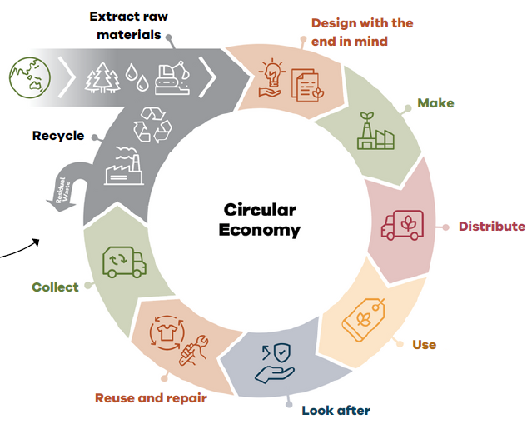
Tomorrow’s Circular Economy
Most materials never become waste
Materials are kept in circulation through
maintenance
reuse
refurbishment
re-manufacture
recycling
Composting
Natural systems are regenerated
Notes:
Transitioning to a circular economy means designing out waste, keeping materials in use for longer, and regenerating natural systems—creating long-term benefits for the environment, society and the economy.
The circular economy is a system where materials never become waste and nature is regenerated.
In this model products and materials are kept in circulation through maintenance, reuse, refurbishment, re-manufacture, recycling, and composting.
CSIRO modelling indicates Australia is operating in about 4.6 per cent circular, Federal government recently released a National CE Framework aiming to double this by 2035
This system wide change provides benefits to nature, society and the economy. It helps us reduce emissions while also regenerating nature- helping deliver on our Nature-positive aspirations, while also providing resilience and improving the self-sufficiency of our community.

Slide 14
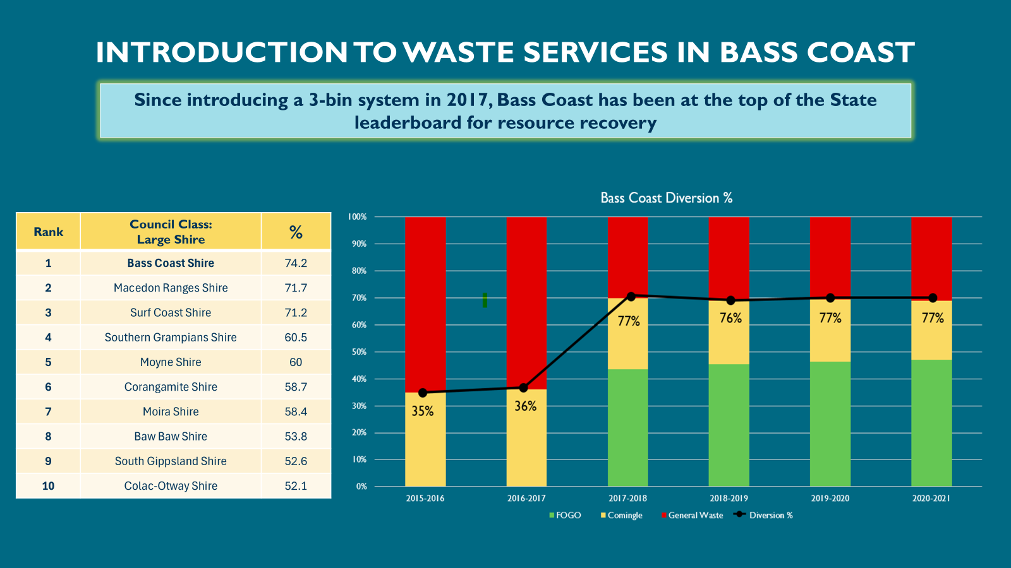
Circularity and emissions reduction
Notes:
Before Bass Coast transitioned to the current 3-bin system, we were recovering only 36% of resources at the kerbside. Two thirds (65%) of kerbside material was being sent to landfill.
With the introduction of the FOGO stream, our resource recovery more than doubled, to >75%.
Landfill emissions have declined by over 50% since the introduction of FOGO.
This success can be entirely attributed to the collection service settings we have adopted -
Bass Coast Shire Council is classified as a Large Shire, one of 19.
Bass Coast Shire ranks 1st among Large Councils and ranks 2nd overall out of the 79 councils in Victoria.

Slide 15
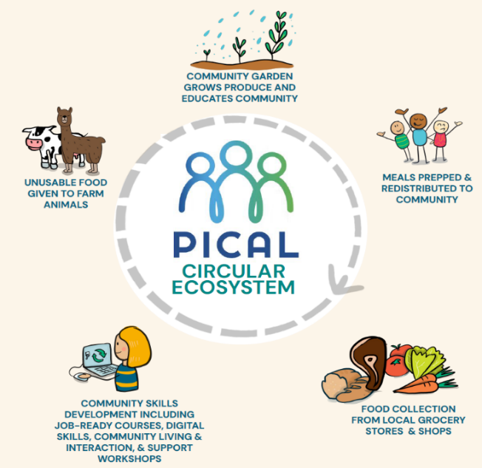
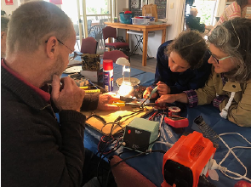
Putting circularity into practice
Putting circularity into practice
PICAL has several circular programs:
redistributing surplus food
upcycling wasted textiles
enhancing social outcomes through education & hands on experience
Wonthaggi Men's Shed has several circular programs:
The WMS Fixit Café provides a free meeting place and it’s all about repairing things (together).
repairs on everything from clothes, furniture, bicycles, and crockery, to appliances, toys, musical instruments, an even sports equipment.
Local Case Studies - Circular Economy Business Accelerator Program | Bass Coast Shire
Notes:
The Phillip Island Community and Learning Centre has several examples of putting circularity into practice;
Rescuing surplus food – each week the team picks up approx. 225 kilograms of surplus food from local supermarkets, community members and the food bank – amounting to 54.1 tonnes of saved food annually.
Food is prepared into meals for redistribution to the community – reaching 50 individuals daily or given to farm animals
PICAL distributes 200 meals per week – providing 4 days of nutritious meals for local households
Supports a repair culture
PICAL Fixit Centre reduces waste by teaching practical repair skills through programs like ‘Girls on Tools’
Community Garden provides fresh organic produce for the food pantry and resource as a local resource for local residents
PICAL provides significant social value to the community while reducing emissions of some 67.3 tonnes of food waste annually, while also reducing environmental impacts of food production.
Wonthaggi Mens Shed
People can attend the WMS Fixit Café to connect with volunteers who help make repairs on everything from clothes, furniture, bicycles, and crockery, to appliances, toys, musical instruments, an even sports equipment.
You can see how the initiative supports social inclusion while keeping resources in use at their highest value (principle 2 of the CE), while diverting waste from landfill (principle 1)
If your interested to find out more about local action – please see link below to local business that participated in a circular economy accelerator program- see link

Slide 16
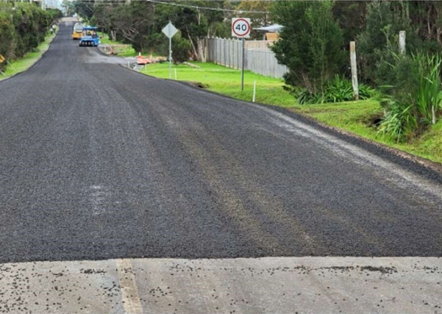
Putting circularity into practice
Bass Coast Shire Council won an award for its sustainable pavement innovation, reusing 3,181 tonnes of recycled materials to revamp a road – all within its existing location.
Notes:
In 2023 BCSC won an award at the 11th AustStab Awards of Excellence
The project reused 3,181 tonnes of recycled materials to revamp an existing road
This prevented the need for 2,558 tonnes of new materials and saved 2,353 tonnes of construction and demolition materials from being discarded
The project reduced truck movements –reducing transport distance by 29,400 km
Saving 16,400 litres of diesel..
You can start to see the benefits not just in reduced emissions from the trucks, but also traffic conjestion, etc. while also reducing the use of raw materials in the road base

Slide 17
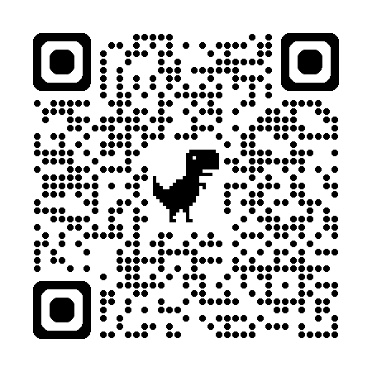
Getting involved…
Circular Economy Engage Page Circular Economy Framework | Engage Bass Coast
Review the draft Circular Economy Framework and provide your feedback through the survey questions or via email to basscoast@basscoast.vic.gov.au
Attend a drop-in or online session – details on the Engage page

