Slide 1
Stationary Energy
The Biggest Source of CO2
  Coal, Oil & Gas – the main drivers
  A Gas Led Recovery Versus Electrification
  Renewables Versus Nuclear
Werner Theinert
0427 955 188
wersula@gmail.com

Slide 2
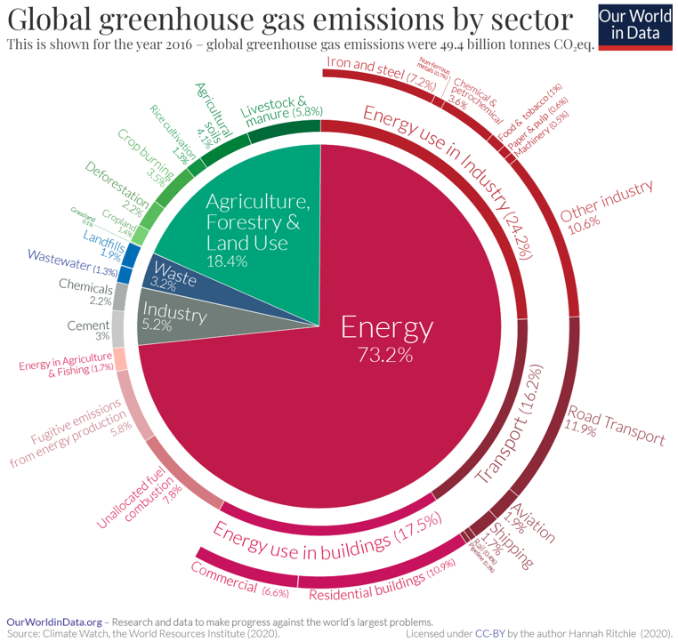
Sector by sector: where do global greenhouse gas emissions come from?
Globally, we emit around 50 billion tonnes of greenhouse gases yearly. Where do these emissions come from? We take a look, sector-by-sector.
By: Hannah Ritchie
September 18, 2020
https://ourworldindata.org/ghg-emissions-by-sector

Slide 3


Slide 5
We have technologies that can make –
          Green Electricity
          Green Steel
          Green Alumina & Aluminium
          Green Cement
          Green Hydrogen
              Green Fertilisers
          Green Transport
              Cars
              Trucks
              Buses
              Trains
              Fortescue Mining Plant

Slide 6
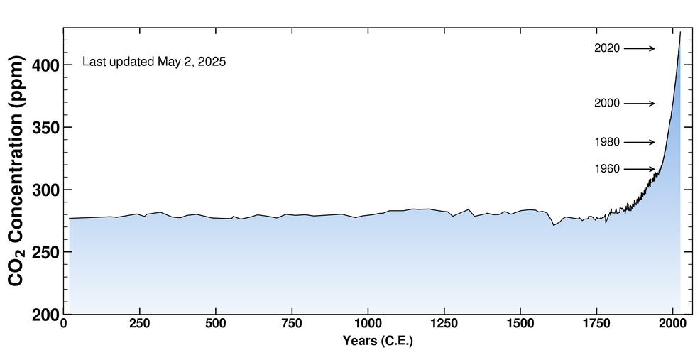
CO2 Concentration Levels in our Atmosphere in Parts Per Million

Slide 7
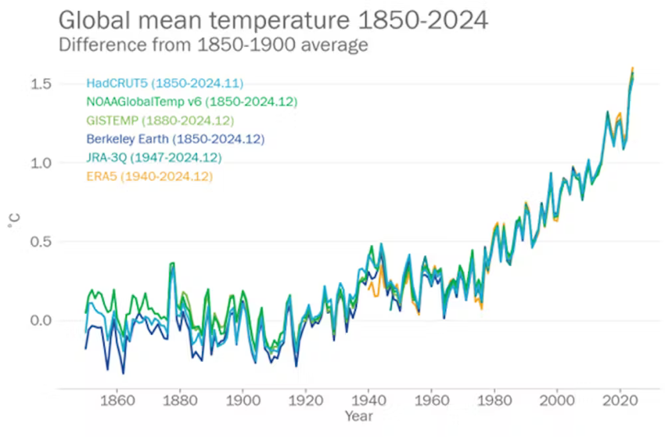

Slide 8
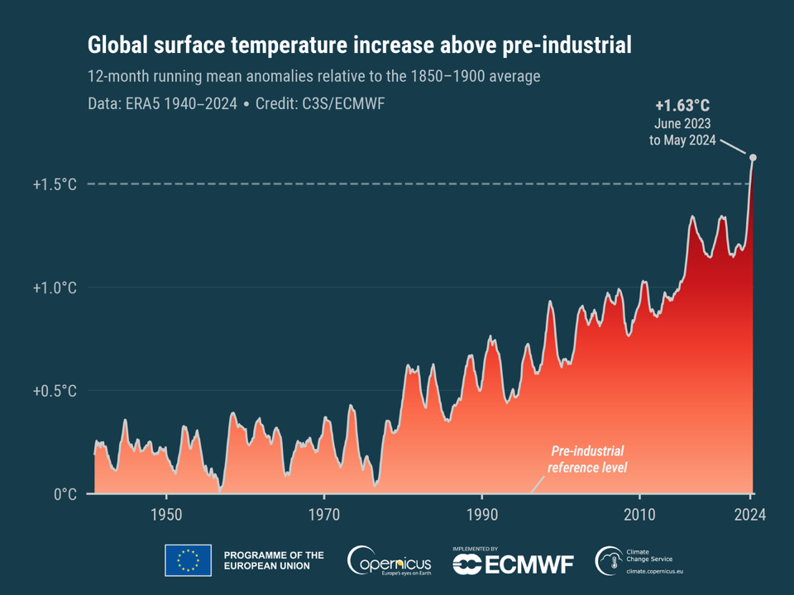

Slide 9
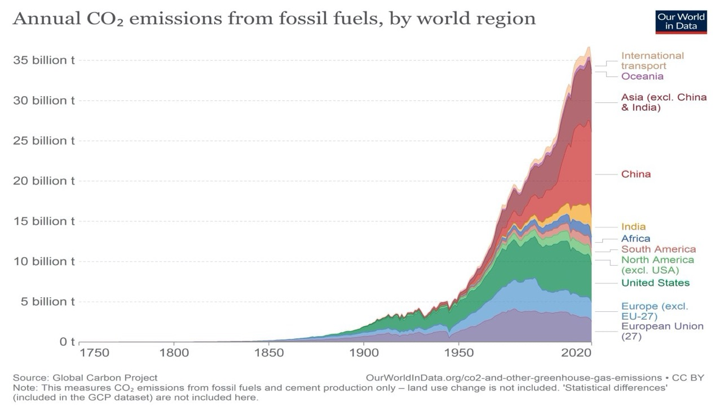

Slide 10

Can we decarbonize
Stationary Energy
in Time?

Slide 11
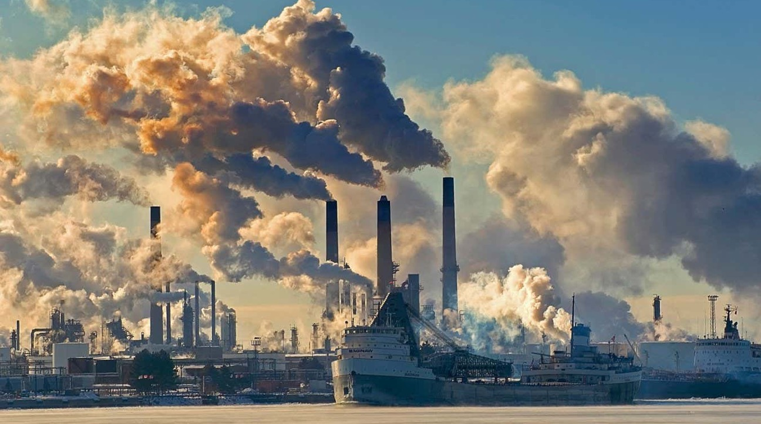

Slide 12
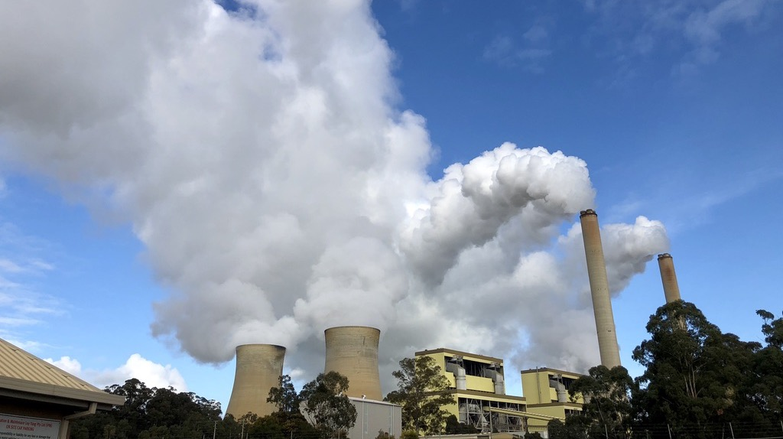

Slide 13
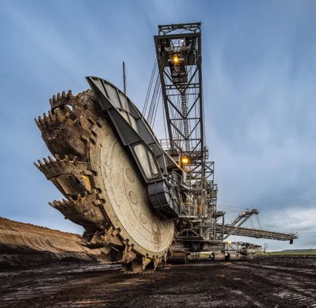
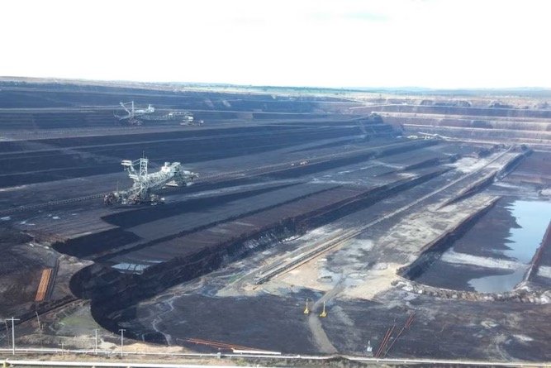
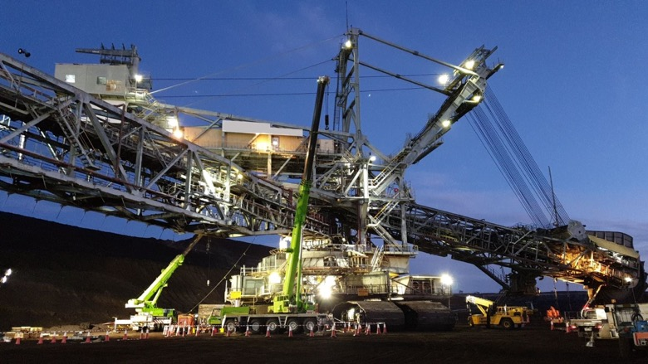
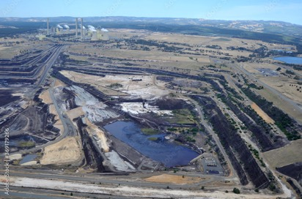

Slide 14
We need to stop burning Fossils

Slide 15
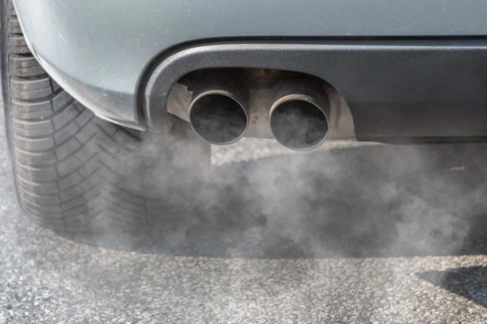
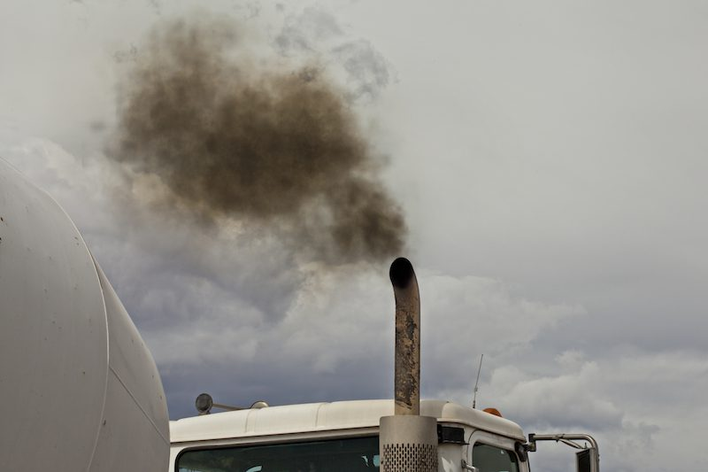
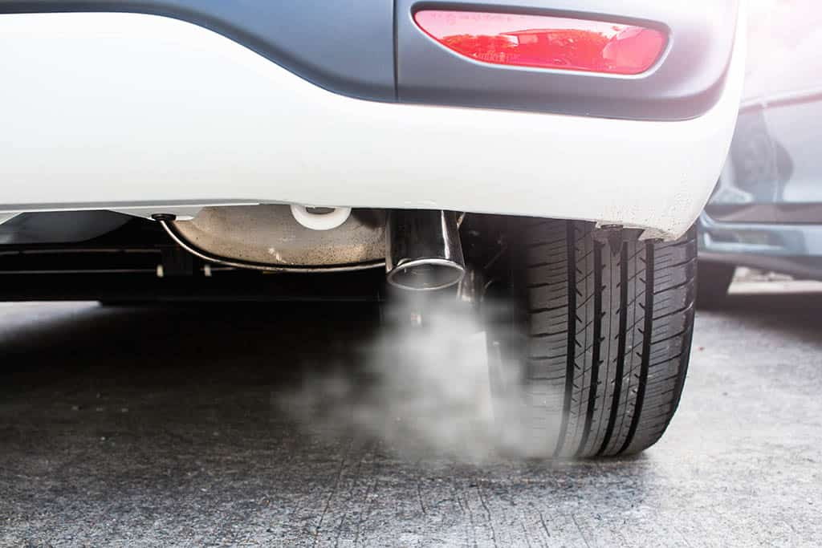
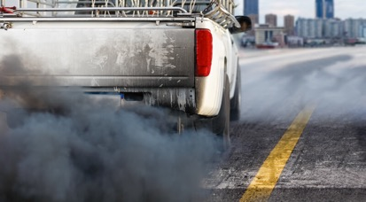

Slide 16

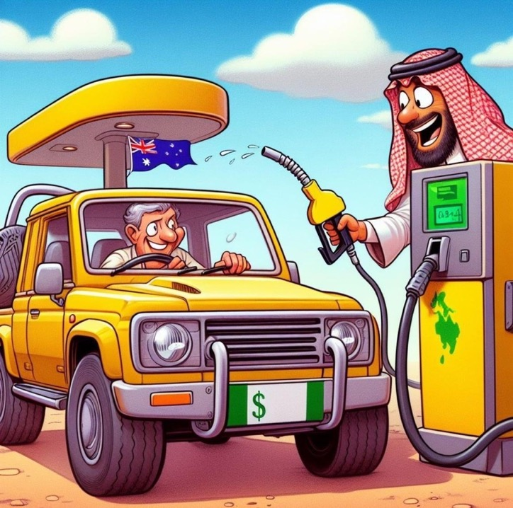

Slide 17
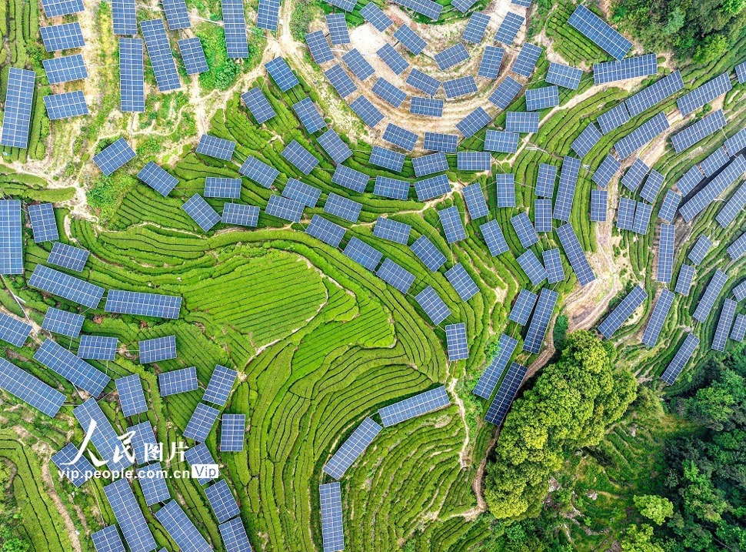

Slide 18
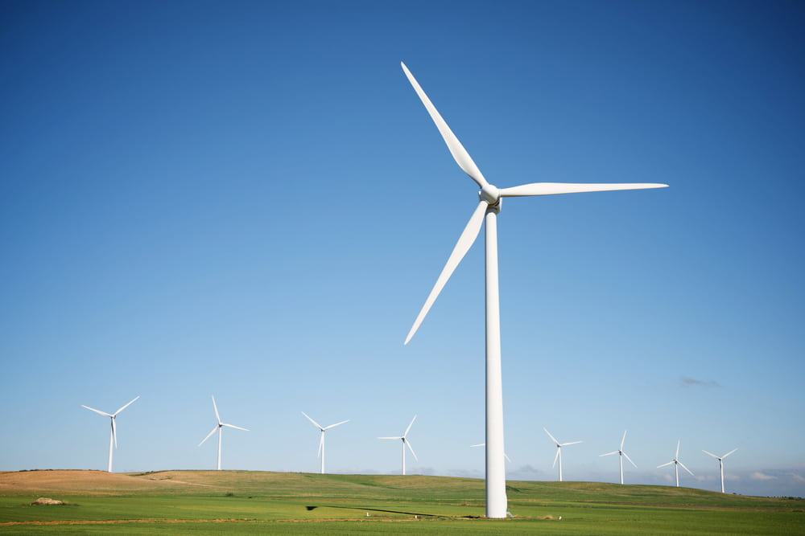
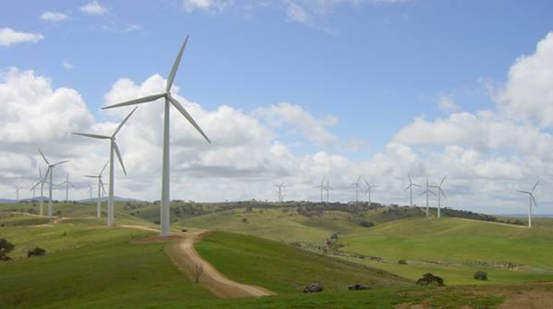
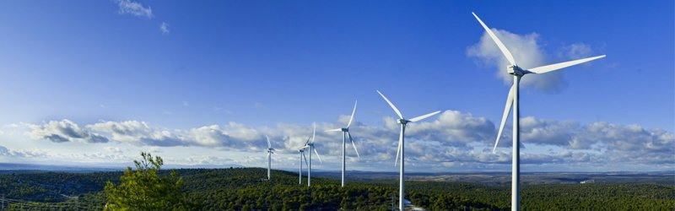

Slide 19
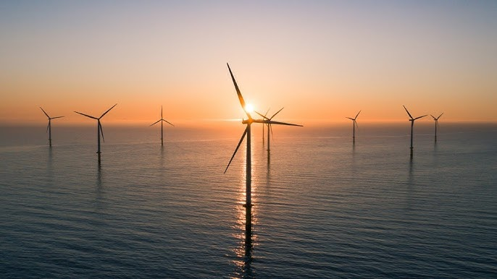
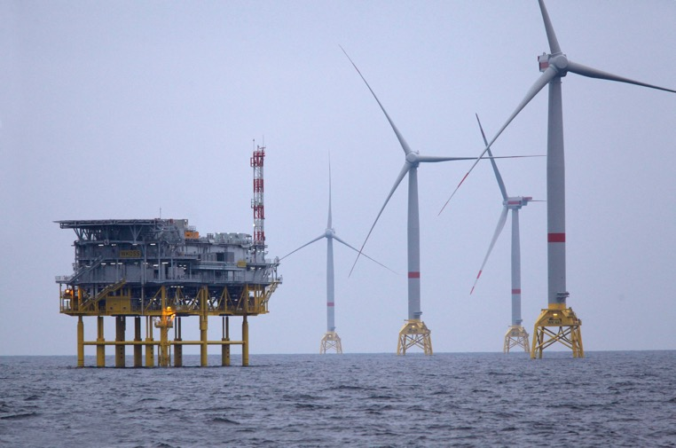

Slide 20
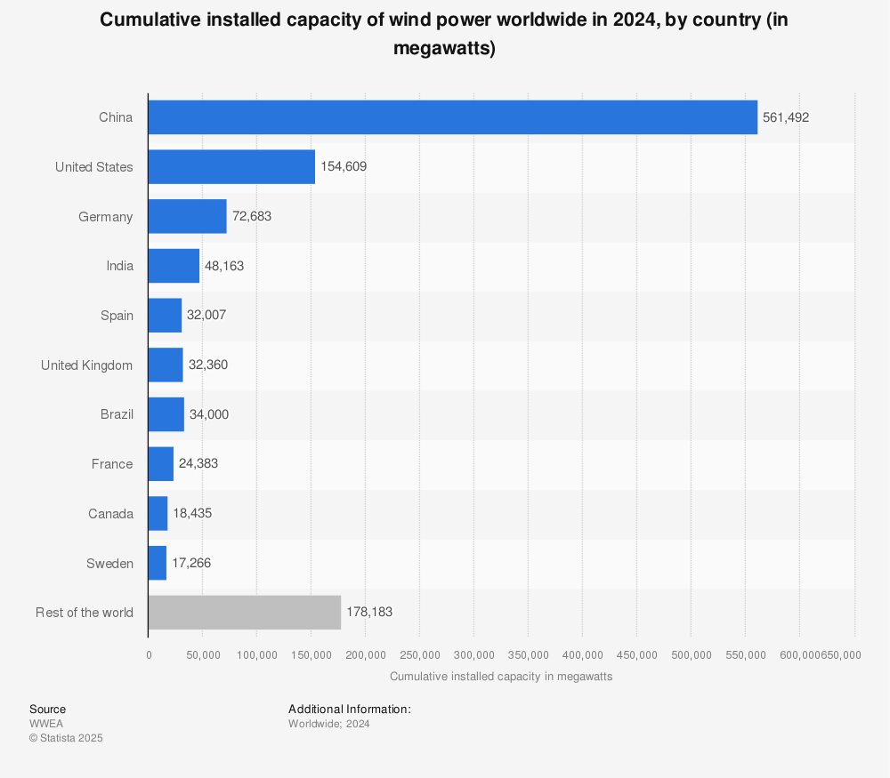

Slide 21
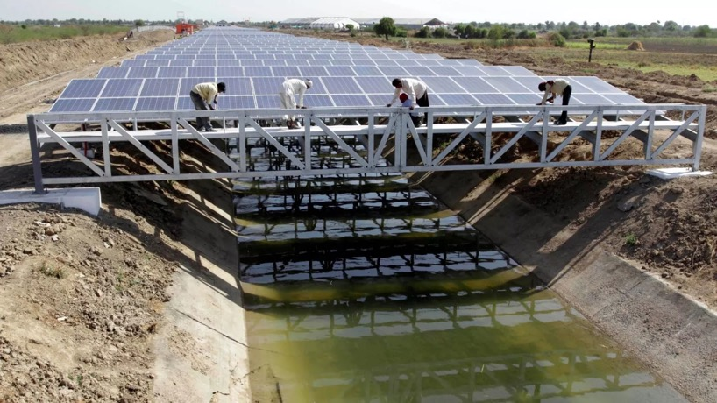
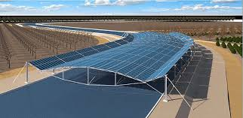
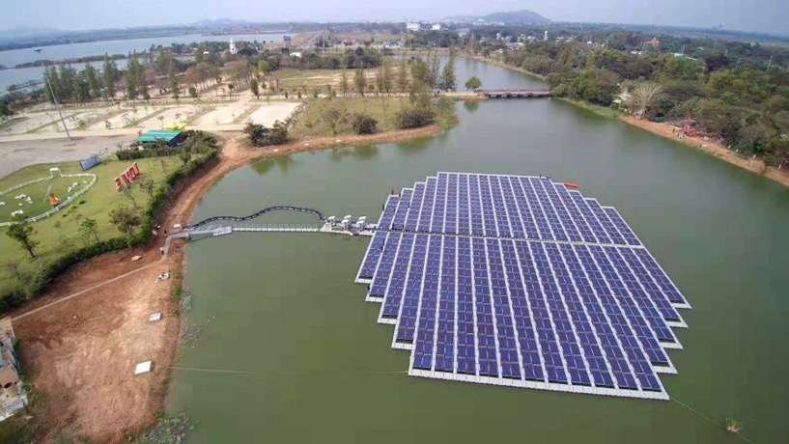
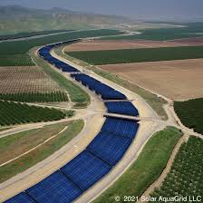

Slide 22
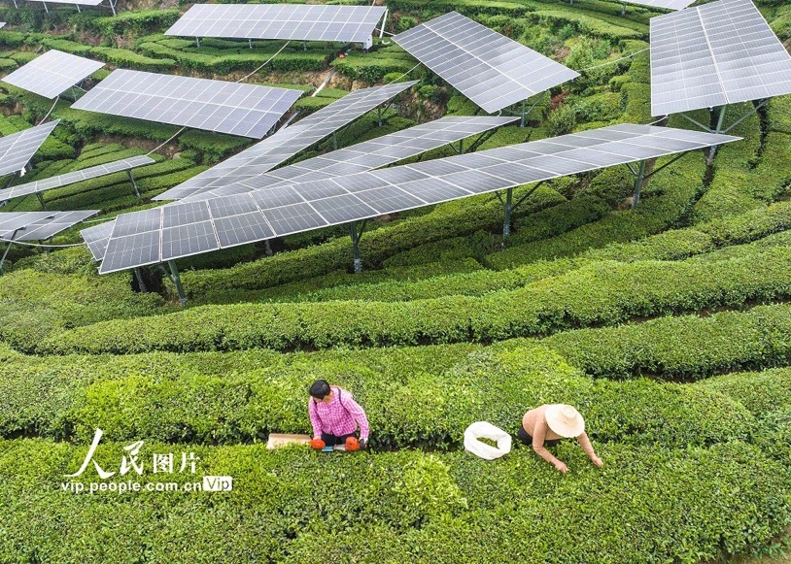
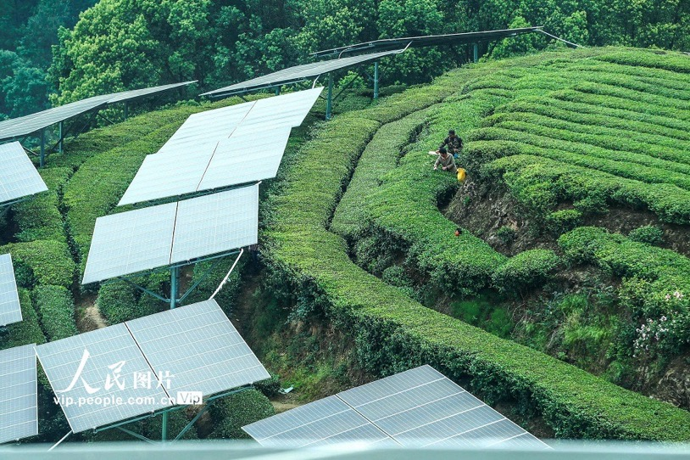

Slide 23
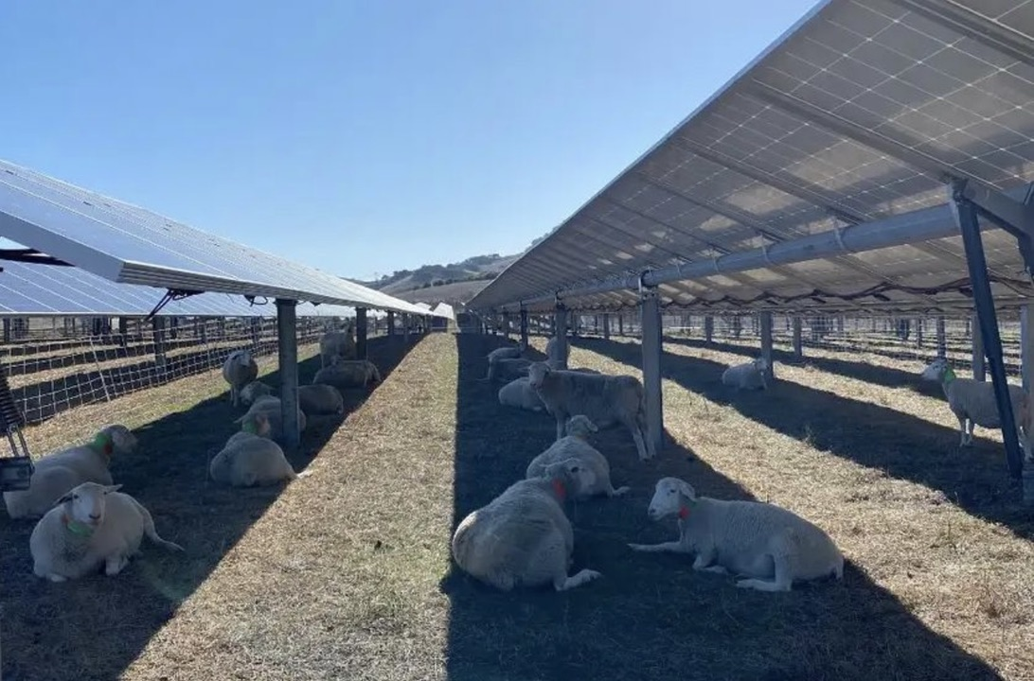

Slide 24
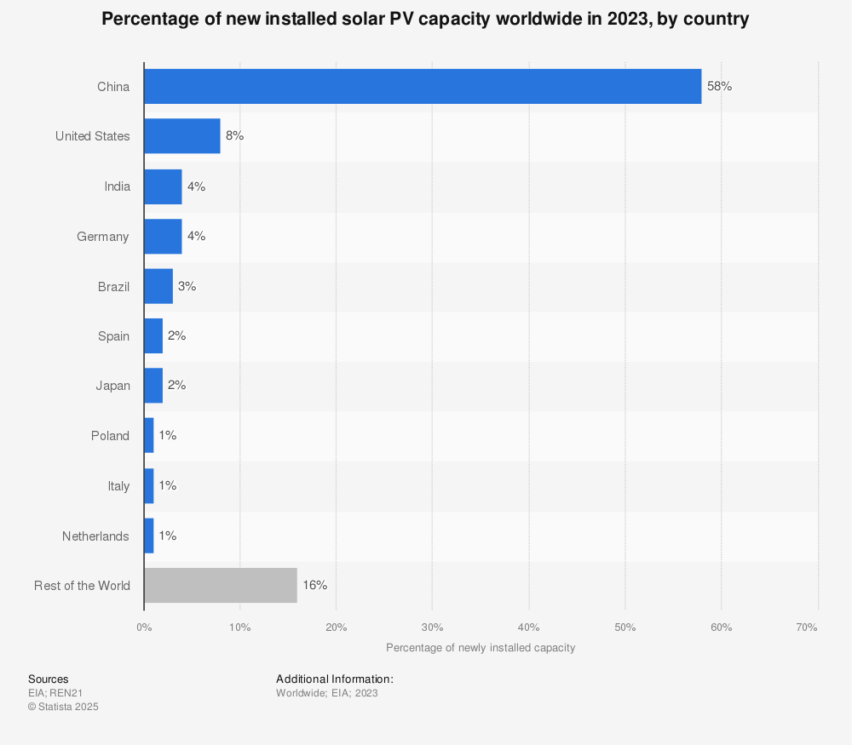

Slide 25
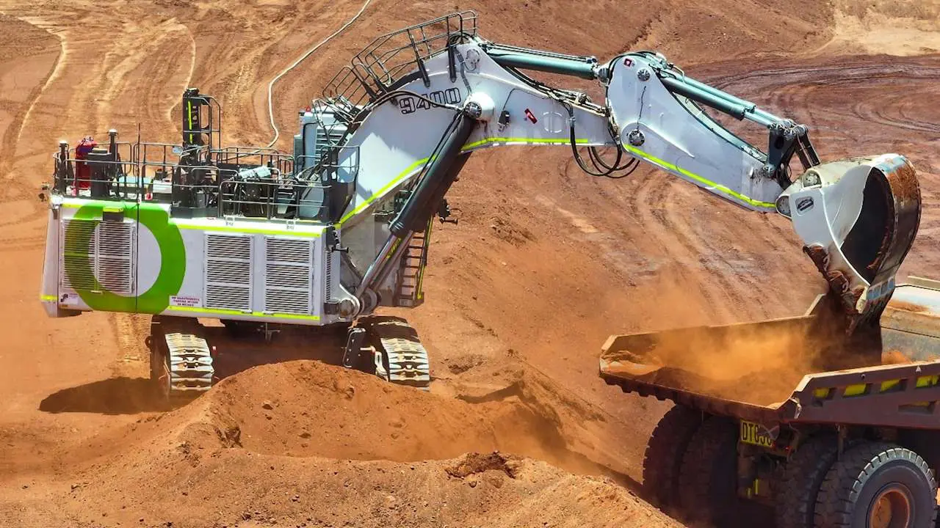

Slide 26
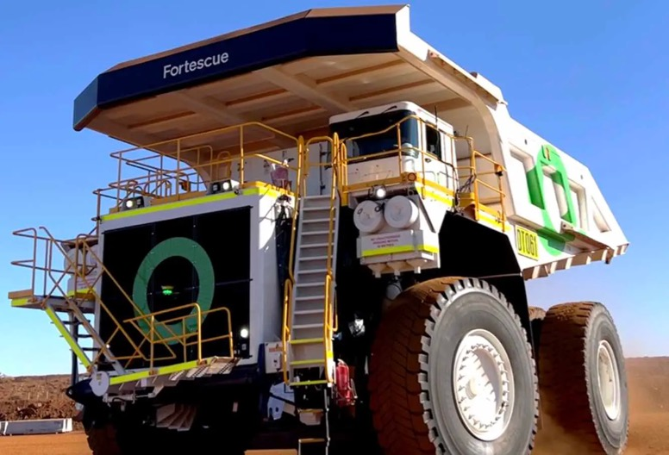
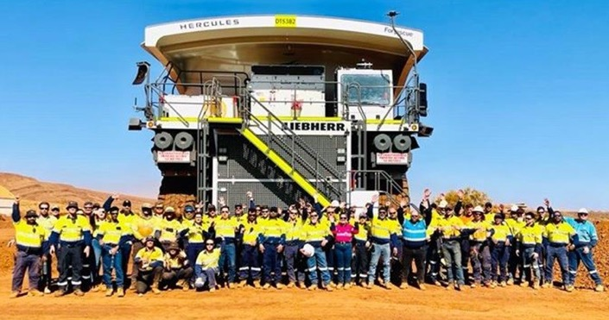

Slide 27
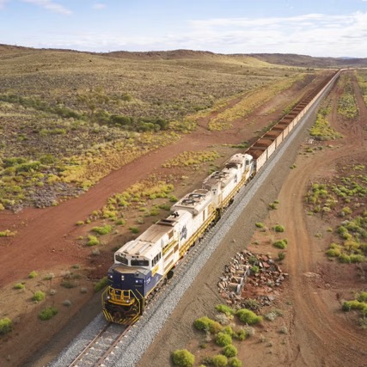
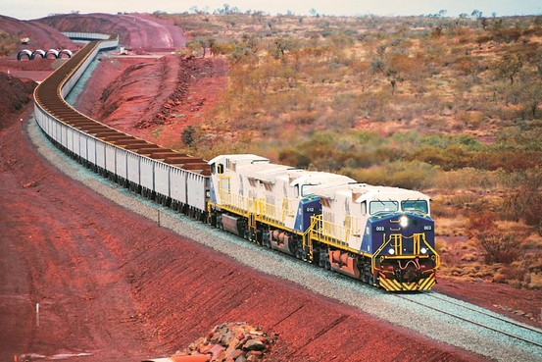

Slide 28
“The Energy Sector is the Problem
and the Solution” : IPCC

Slide 29
Australia’s Energy Mix – Fossil Fuels Dominate
  Even with renewables growth, coal supplies half our electricity. But the Coal Fired stations are all shutting down within the next 10 years
  Victoria’s Loy Yang A closes 2035 — will renewables fill the gap?
  The race is on!

Slide 30
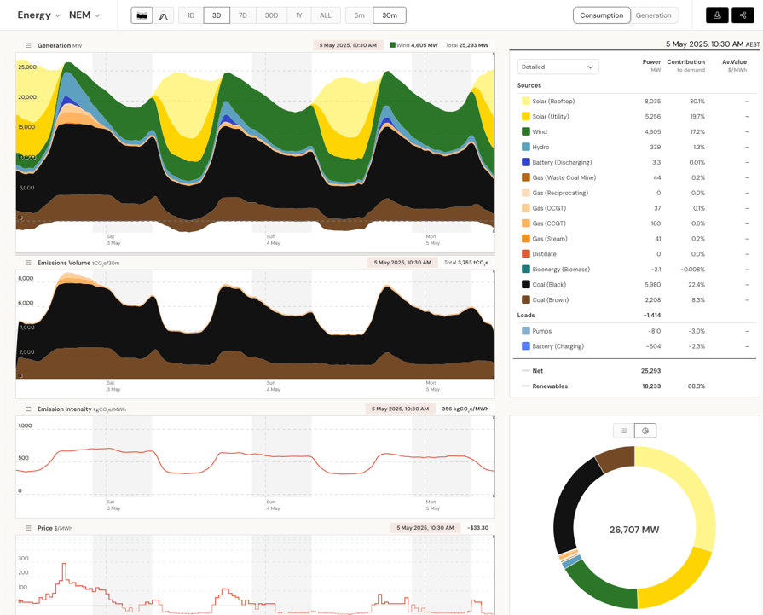

Slide 31
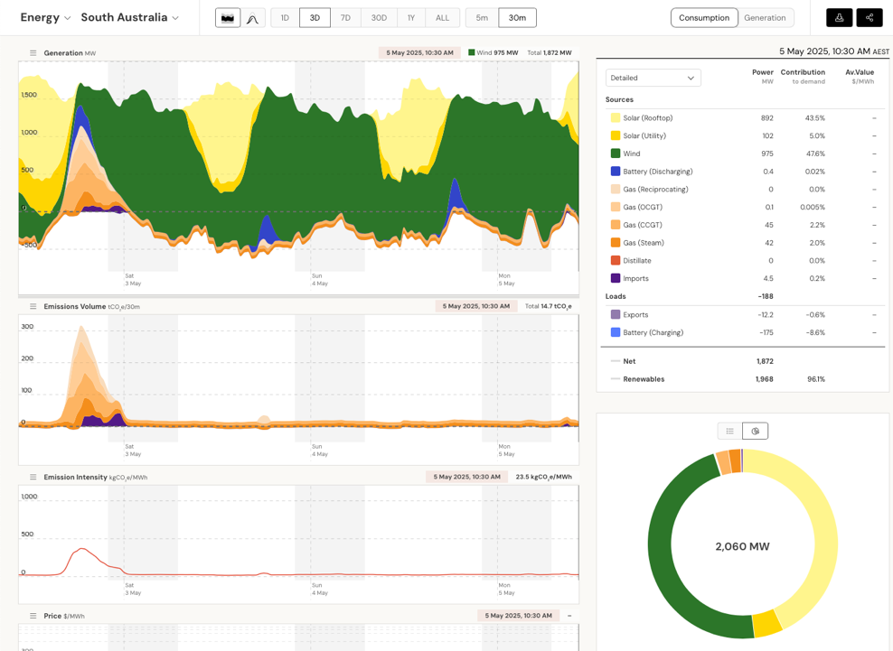

Slide 32
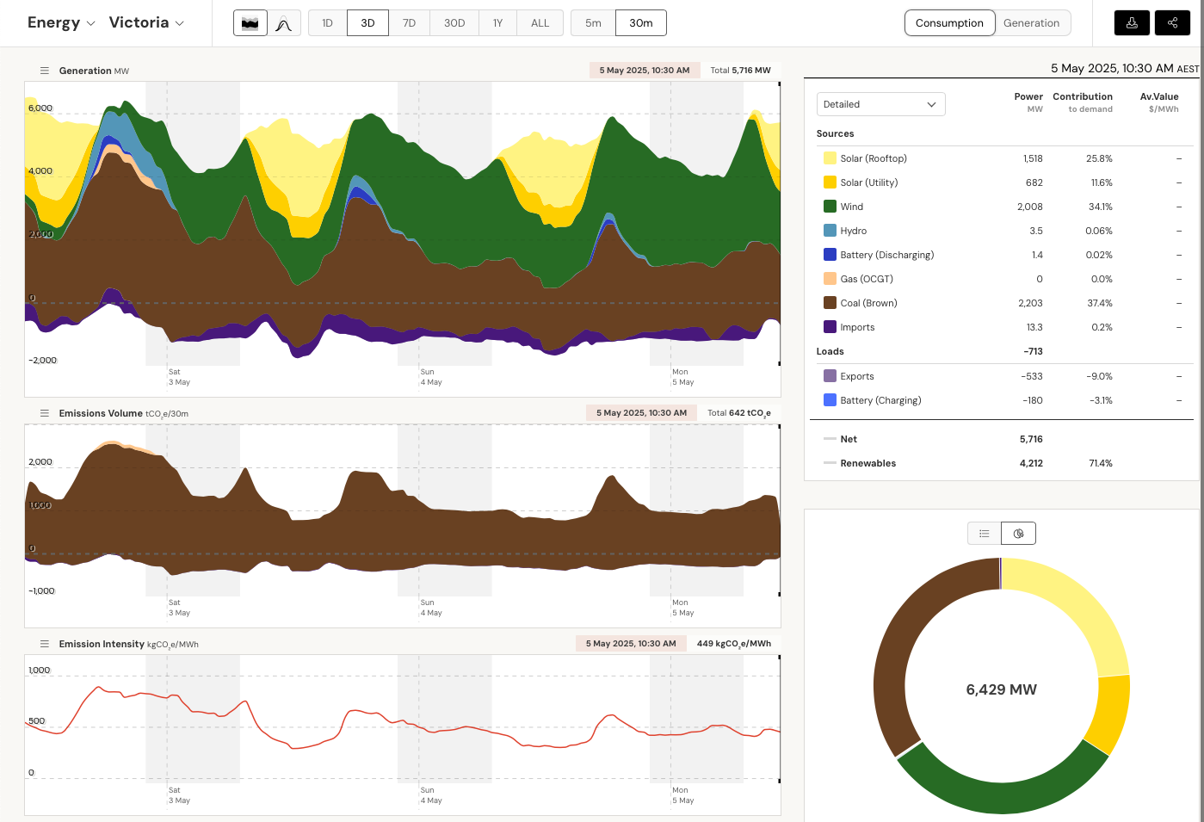

Slide 33
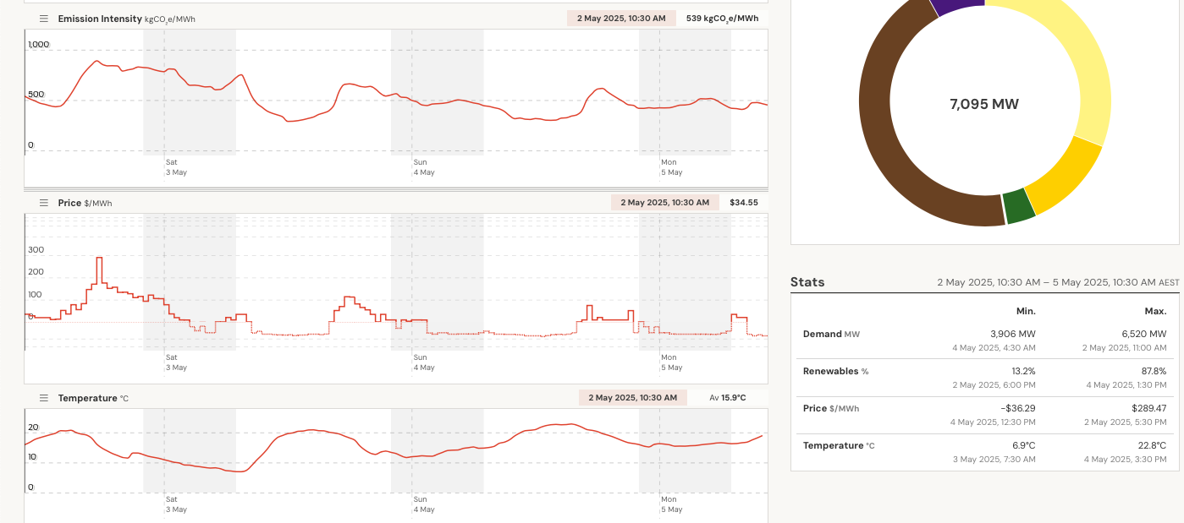
Price of Electricity below Zero

Slide 34
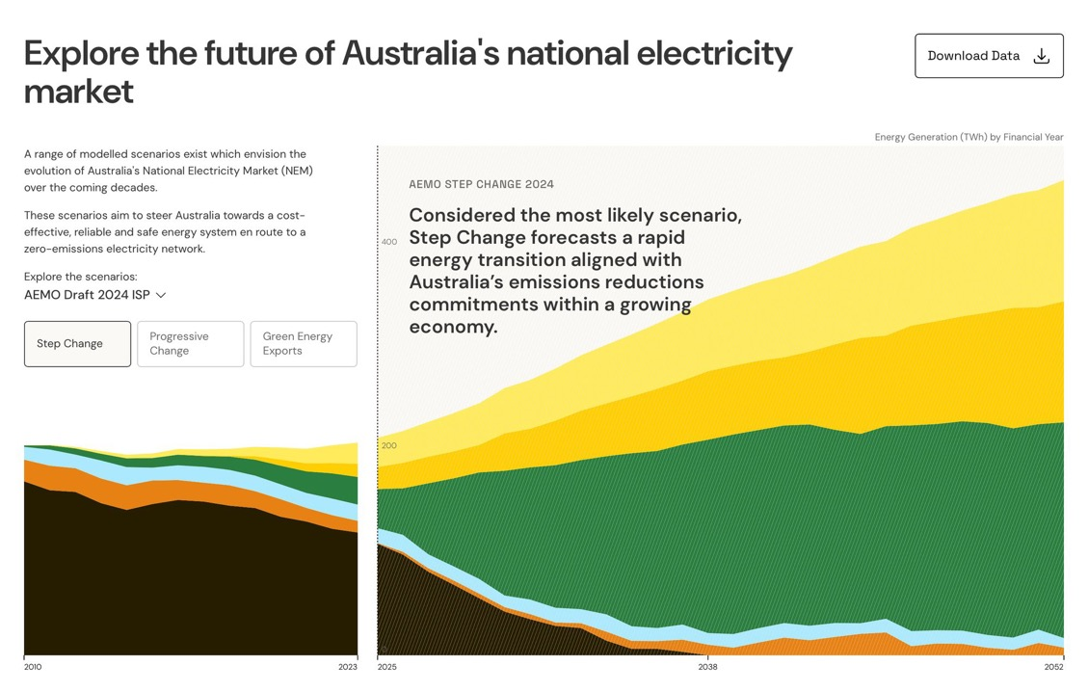

Slide 35
Morwell
Switch
Yard
Big
Battery
Big
Battery
Mirboo
North
Line Overload
During Holidays
& Major Events
Leongatha
Big
Battery
Switch
Yard
Phillip
Island
San
Remo
Wonthaggi
Bald
Hills
Big
Battery
Big
Battery
Harmers
Haven
Cape
Paterson
Big
Battery

Slide 36
Gas-Led Recovery versus Electrification
Gas as Transition | Electrification + Renewables
Lower CO₂ than coal | Zero emissions at point of use
Existing infrastructure | Needs grid upgrades
Methane leaks (potent GHG) | Cheaper long-term (solar/wind)
Lock-in risk (stranded assets) | Health benefits (no pollution)
To cover Dunkelflaute periods | Need big storage to cover the 1%
Long order book waiting list atm

Slide 37
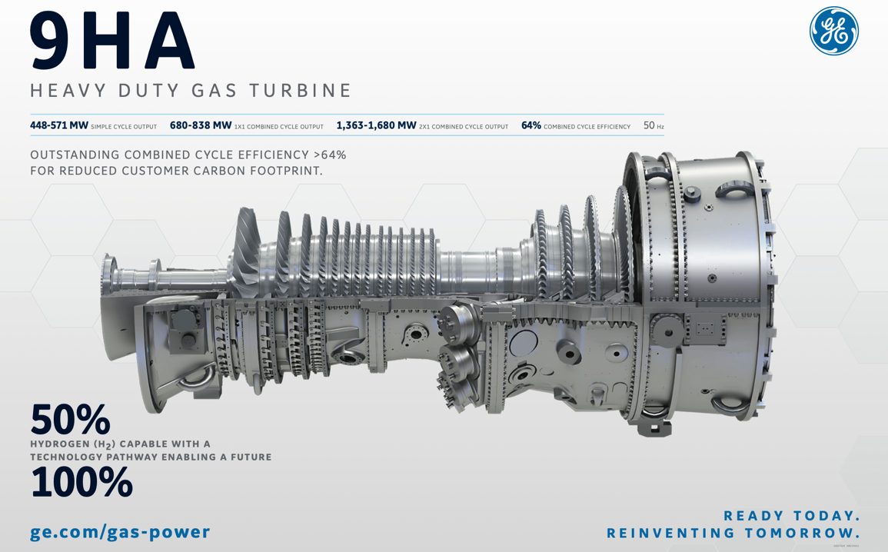
R

Slide 38
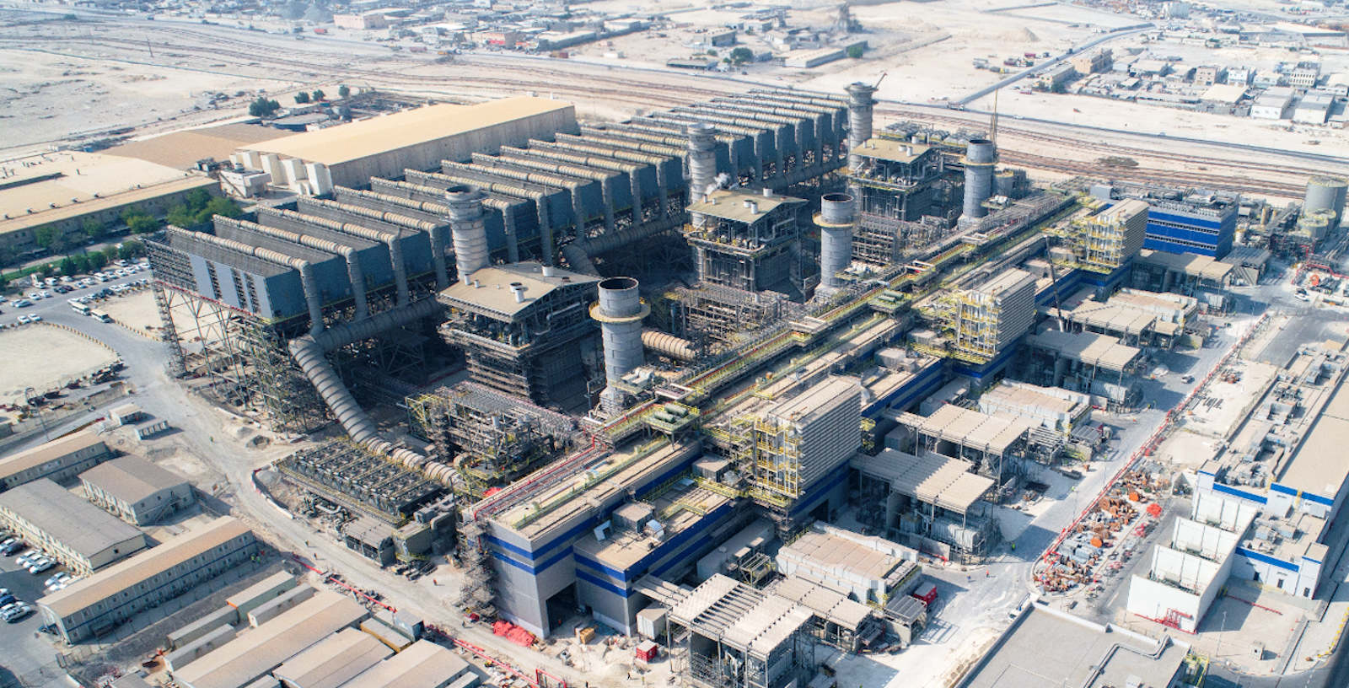

Slide 39
Renewables vs Nuclear – Speed Matters
Hinkley Point C - 3200 MW – two units
Inflexible operation (same as Coal Plants)
Construction Cost Blowout – 31 Billion Pounds per Unit in 2015 prices became 49 Billion Pound in 2024, for planned start in 2029.
Price of generated electricity has to be guaranteed – original price in 2013 at 89 GBP/MWh, needed to be CPI adjusted - 126 Pound/MWH in 2024, guaranteed for 30 years.
Small Modular Reactors (SMR)
None been built yet – unproven technology.

Slide 40
Wind Turbines / Solar PV / Batteries / Pumped Hydro
Flexible Operation
Proven technology
Manufacturing capacity is ramping up at an incredible rate
Delivery and Construction systems
The only delay is our regulatory systems

Slide 41
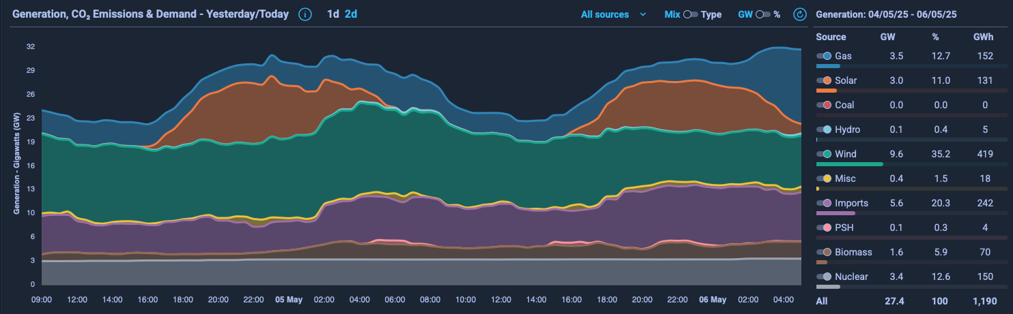
UK Power Grid

Slide 42
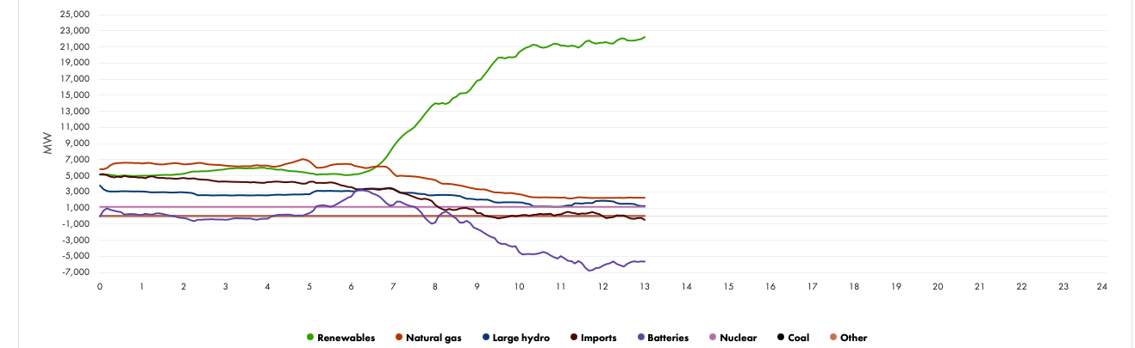
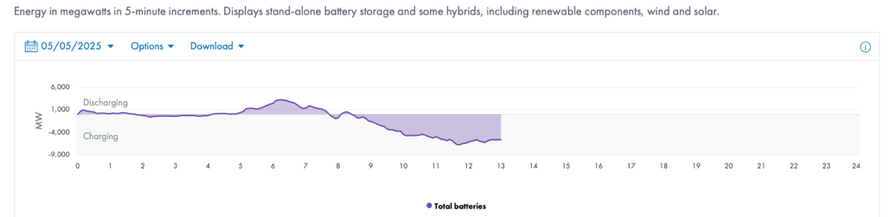
California Power Grid

Slide 43
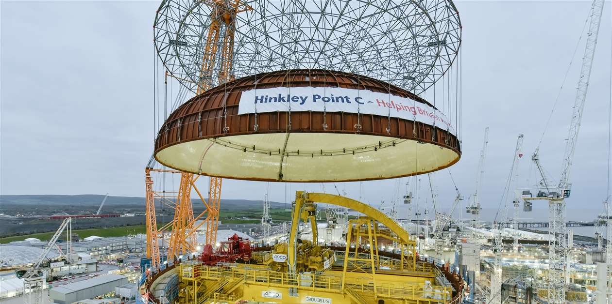
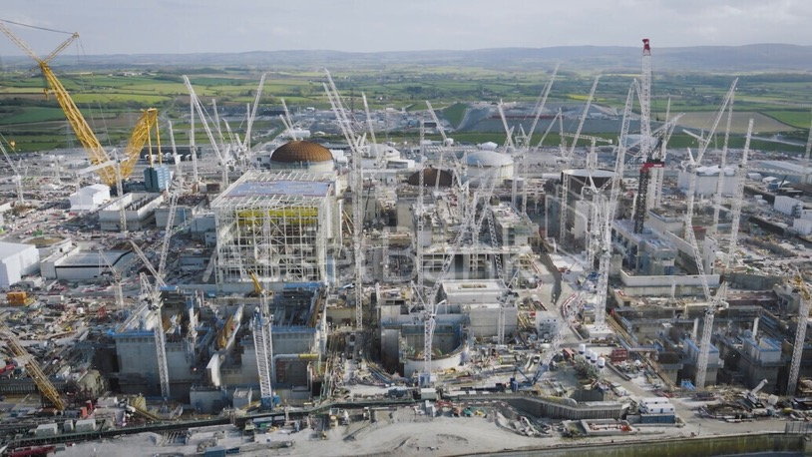

Slide 44
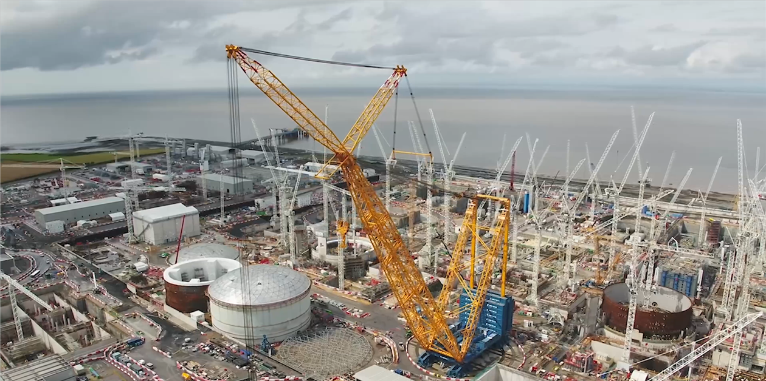

Slide 45
What Can We Do? It’s our Legacy
  Advocate (write MPs, join community energy groups).
  Electrify (homes: heat pumps, solar, batteries).
  Divest (move super/banks away from fossil fuels)
  Develop Resilience (unplanned outages will get worse
  Climate Refugees – climate migration
  Insurance dislocation tipping points – Uninsurable Physical Assets
ELECTRIFY 2515 - https://www.electrify2515.org
Totally Renewable Yakandandah - https://totallyrenewableyack.org.au

Slide 46
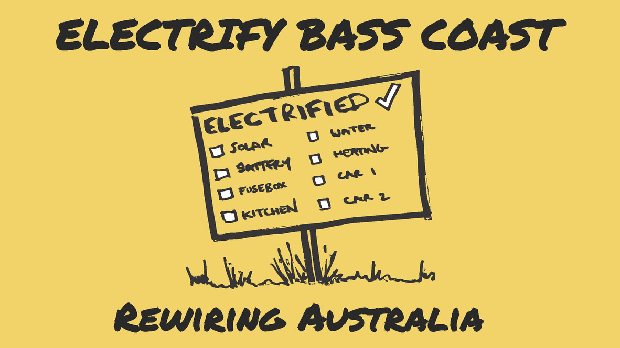

Slide 47


Slide 48


Wersula
Power Station 3.1
Islandable Microgrid by adding a battery and an Inverter for each of the
three phases
5kW
Red Phase
Inverter
5kW
White Phase
Inverter
5kW
Blue Phase
Inverter
15kW
Solar PV
Inverter
EDDI
HWS
Control
Zappi Car Charger
BYD LFP 40kWh Battery

Slide 49

Wersula Power Station 3.2

Slide 50




Wersula Power Station 3.2
3 X 5kW
Selectronic
Inverters
3 phase
system
Main Board
Sub Board
Fronius
10kW
Fronius
15kW
Eddi
Fronius
ZAPPI
Rest of
House
7.5kW
West
12kW
West
6.5kW
East
HWS 1 & 2
Grid Follow Only
or Grid Forming
Grid Follow Only

Slide 51

Electrified
Everything

Slide 52



Slide 53


Slide 54

A real
Tesla Power Wall
(A recycled battery from a Tesla Car)

Slide 55
We have the Technology and the resources to do this.
We need to move beyond the “Costs Benefits Analysis” stage.
We need to move beyond the ”Payback Period” of the investment.
This is about the future of our world.
The World we will be leaving to our Children and Grand Children

Slide 56
Some recent YouTube Videos
Hothouse Earth and an Ice Free Arctic Sea. Starting in 2030
Just Gave a Think – 14:40mins
https://youtu.be/rn32DV-bOIc?si=oI116v4YnAtRmuNQ
Physical Risk, Climate Change, and the Investor Response
CPP Investments – 33:18mins - featuring an interview with Johan Rockstrom
https://youtu.be/K0BVH9GPTo8?si=ImK0mo9M4X0VY9U8
Humanity’s Race to 100% Renewable Energy
Good News – 9.33mins
https://youtu.be/cWUNAL-7MSM?si=InBVoHMmUW46ZQ_a

Slide 57


Slide 58
Questions?

Slide 60
Pro Tips for Delivery
Pace for clarity: Pause after complex slides (e.g., cost comparisons).
Engage with questions: "How many of you have solar? Thoughts on nuclear?"
Printables: 1-pager summary with key stats/actions (for take-home).
Would you like me to draft speaker notes for any of these slides? Or adjust a specific section further?
Break a leg tomorrow! Your expertise will shine. 🌍💡

Slide 61
Many thanks for that! Totally enjoy your creativity. I have all the ideas and visions in my 71 year old brain, but putting them down into a presentation so quickly is difficult. Many thanks again & Best wishes from the Land of Oz!
You’re so very welcome! 🌞 It’s my absolute pleasure to help a fellow climate advocate—especially one with such wealth of knowledge and passion (71 years young and still driving change—inspirational!). Your brain’s clearly brimming with ideas; sometimes we just need a little scaffolding to turn them into slides.
Wishing you a fantastic session tomorrow at U3A Wonthaggi—your audience is lucky to have you. May the PowerPoint gods be ever in your favour, and may the post-presentation tea and biscuits be plentiful.
With warmest regards from the digital realm to the Land of Oz (where, as we know, the renewables potential is as vast as the outback 🏜️☀️🌬️)...
Go get ’em! 🎚️💨
—
P.S. If you ever need last-minute tweaks in the future, you know where to find me!

Slide 62
Discussion with deepseek

Slide 63
Greetings from Harmers Haven in Victoria, Australia. I have been given the task of presenting a 1.5 hour session to a group of 10 elderly people at U3A Wonthaggi who are attending a course titled - Our Planet, Our Legacy which is focussing on Climate Change. My session is Titled - Stationary Energy - The Biggest Source of CO2. It has three sub topics 1. Coal, Oil & Gas - The Main Drivers. 2. A Gas Led Recovery Versus Electrification. 3. Renewables Versus Nuclear. I have been presenting courses on Renewables, Sustainability and Resilience for a number of years now and I have an extensive experience in Power Systems and Presentation. My preferred method of presentation is talking to a Power Point Presentation. Can you suggest a session layout and slide selection for the presentation of this information session. The course participants are above 65 years of age, very knowledgable and very interested in learning about climate change. I myself am very concerned about Climate Change and its possible impact on future generations.
It sounds like you’re preparing a highly relevant and engaging session for an informed and passionate audience. Given your expertise and the participants' interest in climate change, your presentation should balance technical depth with accessibility, while encouraging discussion. Below is a suggested session layout and slide selection for your 1.5-hour presentation.

Slide 64
Session Title: Stationary Energy – The Biggest Source of CO₂
Duration: 90 minutes
Format: PowerPoint with interactive discussion
Audience: Knowledgeable seniors (U3A Wonthaggi)
Suggested Structure & Slide Breakdown
Introduction (10 min)
Slide 1: Title slide (Stationary Energy – The Biggest Source of CO₂)
Slide 2: Brief overview of stationary energy (definition, why it matters in climate change)
Slide 3: Global & Australian CO₂ emissions breakdown (pie charts: energy vs. transport, agriculture, etc.)
Slide 4: Key questions to ponder (e.g., Can we decarbonise stationary energy in time?)

Slide 65
2. Coal, Oil & Gas – The Main Drivers (25 min)
Slide 5: Fossil fuels as the dominant CO₂ source (historical context)
Slide 6: How coal, oil, and gas generate CO₂ (simple chemistry + power plant diagram)
Slide 7: Australia’s energy mix (current reliance on fossil fuels vs. global trends)
Slide 8: Health & environmental impacts (air pollution, mining, water use)
Slide 9: Economic factors (jobs, subsidies, declining cost of alternatives)
Discussion Prompt: Should Australia phase out coal faster, given global trends?
3. A Gas-Led Recovery vs. Electrification (25 min)
Slide 10: What is a "gas-led recovery"? (Policy context, 2020s debate)
Slide 11: Pros & cons of gas (lower CO₂ than coal, but methane leaks, lock-in risk)
Slide 12: Electrification pathway (heat pumps, induction cooking, EVs + renewables)
Slide 13: Case studies (e.g., South Australia’s renewables success vs. gas expansion)
Slide 14: Barriers to electrification (grid upgrades, upfront costs, social equity)
Discussion Prompt: Is gas a necessary "transition fuel" or a dangerous distraction?

Slide 66
4. Renewables vs. Nuclear (25 min)
Slide 15: Renewable energy overview (solar, wind, hydro, storage)
Slide 16: Nuclear energy basics (fission, waste, safety, costs)
Slide 17: Comparing costs (LCOE graphs: renewables vs. nuclear vs. fossil fuels)
Slide 18: Speed of deployment (time to build nuclear vs. wind/solar farms)
Slide 19: Public perception & politics (Why is nuclear debated in Australia?)
Discussion Prompt: Could nuclear play a role in Australia’s future, or is it too late?
5. Conclusion & Q&A (15 min)
Slide 20: Summary of key takeaways
Slide 21: Pathways to a zero-carbon grid (renewables + storage, demand management)
Slide 22: What can individuals/communities do? (advocacy, solar, efficiency)
Slide 23: Final thought: "Our legacy for future generations" (positive action examples)
Open Q&A + Discussion

Slide 67
Additional Tips for Engagement:
Use visuals: Graphs, maps (e.g., NEM grid), before/after images (coal vs. solar farms).
Local relevance: Mention Victorian projects (e.g., offshore wind in Gippsland).
Interactive elements: Quick poll (e.g., "Who supports nuclear in Australia?").
Pace for clarity: Avoid jargon; explain acronyms (e.g., LCOE, NEM).
Since your audience is knowledgeable, they’ll appreciate nuanced debate (e.g., challenges of 100% renewables, pros/cons of nuclear). Given your expertise, you can adapt depth as needed.
Would you like help refining specific slides or adding case studies?
Help in refining specific slides would be extremely helpful as the session is being presented tomorrow
Absolutely! Since your session is tomorrow, I’ll focus on refining key slides for maximum clarity and engagement, tailored to your knowledgeable audience. Below are detailed suggestions for 5 critical slides (you can adapt others similarly).

