Slide 1
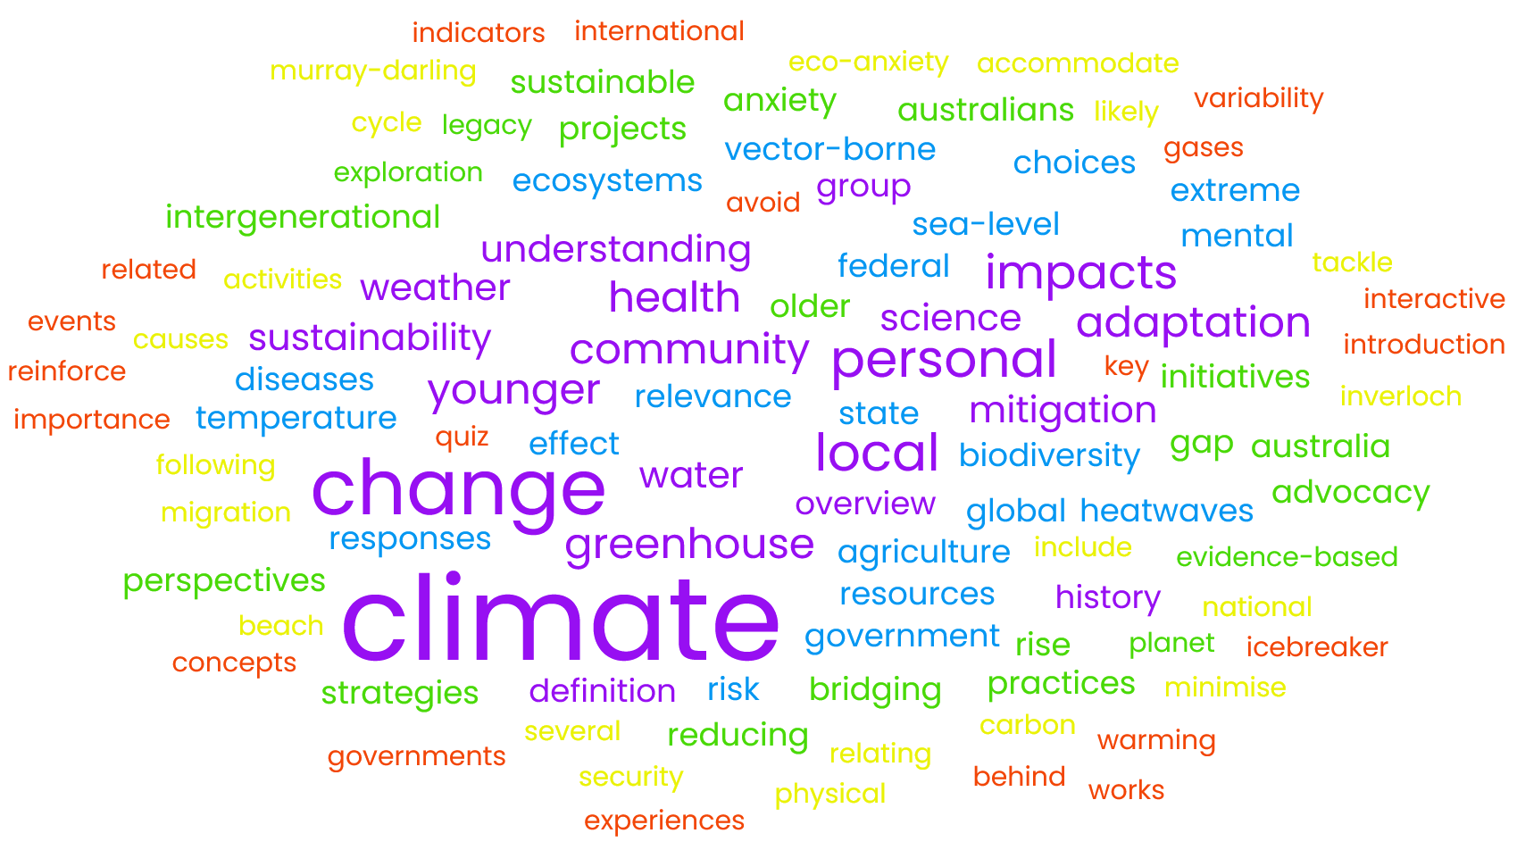
Our Planet, Our Legacy: Understanding Climate Change
U3A Wonthaggi
Session 2
29/4/2025

Slide 2
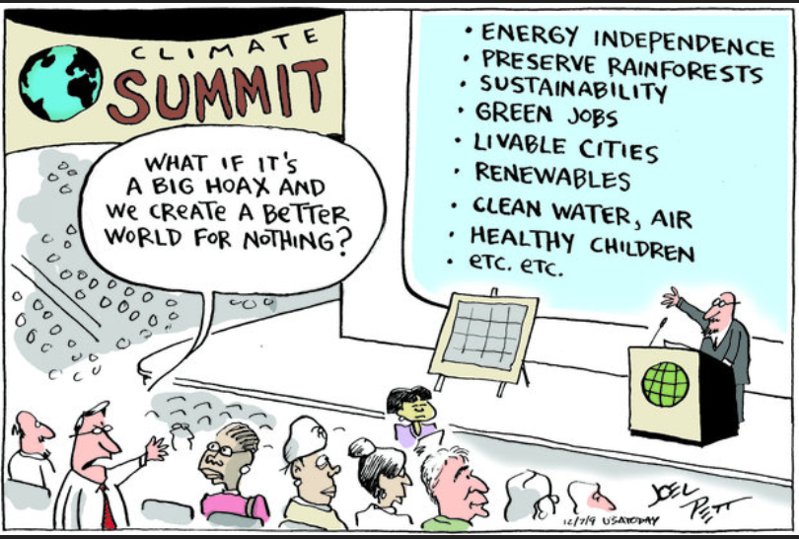
Before we start …

Slide 3
… sadly, it’s not a “big hoax” …
IPCC 2023 Summary for Policymakers:
“A1. Human activities, principally through emissions of greenhouse gases, have unequivocally caused global warming, with global surface temperature reaching 1.1°C above 1850-1900 in 2011-2020.” (emphasis added)
[MNN: 2024: 1.55 °C ± 0.13 °C]
https://www.ipcc.ch/report/ar6/syr/downloads/report/IPCC_AR6_SYR_SPM.pdf and https://wmo.int/media/news/wmo-report-documents-spiralling-weather-and-climate-impacts

Slide 4
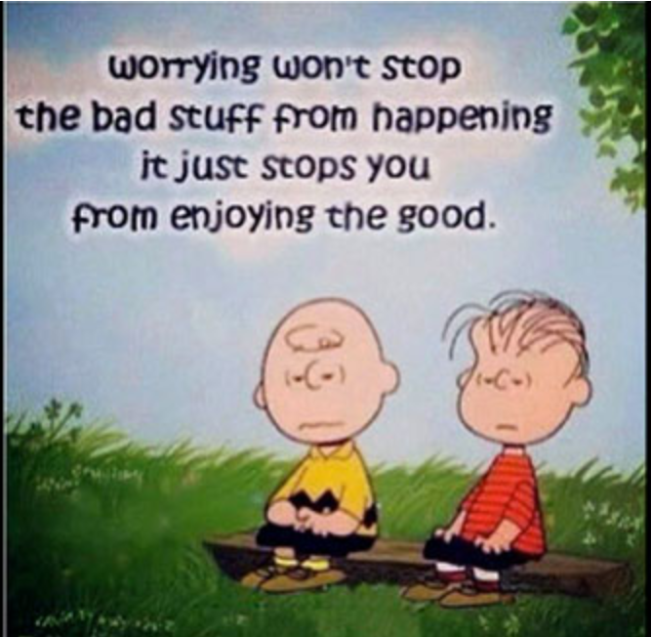
… still, I’m not sure we are creating a better world, yet.
Nonetheless:

Slide 5
Today
Reflections on last week
  Volunteer for next week’s reflections?
The heating of the atmosphere – John
Water, carbon and methane cycles
  Stocks and flows
CO2e – adding apples with oranges
Some mitigation options

Slide 6
Reflection on last week
Different backgrounds; different levels and types of knowledge
We all agree that climate change is happening, now
It’s dangerous, scary, existential … not enough is being done
We all want action on climate
Not an action group
Many, many others groups are:
  Bass Coast Climate Action Network (Bass Coast CAN)*
  ACF, Environment Victoria, Rising Tide, XR, Market Forces, Australasian Centre for Corporate Responsibility, Vote Climate, Get Up!, Climate for Change, Climate Reality Project, Greenpeace, Wilderness Society, BZE, VCAN, CANA, Climate Council, 350.org, etc, etc.**
  Specialist groups for: women, religious, youth/students, artists, farmers, vegetarians/vegans (Less Meat Less Heat), doctors, other health workers, teachers, psychologists, investors, public transport users, policy wonks, etc, etc.**
* www.facebook.com/BassCoastCAN; to join the e-mail list (usually just one e-mail per moth) contact basscoastcan@gmail.com
** Websites for most of these groups are at https://vcan.net.au/find-a-group/

Slide 7
If not about action why are we here?
A learning group:
  share information*
  think about topics from different perspectives
  learn from each other
  expand our own knowledge base
Explore a range of topics
  Some might: reinforce; challenge us to think differently; be new
  Hopefully, all add value to you and/or you add value for others
  Occasional “solutions” or directions of travel
Consider does it (should it) fit with our personal frameworks?
  E.g., more persuasive, better listener, new direction …
Help us each decide/clarify what actions we want to:
  see/encourage/demand from others – individually and collectively
  take ourselves: be the change, activist, better citizen, blogger …
Help make those actions more effective
Solidarity
* (a) http://u3aclimate2025.fastmail.fm – no username; password = Wonthaggi (not a secure site). (b) Mik Aidt: https://climatesafety.info/

Slide 8
Revised topics
Stationary energy – the biggest source (Werner?):
  Coal, oil and gas: the main drivers
  A gas lead recovery v’s electrification ; renewables v’s nuclear
Equity:
  winners and losers – people, global and local
  humans v other species – biodiversity loss
  legal attempts to bridge the gap
Bass Coast and Tipping points:
  mid-term review of the 2020-30 Carbon Action Plan
  BCSC emergency planning
  have we reached tipping points, if so what now, e.g., the importance of adaptation
Health and Economics
  physical and mental health (Michelle)
  economic impacts of the climate crisis
  different models:: Keynesian, neoliberalism, donut economics and degrowth
Regaining the momentum
  the inability/unwillingness of politicians and businesses to act quickly
  mis/disinformation and other strategies to keep the status quo (Big Coal, Atlas Group, etc)
  getting “cut through” for the true climate message
Physical geography and local case study – Inverloch (Aileen)
Intergenerational dialogue
The last word, summary, wrap-up, what do we do now …

Slide 9
Outline
Reflections on last week
  Volunteer for next week’s reflections?
The heating of the atmosphere – John
Water, carbon and methane cycles
  Stocks and flows
CO2e – adding apples with oranges
Some mitigation options

Slide 10
John Di Stefano
The Heating of the Atmosphere
The purpose of this story is to give you an understanding of the reason why the Earth has been heating over the last two hundred years and why it will continue to heat.
This is the story of the simple molecules that constitute the Earth’s atmosphere – the air we breathe!
The impact of this heating of the atmosphere on Earth’s climate I will leave to others. PDF file

Slide 11
1. What is energy?
A. The ability to do work (any physical activity)
2. Energy can be converted from one form to another. What are these forms?
Energy
Thermal
(heat)
Radio
Electro-
magnetic
Micro-
waves
Infrared
Visible
light
Etc.
Etc.
Potential
(stored)
Kinetic
(in motion)
Chemical
Nuclear
Etc.
Elastic
Mechanical
A battery
Food
Etc
Fossil fuels
/

Slide 12
Outline
Reflections on last week
  Volunteer for next week’s reflections?
The heating of the atmosphere – John
Water, carbon and methane cycles
  Stocks and flows
CO2e – adding apples with oranges
Some mitigation options

Slide 13
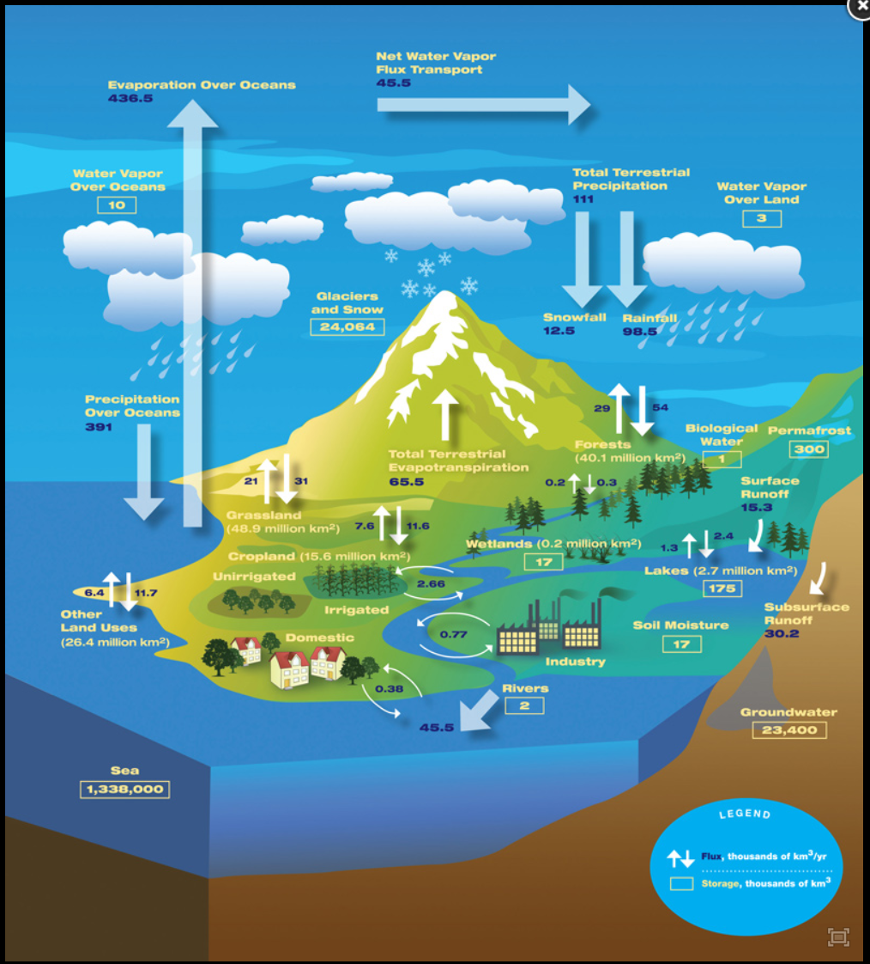
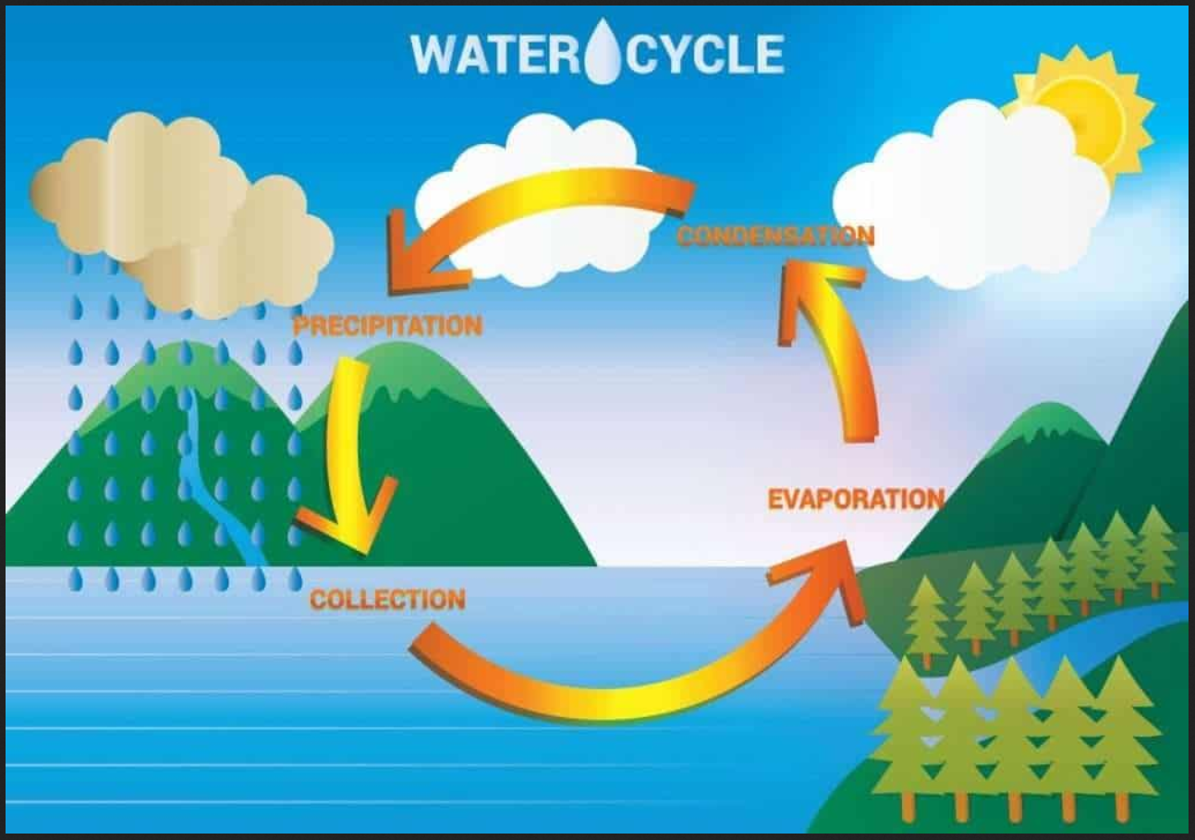
The water cycle
- stocks (sources and sinks), versus
- flows (or fluxes)
- accounting analogy: balance sheet versus P&L
https://jotscroll.com/wp-content/uploads/2021/09/Water-cycle-diagram-1-1024x717.jpg and https://airs.jpl.nasa.gov/resources/151/the-water-cycle/

Slide 14
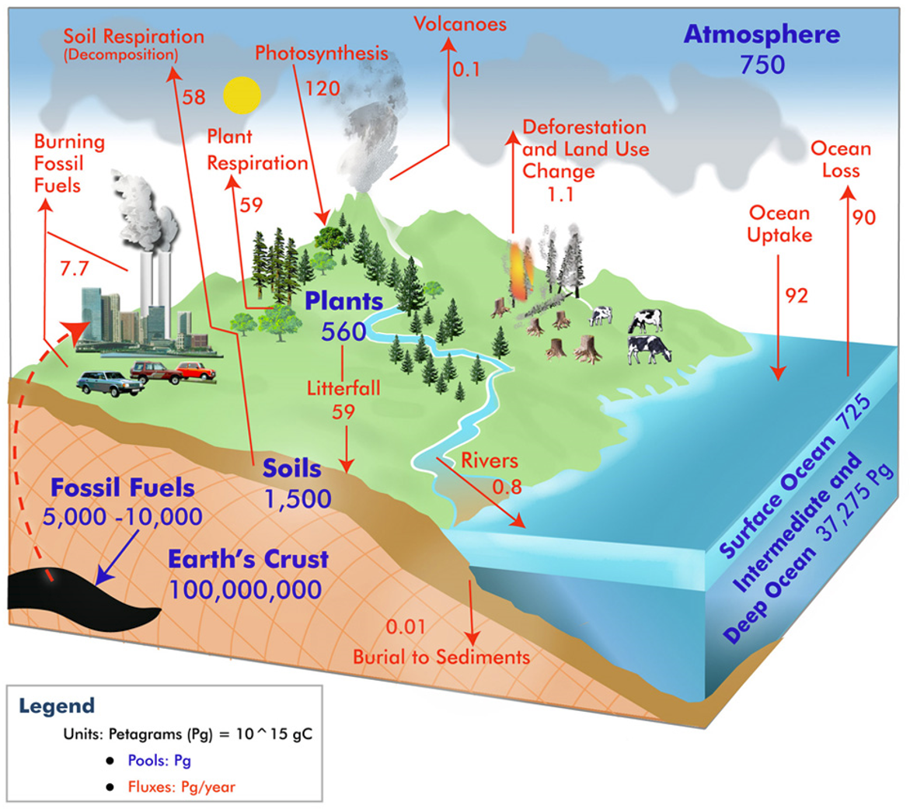
“… the continuous movement of carbon, the most abundant element on the planet, through the oceans, land, atmosphere, fossil fuels and all life on Earth.”
Carbon cycle:
https://airs.jpl.nasa.gov/resources/155/global-carbon-cycle/
see also https://carbon2018.globalchange.gov/chapter/1/

Slide 15
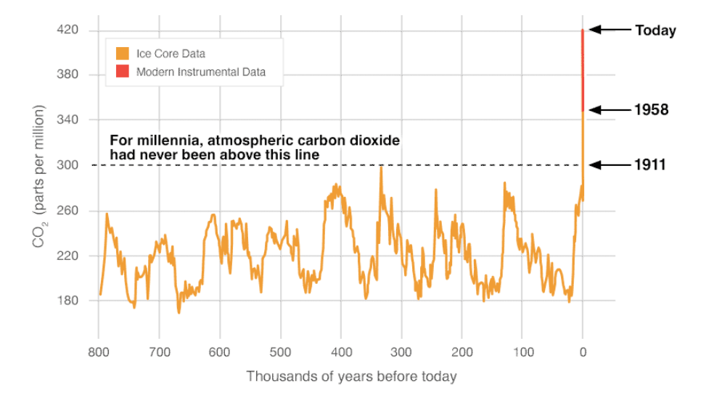
CO₂: bf 1911 < 300 ppm
2002 = 365 ppm
2025 = 428 ppm
https://climate.nasa.gov/vital-signs/carbon-dioxide/?intent=121

Slide 16
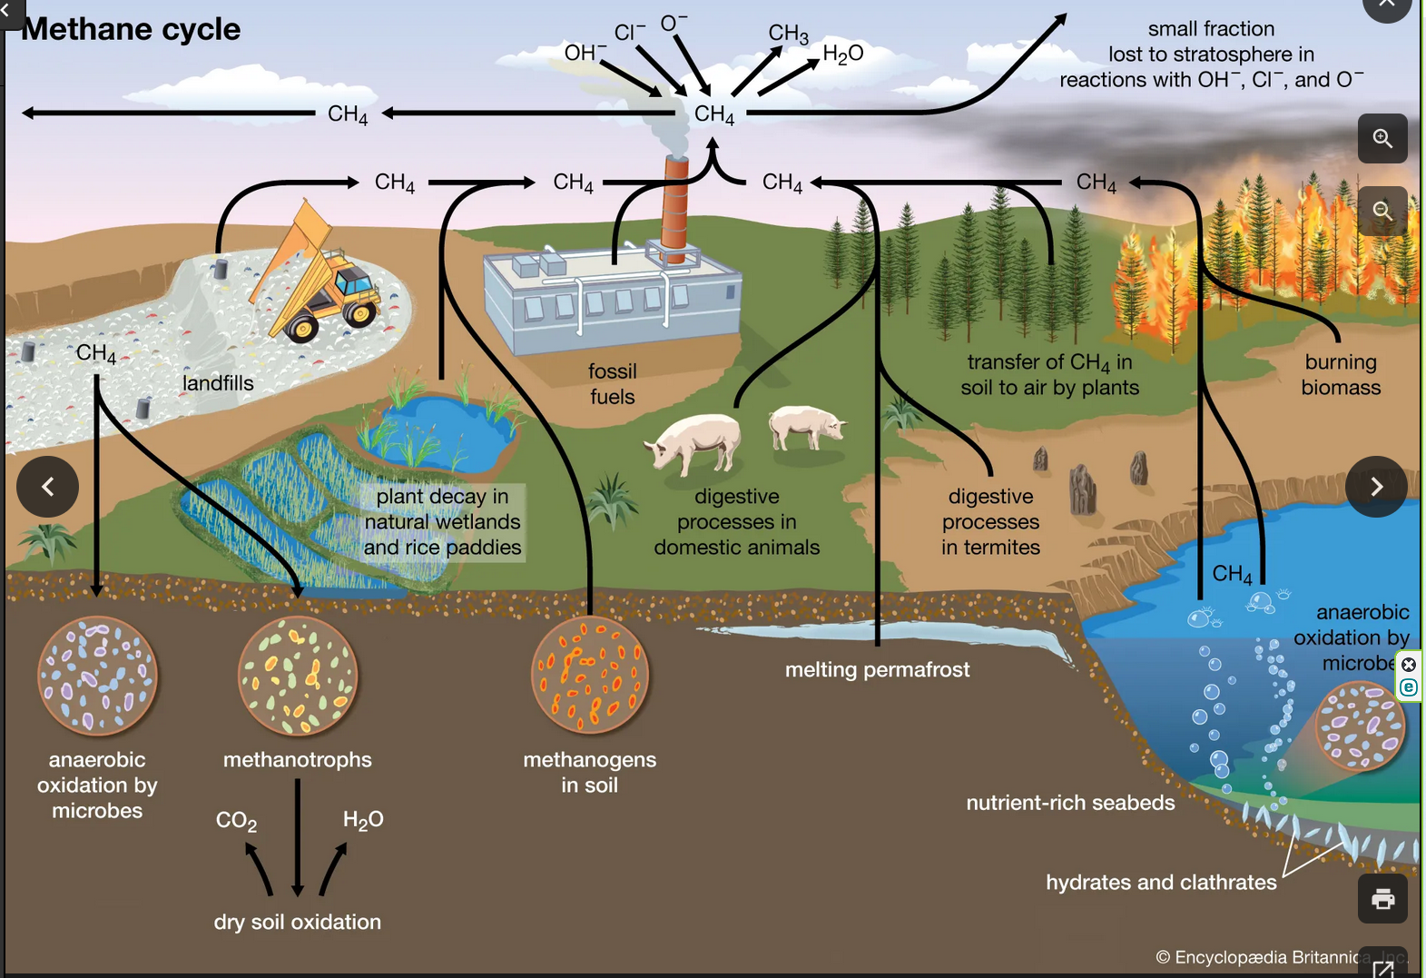
Methane
CH4
www.britannica.com/science/greenhouse-gas/Methane

Slide 17
Outline
Reflections on last week
  Volunteer for next week’s reflections?
The heating of the atmosphere – John
Water, carbon and methane cycles
  Stocks and flows
CO2e – adding apples with oranges
Some mitigation options

Slide 18
CO2equivalent or CO2e
- adding apples with oranges
Some GHGs are stronger than others (“radiative forcing”)
Some GHGs live longer than others
So, how can we add a strong, short-lived GHG (like methane) with a weaker but longer-lived GHG (like CO2)?
We work out their Global Warming Potential over a defined period
Strength
GWP
Time
Covert it to an index where CO2 = 1, that becomes its CO2e
Over 100 years, methane is about 27 times “worse” CO2
But over 20 years, methane is about 80 times worse
How much time do we have, what should our focus be?

Slide 19
Outline
Reflections on last week
  Volunteer for next week’s reflections?
The heating of the atmosphere – John
Water, carbon and methane cycles
  Stocks and flows
CO2e – adding apples with oranges
Some mitigation options

Slide 20
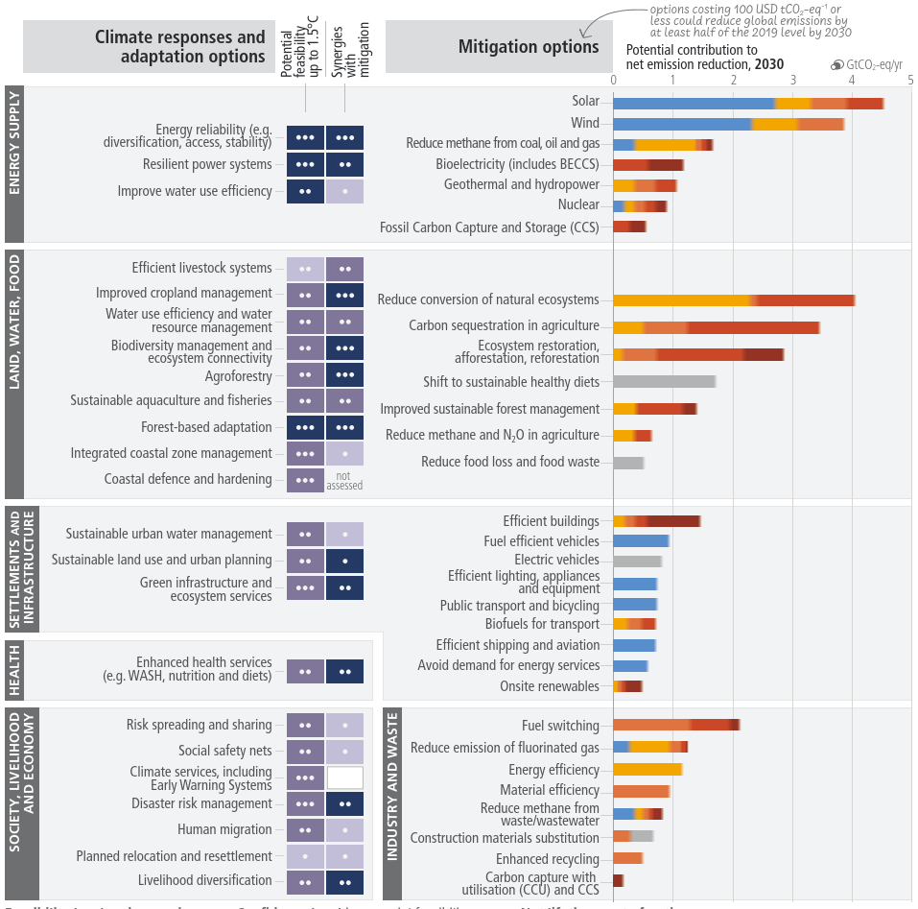
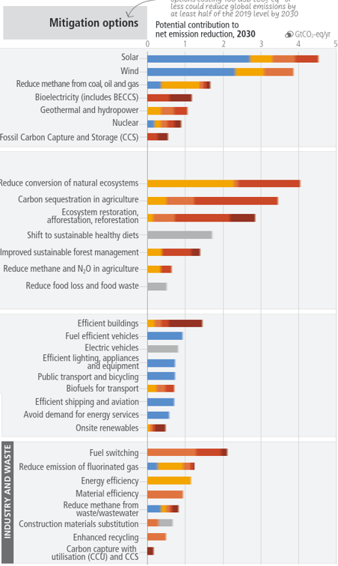
IPCC 2023
Blue = cheap
Red = costly
Solar
Wind
Reduce methane from coal and gas
Geothermal and hydropower
Nuclear
CCS
Reduce deforestation
Agi sequestration
Restore ecosystems
Shift diets
Not covered on the day
Efficient buildings
Fuel efficient vehicles
EVs
Efficient lighting and equipment
Public transport and bikes
Fuel switching
Energy efficiency
https://www.ipcc.ch/site/assets/uploads/2021/12/
IPCC-52_decisions-adopted-by-the-Panel.pdf

Slide 21
Any final thoughts?

