Slide 1
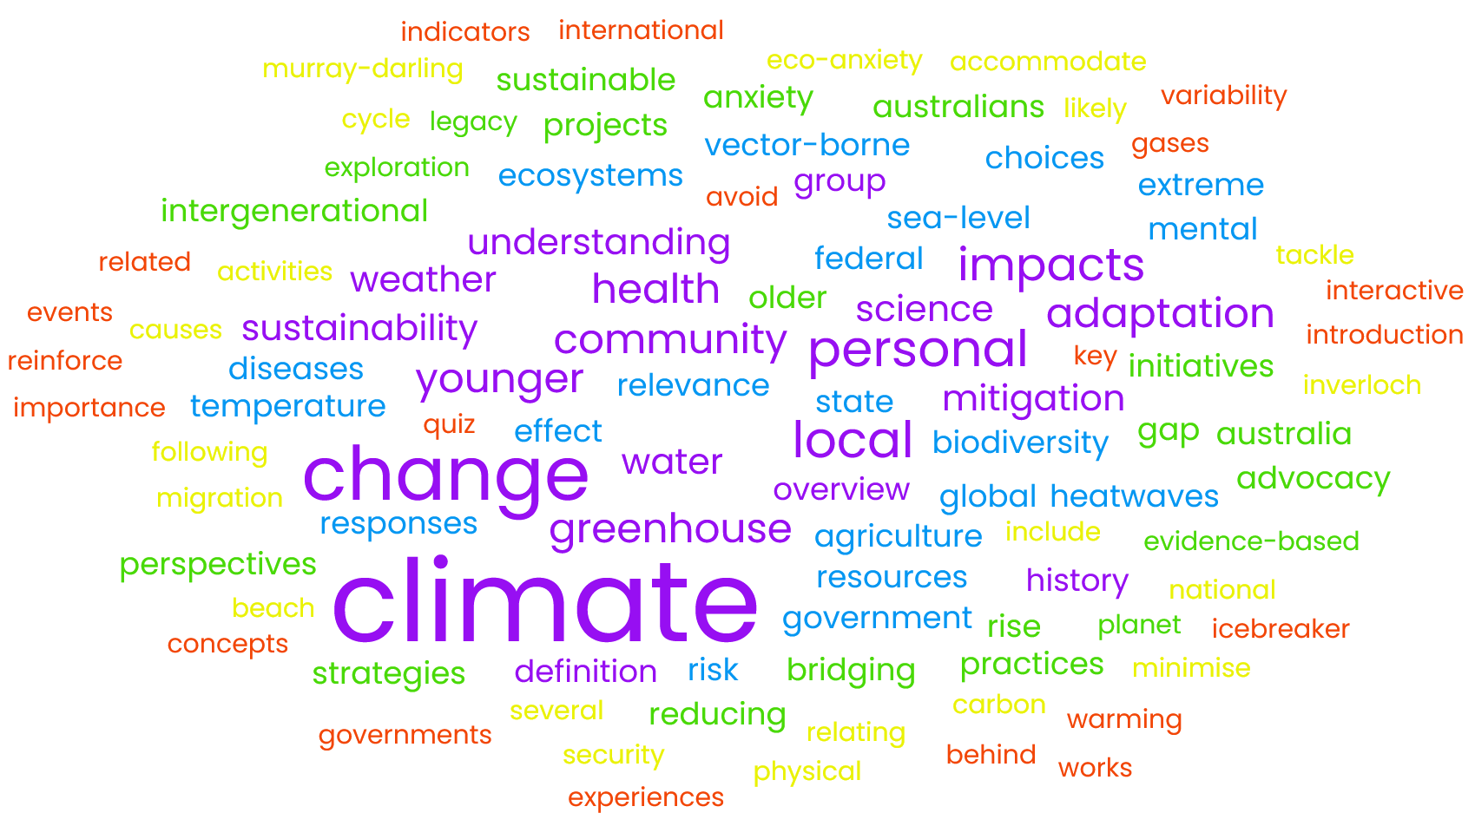
Our Planet, Our Legacy: Understanding Climate Change
U3A Wonthaggi
Term 2, 2025

Slide 2
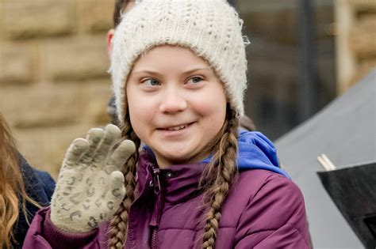
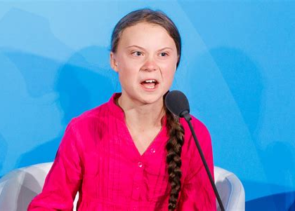
Before we start …
“You have stolen my dreams and my childhood with your empty words. And yet I'm one of the lucky ones. People are suffering. People are dying. Entire ecosystems are collapsing.
We are in the beginning of a mass extinction, and all you can talk about is money and fairy tales of eternal economic growth.
How dare you!”
Greta Thunberg, COP 2019
https://www.youtube.com/watch?v=KAJsdgTPJpU

Slide 3
Overview
What is climate change?
Who’s here?
Background
Why is climate important?
What do we know/want to know?
Wrap-up

Slide 4
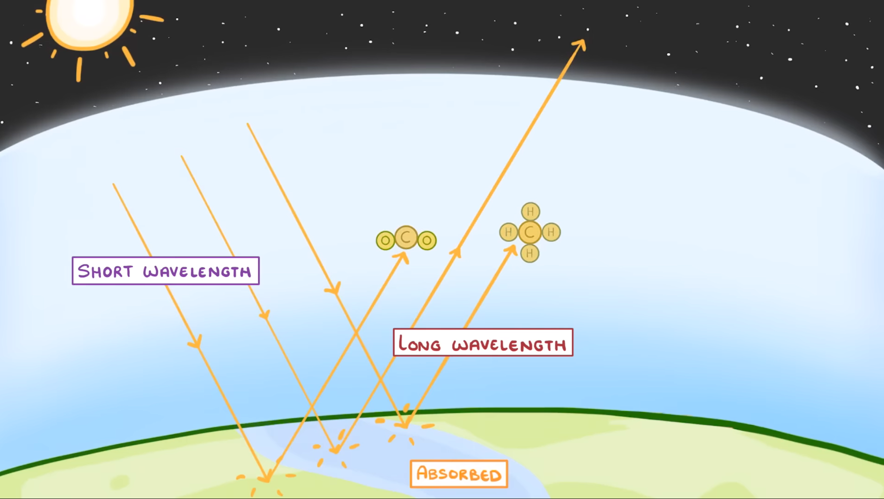
What is climate change?
https://www.youtube.com/watch?v=Z_b2A-d5hGY
Notes:
C:\Users\mnn\Videos\4K Video Downloader\GCSE Chemistry - Global Warming & Climate Change.mkv

Slide 5
Overview
What is climate change?
Who’s here?
Background
Why is climate important?
What do we know/want to know?
Wrap-up

Slide 6
Self introductions
Name and background
Your climate “journey”:
  When got interested in climate change
  Why
  Any Ah Ha! moments
  Any relevant involvement/experiences (e.g., science teacher, member of a group, grandparent)
Something you don’t know about climate change
Complete the sentence:
  “Climate change is 1. ______ , 2. ______ , and 3. _____.”

Slide 7
Overview
What is climate change?
Who’s here?
Background
Why is climate important?
What do we know/want to know?
Wrap-up

Slide 8
About the course
Survey/feedback
  climate change
  specifics ?
The syllabus
  what do we know/want to know?
  apolitical and evidence-based
My role:
  expert ... no
  direct traffic – informal
  logistics, structure, research
Your role:
  “community of enquiry” – shared understanding
  step-up and step-back
  lead a topic or present a summary?

Slide 9
Michael Nugent mnn@fastmail.fm
0416 039 933
Accounting and auditing standards
Canada and USA – broadening services ⚡💡 ⚡
Personal:
  Bayside Climate Crisis Action Group and VCAN
  Climate Code Red, petitions, submissions, letters, presentations, etc.
  Bass Coast Climate Action Network (BC CAN)
  Al Gore Climate Reality training
  Extinction Rebellion
Professional:
  Corporate sustainability reporting
  Global Sustainability Standards Board
  International GHG assurance standard (ISAE 3410)
  International Integrated Reporting Framework
  2 enduring lessons
Notes:
Group decision making

Slide 10
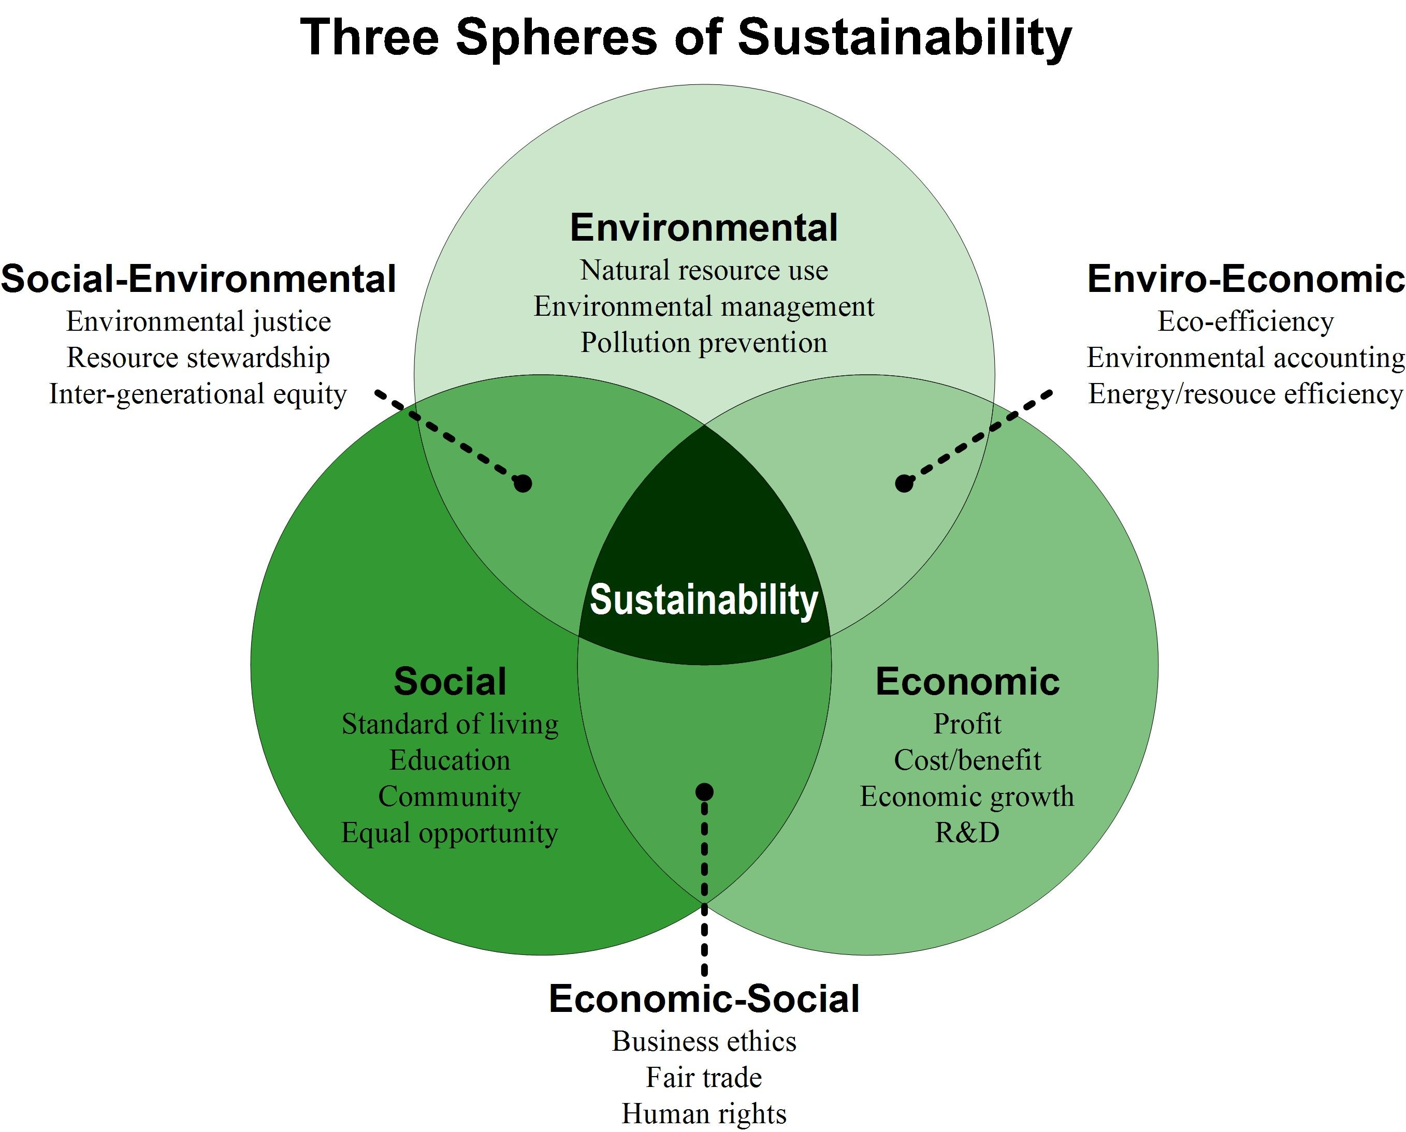
Sustainability: overlapping, but separate, spheres
https://i.pinimg.com/originals/9f/54/4f/9f544fe89cfe5500c2ae7e30f496485b.jpg

Slide 11
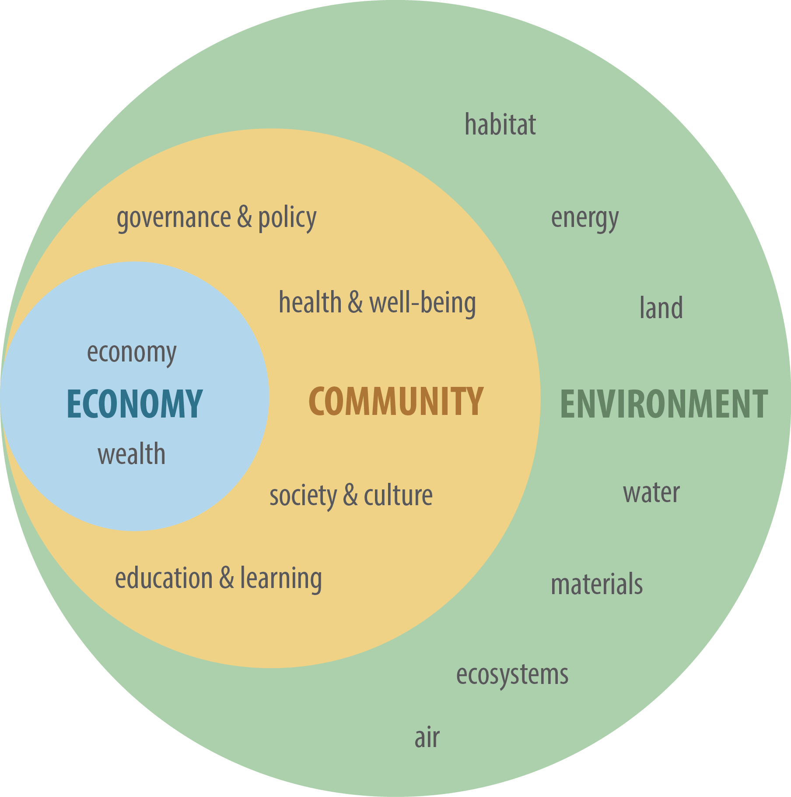
Embedded interdependent
… a series of complex, adaptive systems
https://publish.illinois.edu/lfr/files/2017/01/Sustainabitt.png

Slide 12
Overview
What is climate change?
Who’s here?
Background
Why is climate important?
What do we know/want to know?
Wrap-up

Slide 13
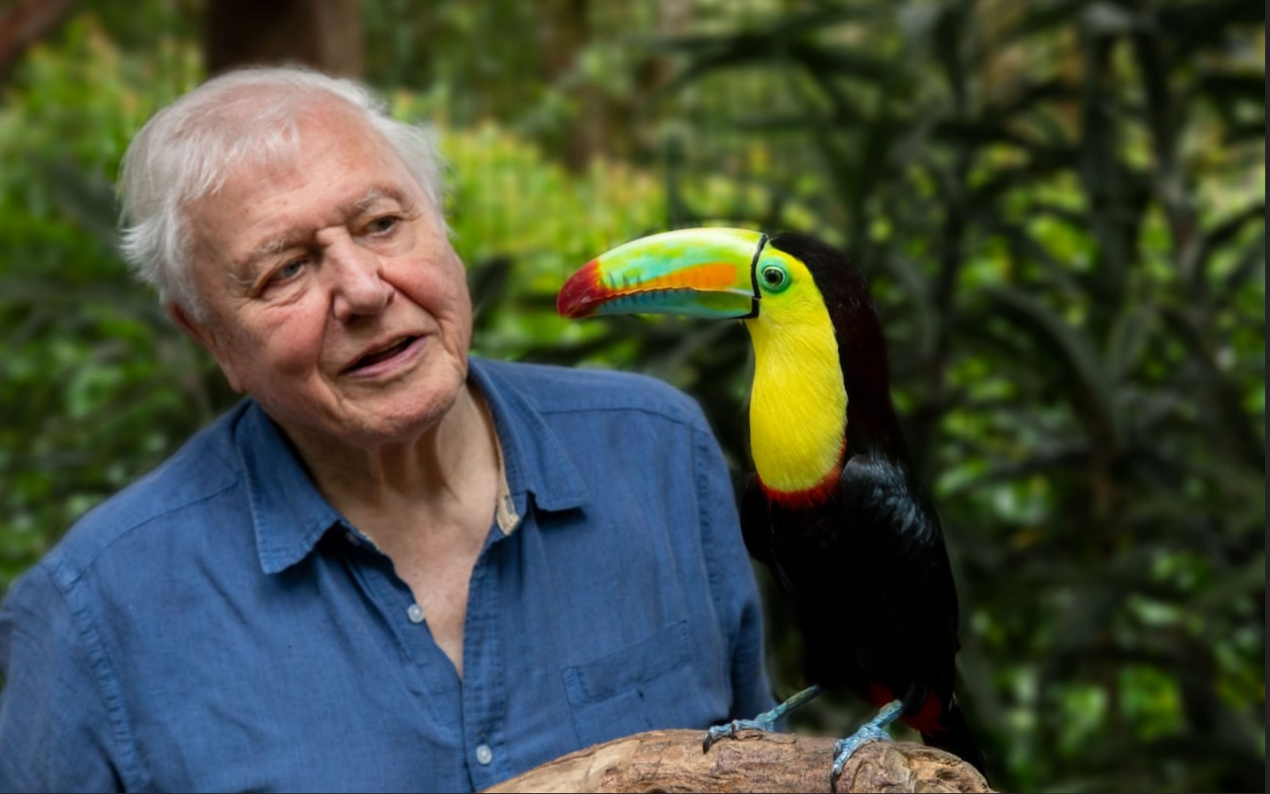
David Attenboroug,
COP 2021
“If working apart, we are a force powerful enough to destabilise our planet.
Surely working together, we are powerful enough to save it.”
https://www.youtube.com/watch?v=o7EpiXViSIQ

Slide 14
Overview
What is climate change?
Who’s here?
Background
Why is climate important?
What do we know/want to know?
Wrap-up

Slide 15
Initial plan
Introduction and overview
Science and history: what causes climate change and how did it get this serious?
Global impacts – environmental: is it just rising temperatures and extreme weather?
Global impacts – social and economic: how will our daily lives be affected?
Mitigation: how can we tackle the causes and minimise the impacts?
Adaptation: how can we “accommodate” those impacts we can’t avoid?
Physical geography and related national impacts: Aileen.
Local case study: Inverloch beach: Aileen.
Connecting across generations: a dialogue with younger Australians.
Taking Action: what to do, collectively and individually?

Slide 16
Examples: deep-dive topics
The science, e.g.,carbon and water cycles, greenhouse effect, deforestation, aerosols
Broader environment, e.g., water, soil, permafrost, fire, biodiversity, sea level, agriculture, acidification
Economics, e.g., “inflation on steroids”, carbon tariffs, Doughnut economics
Health effects: heatwaves, respiratory issues, vector-borne diseases, mental health (Michelle Isles)
––––––––––––––––––
Climate conversations: : best practice for friendly, persuasive chats
The COP process: has it, will it, can it make a difference?
Legal challenges: successes (e.g., Netherlands) and not so much (e.g., duty of care in Aust)
Corporate reporting: accounting, auditing, accountability, greenwashing
Carbon capture and storage: can it ever work?
Big oil, gas and coal: their role in delaying action
Equity and climate justice, e.g., job transition, climate refugees, first nations
The role of religions, e.g., the (late) Pope’s encyclical on ecology
Trump’s impact, e.g., ESG = woke, deleting data, withdrawing regulations
Net zero: good enough, how’s it measured, are offsets a licence to pollute?
Carbon budgets – global, national, and individual
Complexity: adaptive systems, tipping points and Gaia
The gas-led recovery: a “transition fuel”, export v reserve, etc
Nuclear: the evidence
Bass Coast Climate Action Plan: progress to date; prepare for midpoint, 2025,review
Geo-engineering: indispensable or too dangerous?
Notes:
Legal briefing - Recent trends in climate change litigation
https://www.ags.gov.au/publications/legal-briefing/lb-20220601

Slide 17
Overview
What is climate change?
Who’s here?
Background
Why is climate important?
What do we know/want to know?
Wrap-up

Slide 18
A final word…
“You have stolen my dreams and my childhood with your empty words. And yet I'm one of the lucky ones. People are suffering. People are dying. Entire ecosystems are collapsing.
We are in the beginning of a mass extinction, and all you can talk about is money and fairy tales of eternal economic growth.
How dare you!”
Greta Thunberg, COP 2019
https://www.youtube.com/watch?v=KAJsdgTPJpU

Slide 19
Our Planet, Our Legacy: Understanding Climate Change
U3A Wonthaggi
Term 2, 2025

