Slide 1
ACKNOWLEDGEMENT OF COUNTRY
Extinction Rebellion acknowledges the Traditional Owners of the unceded lands on which we live, love, work and rebel. We pay our respects to their Elders, past, present and emerging, and extend our respects to all Aboriginal and Torres Straits Islander First Nations people.
We further acknowledge the traditional knowledge held by First Nations people, and recognise our collective dependence on traditional knowledge in confronting the climate emergency
#BLM #StopDeathsinCustody

Slide 2
PURPOSE STATEMENT
We are facing climate chaos and the breakdown of our planet’s natural life-support systems.
We love this world and the beings in it, and resolve to work together to save our families, our communities, this nation, and all people from suffering and destruction.
We will force our governments to act by creating powerful civil disobedience activities that cannot be ignored.
We leave our differences and quarrels at the door in our commitment to do what is necessary to serve the common good.

Slide 3
RESPECT STATEMENT
We are transitioning towards regenerative cultures. These are cultures of respect and listening, in which people deal with conflicts when they arise, using short feedback loops to talk about disagreements and issues without blaming and shaming. They are cultures in which we cultivate healthy boundaries by slowing down our ‘yes’ and returning tasks when we are unable to follow through. They are healthy resilient cultures built on care and support, where people arrive on time for commitments. We are all crew.

Slide 4
The Pledge

Slide 5
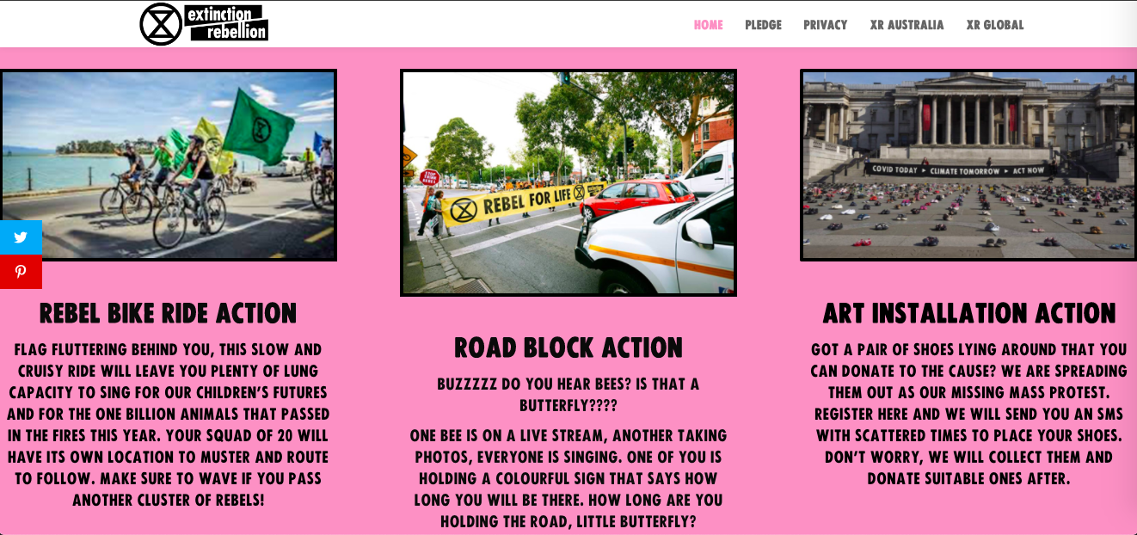
Three Actions

Slide 6
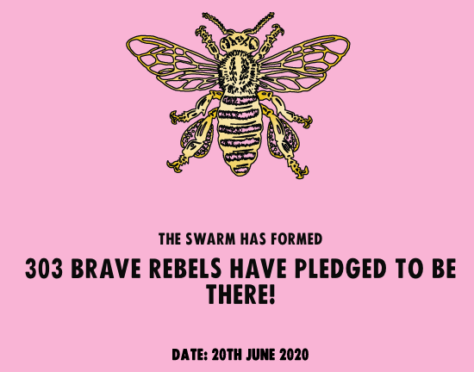

Slide 10
Five Bike Squads

Slide 11
Three road swarms

Slide 12
Three Arrests
$330 fine each

Slide 13
Family Friendly

Slide 14
Objectives:
Make Climate and Ecological Emergency a part of the national conversation.
Draw attention and build brand recognition: “Extinction Rebellion”, and the Hourglass Rune
Message the three demands
Make civil disobedience more approachable to the public
Inspire the sympathetic to learn about / join the movement
Attract media attention to the day of action by disrupting traffic flow, support mainstream media broadcasting of our key messaging
Familiarise rebels with low-level NVDA, and potential role divisions in affinity groups
Re-energize participant rebels with sense of XR community, freedom, social bonding, physical exercise, etc.
Form affinity groups that can be retained after the action
Channel newly active rebels into deeper engagement

Slide 15
Why Pledge?
A pledge is a commitment to act.
Having a pledge counter builds excitement and solidarity.
By Pledging we could ask for data on how to sort between the actions.
We could make sure we had all the data we needed, eg Agree to principles
The Format of the action plan is scale able by asking people to nominate themselves as a leader.

Slide 16
Rough guide
Liaise with rebels who would join the anchor circle/provide input into action
Created content – video, posters
Website/social media goes live
Liaise with police
Train leaders in plan with intermittent zoom sessions
Facilitate leaders in co-ordinating team
Pre-brief
Action
De-brief
Follow up on loose ends

Slide 17
Team co-ordination
Art Action:
Art Co-ord
Marshals
Police Liaison
Rebel Reds
Spokes
What team are you in?
Bike Squad:
Squad captain
Regen
Police Liaison
Front rider
Shepherd
Rover
Arts Support
Rebel rouser
Comms Specialist
Live streamer
Anchor circle:
Circle co-ord
Squad snr captain
Hive regent snr
Regen
Media liaison
Road Swarm:
Road Co-ord
Regen
Police Liaison
Banner holders
Arts Support
Rebel rouser
Comms Specialist
Live streamer
Floaters:
XR TV
First aid
Spokes

Slide 18
Police and Arrests
We Liaised with police and told them EVERYTHING.
We negotiated the swarm tactic with no arrests.
We signaled that because we believe in taking responsibility for our actions and making sacrificial gestures to express how dire the situation is, three rebels would sit on disclosed road at rough time. When those rebels sit, they will not move until arrested.

Slide 19
Covid-19
Groups of 20 – limit for public gatherings
Kept records of who was on what team so if an outbreak happened, we could let the team know.
Masks and sanitizer a must.
Empowered regen person to keep an eye on peoples social distancing and facilitate 1.5.
The media scrutinised, but we were on top of it.

Slide 20
Action Plan
12:00 pm Zoom Pre-brief
2:00 pm -3:00 pm Action
4:30 pm De-brief brief
Road Swarms:
Parliament house - Vic Markets – Flinders St
Bike Swarms:
Various muster points.
The Art action is from 2:00 pm – 4:00 pm.
We limited how long the action was for regenerative and transmission reasons.

Slide 21
Media coverage:
Channel 10: https://twitter.com/i/status/1274240933970796545 Channel 7: https://twitter.com/7newsmelbourne/status/1274254239712174080?s=21 Channel 9: https://twitter.com/9newsmelb/status/1274255187520229377?s=21 Independent long form media: https://voiceofaction.org/were-going-to-lose-everything-xr-rebels-hit-the-streets-with-an-urgent-message/

Slide 22
Questions?

Slide 23
The Pledge Questions

Slide 24
Mandate:
When someone has a mandate it means that they have the authority to make decisions within the description of the mandate. A mandate describes a role (defined ongoing work) and is made up of 'purpose', 'accountabilities' and 'domain' (optional).
Encouraged to seek advice from relevant parties and engage with different opinions respectfully and mindfully.
With respect, you have final say on the decision.

Slide 25
Mandates Expanded As always, you do not have to do all the work yourself, rather are tasked to manifest it in the world.
Circle co-ordinator | Keeping a birds eye view on all the moving parts, general wellbeing of the action and rebels. Keeping over-all momentum in harmony - managing due dates. Overseeing creation/distribution of rolling agenda, messaging doc, action plans. Keeping the team up-to-date pre and post meeting via an email list (Use BCC) Liaising with Regen to help manage conflicts – clear mandates help. Inspirational messages, lots of “Thank You’s” and grace. Recruitment of missing skillsets

Slide 26
Mandates Expanded As always, you do not have to do all the work yourself, rather are tasked to manifest it in the world.
Bikes co-ordinator | Point person for all Bike Captains Creates route suggestions for bikes – squads are autonomous though Communicates to Bike captains messages from the Anchor circle Co-ordinates …
Road co-ordinator
Regen advocate
Media liaison
Arts Action Co-Ordinator | Co-ordinates an autonomous team.
Data Manager | Divides data to coordinators and is responsive to team needs for top ups. Keep clear, up to date data of teams. Facilitate data security.
Overall Arts Co-Ord | Assists Team Leaders to obtain the arts they need

Slide 27
Step one: Conferring with vested interests
As per SOS principles any time we act in the name of the rebellion, we must talk to people about it. Taking up a mandate means you have final say on how its done, however, it is prudent to talk to key players in the rebellion to find out their thoughts.
Since we considered this a major action The Pledge team took it to:
VIC Strategy Circle
VIC Actions Circle
Key people from each VIC working group.
Key rebels in city-based local groups - to mention in their next meeting
This ensures anyone who has concerns or wants to help co-ordinate can do so.

Slide 28
First Meeting Suggestions
Discuss objectives and the plan for the action.
Adjust to local desire.
Talk about a date for action
Discuss communications channels and preferences
Assign mandates in the Anchor circle.
Set some general milestones to celebrate:
Website goes live
Media Release in final.
Recommended locations of actions competed

Slide 29
Comms leading up to Action
Anchor circle used just one weekly meeting to communicate until the week of action, with a pre and post meeting email update.
Week of action Anchor Circle created, each team has one or two reps in this chat.
Free to use Base or MM too, we just didn’t.
Once the pledge is live, host 2 or 3 squad captain briefs.
Go over the plan with them,
Assign them a buddy if inexperienced/time poor/have over capacity of leaders.
Captains may start managing a team together, then split off if you need to create more teams than volunteers later on.
Pass on Action Documents
Data manager sends groups of 15 to Captains
So last minuet pledgees can go into a fully formed team.
Signal chats were created by Swarm and cycle captains and they usher their team onto that.

Slide 30
Comms during action:
During the action, some of the anchor circle were off site keeping a birds eye view of the action, communicating between teams and ready to respond.
Each team had one person with an earpiece in ready to take a call from Anchor circle.
Some teams had a dedicated person to stay on the zoom and listen for updates/facilitate information to the Anchor circle

Slide 31
Supplies
Swarms:
Supplies for your team to pick up:
Banner
Flags
Signs
Squads will procure these supplies:
Medical masks
Water
Nibbles
Signs
Sanitiser
High-vis vests
Whistle
Bee or Butterfly costume (any and all effort appreciated)
Squads:
Supplies for your team to pick up:
Banner
Flags
Signs
Supplies for your team to acquire:
Helmet
Medical mask
Sanitiser
Flags
Zip ties
Water
Nibbles
Music
High-vis vests

Slide 32
Media
We had a media liaison positioned at art action, with a road swarm on the other side of the road. Media also traveled to all the swarm locations for footage.
Designated (trained) spokespeople who are clear on messaging.
LIVE STREAMERS
Clean your lense!!!
Film horizontal
Text: LIVE @ <location>/LIVE – Rebels taking a ride to get the word out that the climate and ecological emergency is still a very real threat and we won’t be silent about the Federal gas led recovery plan.
Different pages live at different actions.

Slide 33
Police Liaison
Have advised the police of our plan
They are likely to let us hold intersections for one cycle green – red – green.
There will likely be police with every team
Be respectful – only one line of communication – Police liaison
We are not looking to get anyone arrested on Saturday, but if it happens, we will support them. Any time we break the law, we are at risk of arrest.
STAY NON-VIOLENT
Stick to the plan – Say what we are going to do – Do what we say.

Slide 34
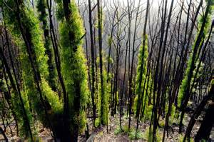
Regenerative Culture- healthy, resilient and adaptable.
As a community, we are only as strong as every individual. Which is why we strive to support and nurture one another with self awareness.
XR’s 3rd Principle: We Need A Regenerative Culture: Creating a culture which is healthy, resilient and adaptable.
The crux of this is, if we are to give our energy to this rebellion, we need to be caring for ourselves and each other. When partaking in this fight, challenges of involvement arise within us; a Regenerative Culture gives us the power to combat these challenges.
Regenerative Culture seeks to bring a different approach to climate and other activist movements. It is about how we move towards practicing and demonstrating the change we want to deeply experience in life in all society.
Its purpose is to nurture a new culture that is resilient and robust and which can support us all through the changes we must inevitably face together.
Regenerative Culture precedes, holds us through and lasts beyond the actions that we take as part of our rebellion.

Slide 35
Regen things to be mindful of this time around…
Have a buddy- Taking part in actions can be taxing. Consider having a friend either alongside you at the action or someone not involved who you can talk about things with.
Post action slump (or crash)- You’ve been going and going putting in loads of work to ensure things go smoothly. The day of the action arrives and the adrenaline is pumping. With all the energy required to ensure the success of an action both before and during the event, a period of low mood following it all is normal. Remember that you are not alone and reach out if you need.
Consider the ways in which you practice self-care- Would any of these methods be useful for you in the lead up to the action? Would any be particularly useful following the action?
Specialty roles- Action Wellbeing Supporters, First Aiders, Legal Observers
Check-ins throughout and Debriefing following the action is a huge way in which we create a Regenerative Culture.

